Slide 1
Supporting people at home
a partnership at all levelsdes
Breid O’Brien
@breidobrien
#NHSXInnovCollab
Notes:
Speaker = Hayley

Slide 2
Introduction to NHSX
NHSX is a joint unit bringing together teams from NHS England and NHS Improvement, and the Department of Health and Social Care to drive the digital transformation of health and care.
We are a diverse team with a range of skills and expertise, including clinicians, technologists, policy experts, developers, data scientists and project managers from across health and care.

Slide 3
Our Approach
Digitise
Level up NHS and social care services to ensure they have a core level of infrastructure, digitisation and skills
Connect
Join services together through technology, allowing health and care providers to share information with one another and take a shared approach to procurement and implementation
Transform
Using the platform of a digitised, interoperable, connected health and care system to deliver services more effectively and productively, and with the citizen at the centre
Notes:
Speaker = Breid

Slide 4
Digitisation of social care improves care outcomes
FAMILY
REMOTE MONITORING
PRIMARY CARE
Enabling families to be involved in care through family portals
Supporting preventative care and enabling people to live independent lives
Providing access to primary care data that supports care delivery and enables virtual consultations and care
CARE MANAGERS
INDIVIDUAL
SHARED CARE RECORD
STANDARDS AND INTEROPERABILITY
Giving care managers insights that improve the quality of the care they provide
Supporting person-centred care through digital care planning
Bidirectional information sharing between care settings so that it can support preventative interventions
INFRASTRUCTURE
REGULATORS AND COMMISSIONERS
CARERS
ACUTE NHS TRUST
Connecting care providers to enable access to digitised care
Supporting the sharing of admissions and discharge information so that clinicians and carers have the data they need
Providing carers with the information they need at the point of care, saving time to reinvest in care and driving quality and safety
Standardising data collections for regulators and commissioners
Notes:
Speaker = Breid
There is a huge amount of work underway in NHSX to support digitisation in the sector and join up health and care, in addition to the partnership approach we’ve seen. What is important is to ensure the individual and their needs are at the centre, and then use this to build services out with an understanding of how innovation can contribute to improved outcomes.

Slide 5
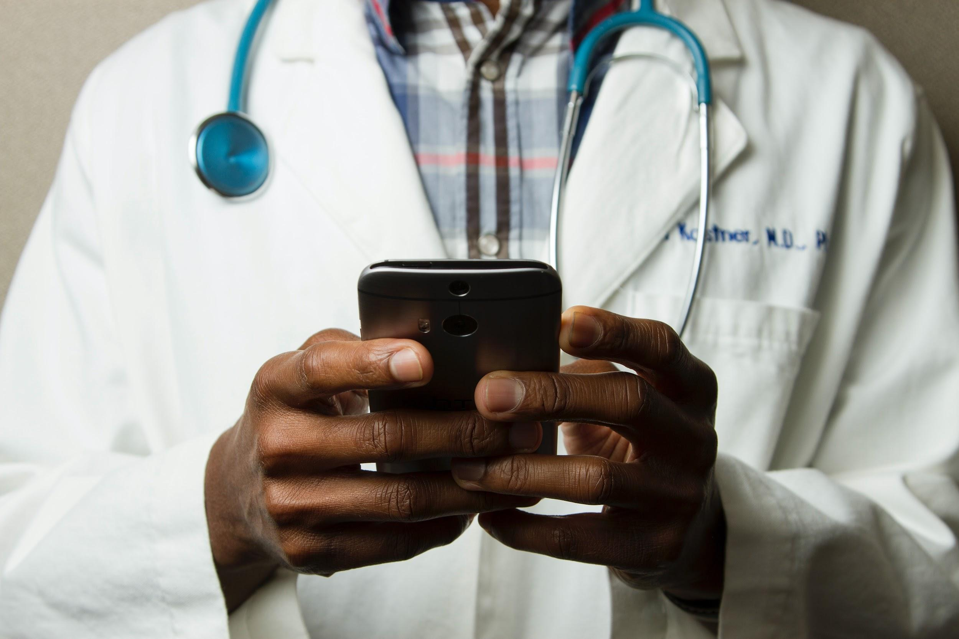
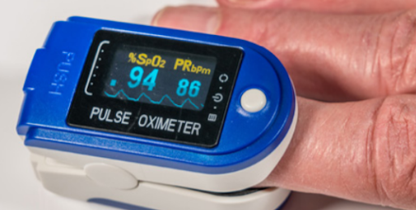
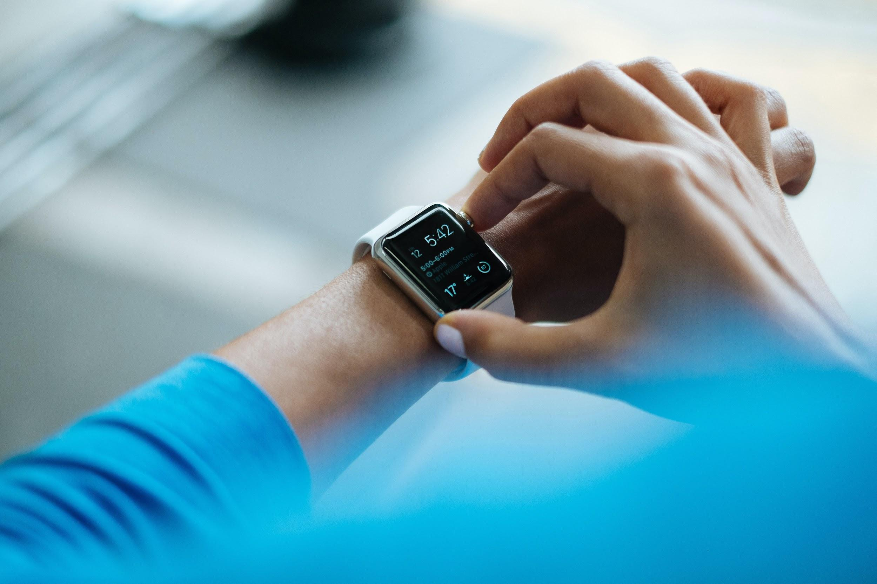
What does supporting people at home mean?
Partnerships with patients and citizens - enabling self-care whilst knowing they are supported by their clinical team in the background
Using digital tools to enable more care to be delivered at home inc the c400k people for whom home is a care home,
This is all about making an offer, and not making assumptions on behalf of people
All services can continue to be accessed face to face - most appropriate for the patient
Working in partnership with NHSEI and Social Care colleagues
Notes:
Speaker = Breid

Slide 6
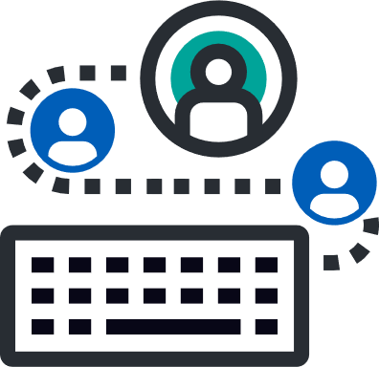
Regional Scale Programme 2020/21
North West
North East & Yorkshire
East of England
Extending and integrating remote care in care homes
COVID-19 tracker and outbreak management tool
Cardiology virtual wards, and ECGs recorded at home for people with Severe Mental Illness
Remote monitoring in care homes
Remote care for the most vulnerable
Remote care for mental health crisis
Digital transformation of heart failure pathway
Remote monitoring of vulnerable patients
Outpatient transformation
Paediatric virtual wards
Complex needs virtual wards
London
Midlands
Virtual wards in care homes
Remote monitoring in care homes
Care home transformation & connectivity
Remote monitoring with virtual wards
Remote monitoring for patients with long term conditions
Remote monitoring in care homes
Digital transformation in care homes
South West
South East
Remote monitoring in care homes
Remote monitoring for COVID-19 patients
Remote monitoring in care homes
Digital tools for individuals with learning disabilities
Improving communication across clinical teams
Outpatient transformation
Notes:
Speaker = Breid
30,791 residents and 1,204 care homes (Nov-Apr)

Slide 7
21/22 Care Sector Summary
>100,000 people supported at home in 21/22
Covering all 7 NHS Regions
Using 11 Different Digital Solutions
27 Care Sector Projects
Building on from 11 Care Sector Projects in 20/21

Slide 8
Through the national Innovation Collaborative we are:
building a learning system to enable the adoption, scale and spread of remote monitoring to support people at home;
supporting regions and local systems to increase their capability and capacity to deliver their plans at scale;
Facilitating engagement across health and care and supporting the rapid dissemination of knowledge;
working in partnership with our national AHSN network
15 Academic Health Science Networks (AHSNs) across England, established by NHS England in 2013 to spread innovation at pace and scale – improving health and generating economic growth. Each AHSN works across a distinct geography serving a different population in each region. https://www.ahsnnetwork.com/

Slide 9
“We have seen a 23% reduction in 999 callouts in the care homes using the Feebris remote monitoring compared with care homes that have not.”
Mike Armstong, Havering Care Association, London
“We know our residents well, so we tend to recognise when they’re not themselves, but now we can take their observations it’s made us more confident speaking to health professionals. For others thinking of using the kit: it’s basic, straight forward and you should not be worried - it tells you what to do! We’re really pleased to be super users so that we can teach others how to use the kit. The best bit is seeing how our residents react to it. We have one resident who likes how the kit talks back to him – it makes him laugh and means he is engaging in his health.”
Feedback from Health Care Assistants, Care Home in Barnet, North Central London
User feedback
“The opportunity to gather real-time data on a person’s condition and overall well being is exciting because it has the potential to transform the way we support the health of people with learning disabilities. We hope these new technologies can help us interact more with individuals and their carers to identify and treat health conditions as early as possible.”
Dr Shanil Mantri, GP and Digital Health Lead
South West
“The equipment was praised by paramedics on several occasions – it saves crucial time and provides in-depth knowledge fast in emergency situations.”
Care Home Manager

Slide 10
Like to know more? For links to case studies, videos, podcasts, animations, r @NHSX #digitalhomecare #NHSXInnovCollab Or drop us a line - innovation.collaborative@nhsx.nhs.uk
For links to case studies, videos, podcasts, animations, event details
Join the NHSX Innovation Collaborative workspace on FutureNHS by emailing
InnovationColloborative-manager@future.nhs.uk
Follow us on Twitter
@NHSX
#NHSXInnovCollab
or drop us a line: innovation.collaborative@nhsx.nhs.uk
Digitise
Connect
Transform
Notes:
https://www.nhsx.nhs.uk/covid-19-response/technology-nhs/the-nhsx-national-innovation-collaborative-podcast/

