Slide 1
Warwickshire North
Remote Monitoring in Care Homes
Our Experience
‘Helping you to help yourself; there for you when you need us’

Slide 2
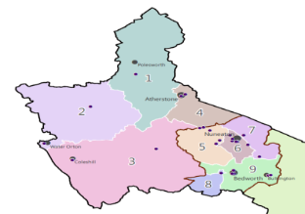
Background & Journey
2019 SWFT planning Care Home Pilot planning
2020 Covid-19 Pandemic – Telemedicine
London/Liverpool/Kent Telemedicine Comparison – Shared learning
Warwickshire North Project (Programme Board)
Partner Engagement
Telehealth contract
Implementation
5 Phases
~5 Care Homes per Phase
‘Helping you to help yourself; there for you when you need us’

Slide 3
Care Home Project Key Deliverables
28 Adult Care Homes across Warwickshire North in scope
24 Care Homes now live with Docobo
Implement over 5 phases between November 2020 & March 2021
Engage with Care Homes ✓
Demo of system ✓
Bulk Resident registration on to system ✓
Devices delivered ✓
Care Home staff virtual training ✓
1 week & 4 week follow up reviews with Care Homes ✓
Registration & Discharge training Docobo Champions ✓
Establish Remote monitoring team within SWFT ICC ✓
Establish OOH Response process within UR Service ✓
‘Helping you to help yourself; there for you when you need us’
Notes:
Work is proceeding to gain engagement with the final 5 CH’s
Nursing Homes less engaged than Residential Homes.
Use for deteriorating patients is variable
New ACP role is leading the on-site training and engagement.

Slide 4
Care Home Feedback
We are not getting a call back as quickly as we should. | We are linking our email alerts with our phone system which means we will be alerted as soon as a deteriorating patient alert is put through.
We feel in control of our resident's health and wellbeing and can access help without worrying about who to call. | That’s Great! It's fantastic that the pressure of who to call for each situation has been removed. For community services it means that we are not getting called out for something urgently which could have waited so benefits both ways.
We are struggling to get all patients observations done on the same day each month. | Feedback from other Care Homes suggests that implementing the routine observations as part of ‘Resident of the Day’ removes any duplication.
You will de-skilling our Nurses | Visits to Nursing Homes by Clinical Practitioners to build relationships and discuss the benefits they can bring to the staff and residents as a result of their advanced training
There's too many ways to contact community services causing confusion over which one to use in which situation. We don’t know what may class as urgent, same day, or routine and don’t want to get it wrong. | With Virtual Ward Rounds starting prior to Docobo we understand this concern and therefore will be putting the virtual ward round request form on the Docobo system to minimise any confusion. Also, the ICC will triage any alert with you to make a decision on the urgency of any visit required.
‘Helping you to help yourself; there for you when you need us’

Slide 5
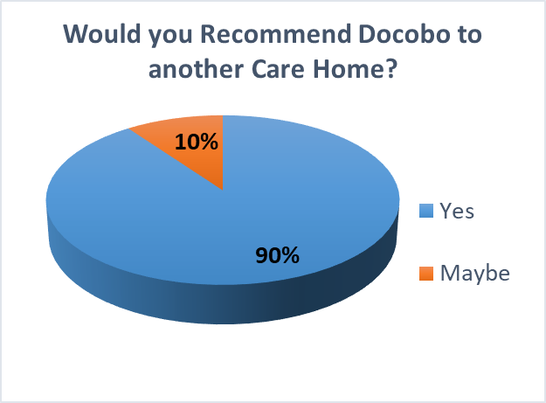
Care Home Staff Survey (Residential and Nursing)
83% response rate from electronic questionnaire
Comments
Much easier than doing over the telephone to ISPA.
I think once we confident on what we should be using Docobo for it will be a great system.
Very useful and handy being able to keep up to date with residents’ observations and passing information into other healthcare professionals
If you feel like something is not quite right with your resident but you cannot put your finger on it you can do the DOCOBO and get the resident checked out.
Provides you with a good baseline. It is easier than calling the community teams
Very effective and results in positive outcomes for residents
its a good system to use as you can relay the information to other healthcare professionals'
it improves resident care outcome as a service user in our care home kept having multiple falls and after referral via Docobo to ICC team, it was identified she had an underlying infection, she was treated with a course of antibiotics and the infection was resolved and her falls also stopped'
I live in Leicestershire and we do not have Docobo there and I will tell them as I absolutely love it, it’s very good, takes the weight off my shoulders knowing Practitioners are available to support me, the practitioners are very reassuring for me and the patient, they have at times responded within 10minutes, I feel much safer in my role , Ambulance call outs have reduced
Docobo Team are very supportive and any concerns you raise are dealt with, its quick and easy and you get a response quickly' However I would like to have more space on the SBAR
it takes some getting used to like anything new '
it takes a bit to get used to but once you are used its quicker and you get quick response, saves time' Janice at Linden Residential Home
it saves time on phone calls; it gives clinicians better view of the patient and results in them being seen quicker'
the nurses coming out nowadays are highly skilled, and they make the clinical decisions and prescribe without GP, it’s been very positive'
If you just feel like one of your residents is not right but cannot put your finger on it you can use DOCOBO to ensure they are medically well and the nurse will be out to check on them
83% response rate from electronic questionnaire

Slide 6
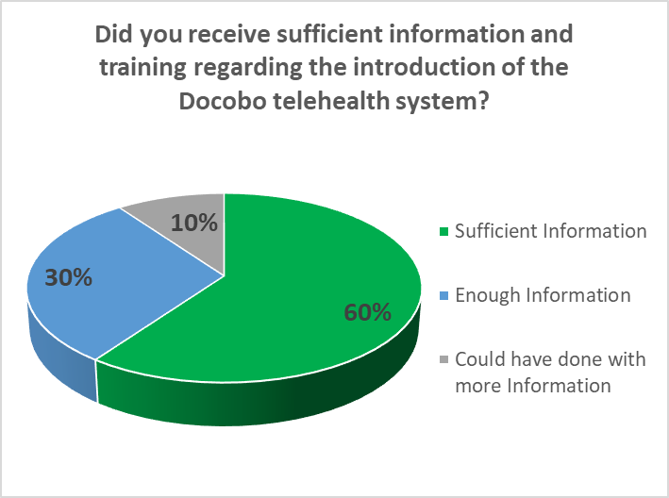
Care home staff Survey (Residential and Nursing) Preparation and Docobo Support
Care home staff Survey (Residential and Nursing) Preparation and Docobo Support

Slide 7
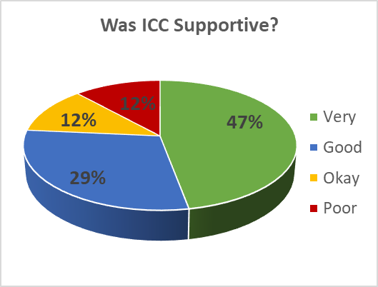
Care home staff Survey (Residential and Nursing)
Care home staff Survey (Residential and Nursing)

Slide 8
ICC - OOH Triage Hub
ICC - OOH Triage Hub

Slide 9
Management of Clinical Alerts – Outcomes
Management of Clinical Alerts – Outcomes
Alert Intervention Type & Outcome | Nº Alerts | % Total Alerts
Call Made to Care Home, Advice Given | 113 | 79%
GP/CP visit avoided | 106 | 74%
To be seen on next GP/CP Virtual Ward | 4 | 3%
A&E attendance avoided | 2 | 1%
Ambulance callout avoided | 1 | 1%
Urgent CP Visit | 30 | 21%
GP Contact avoided | 30 | 21%
Grand Total | 143 | 100%

Slide 10
Next Steps
Future Remote Monitoring in Care Homes Opportunities Identified;
End of Life Support
Learning Disabilities Homes & Assisted Living
Mental Health Homes
Cardiac Arrhythmias
‘Helping you to help yourself; there for you when you need us’

