Slide 1
The Blue Box

Slide 2
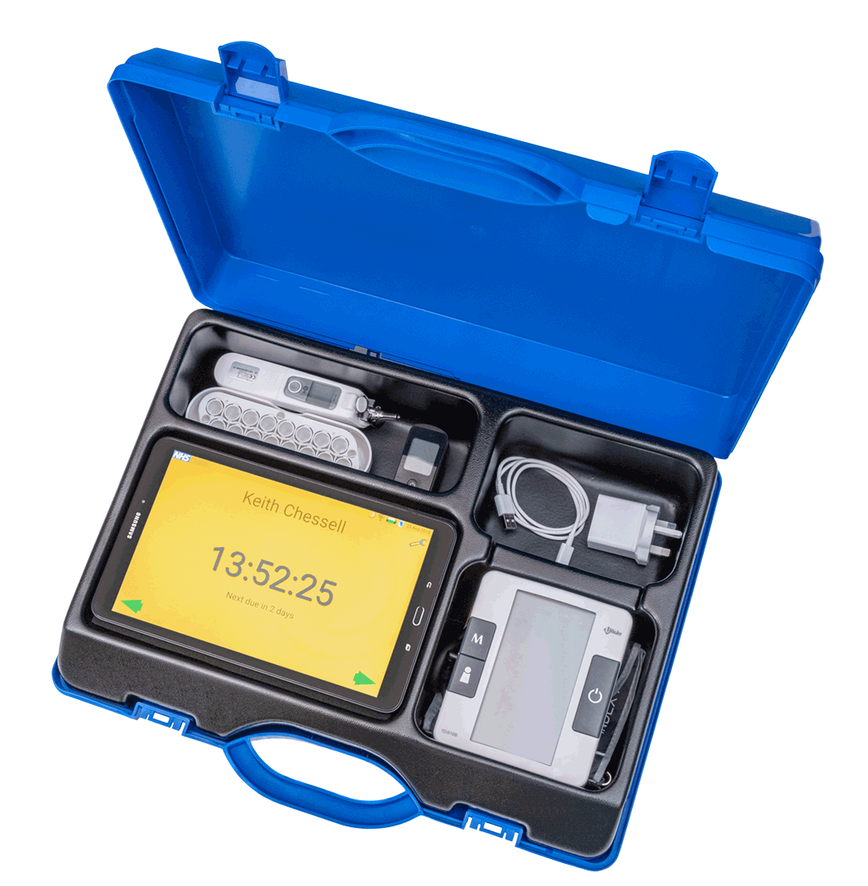
The Blue Box
Designed for care homes
Bluetooth instruments: SpO2, BP, Thermometer, Stethoscope, ECG, Glucometer, Spirometer, Scales and more
Photo history for wounds and diagnosis (e.g. remote podiatry)
Wide range of assessments including NEWS2, Soft Signs, SBARD etc

Slide 3
The Blue Box In Action

Slide 4
Used by
2,500 care homes commissioned by 50 NHS regions and local authorities from Stornoway to Cornwall
Monitoring 70,000 Nursing / Residential / LD care home residents
12,000 Care home and clinical staff users
150 Domiciliary care agencies, 2,000 clients
400 People at home living with long term conditions
1,000 People post hospital (Covid) discharge or shielding

Slide 5
Barnet Care Homes Case Study
The Care Home GP said:
The staff in care homes are trained to act upon different NEWS2 scores including when to call me, their GP, when to call NHS111 or 999 and when to be reassured.
When I do my care home reviews, I can see the observations for these patients and enter them into the patients EMIS records.
Its like having a second pair of hands in the care home. It has been invaluable to me and the home and greatly improved the way we work.
The Care Home Manager said:
The impact on having Whzan has proved to be invaluable for our service.
The paramedics have come on scene and have the basic stats.
Whzan plays a major part, especially in these troubled times, improving safety and care.
Our staff feel empowered and more confident when contacting the NHS.

Slide 6
Impact
NHS reported reductions from care homes
71% in A&E attendance
46% in bed days spent in hospital
35% in unplanned GP visits
33% in emergency admissions
22% reduction in ambulance requests
50% reduction in 111 / 999 calls
NHS studies proved using Whzan in 8 Care homes saved more than £756,000 in A&E and ambulance services per year

