Slide 1
Care Home Summary
Registrations are at 99.3% and denominator is 15056 for this week.
Frequency of updates - 81% updating within last 7 days, and an average 61% within latest 48 hours (last week’s data: 83% within 7 days, 63% within 48 hours).
Regionally COVID infection % rates (infections / derived occupancy) are averaging at 0.6% across all areas and increasing slowly, with South West being the highest at 0.90% (Slide 2). There is also a COVID infection % rate based on the stated resident count as the denominator (Slide 3) which is also following these trends.
Nationally, the number of triggered outbreaks, based on 2 or more new cases being reported, have seen a dramatic increase over recent weeks, with 322 new outbreaks in the last 7 days, and 1862 active outbreaks (last week’s data: 96 new; 1862 active) (slide 4). The Midlands, North East & Yorkshire and South West regions are currently the largest contributors towards outbreaks.
New COVID cases for Staff Confirmed and Resident Confirmed cases had significantly reduced nationally. After a spike across Jul-21, specifically attributable to newly confirmed staff, cases appear to remaining steady.
Occupancy increased to 82% nationally for July and continuing to show improvements with a position of 83% for September. All regions had previously shown declining levels of occupancy, but over the last few months now appear to be stabilising with all regions now showing increases.
Covid vaccinations show 96% of residents have been vaccinated with at least one dose, and 94% receiving two doses, compared to last week. Staff vaccinations have increased to 94% to date of at least one dose, and increased to 87% having received two doses. (see slide 5 for England summary using SAGE minimum standard guidelines – staff)

Slide 2
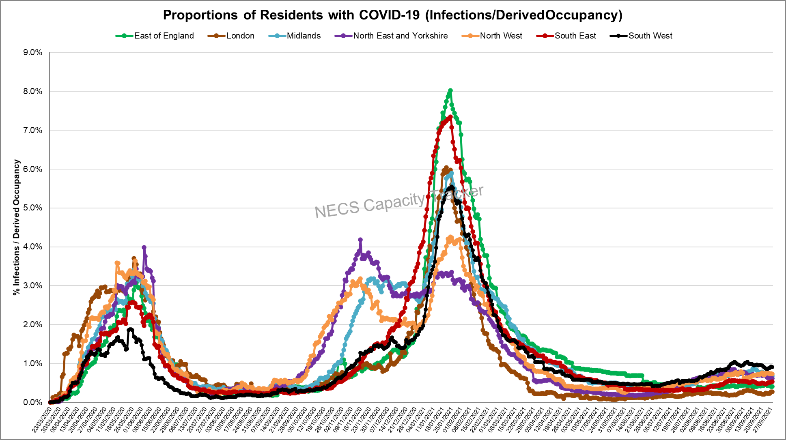
Capacity Tracker: Care Home Infection Rates By Region based on Derived Occupancy
(as of 09:30 hrs 28/09/2021)
Infection rate: Number of Resident cases / Derived Occupancy
South West currently highest, with slight values plateauing across all regions

Slide 3
Capacity Tracker: Care Home Infection Rates By Region based on Resident Count
(as of 09:30 hrs 28/09/2021)
Infection rate: Number of Resident cases / Resident Count (reported from 11/12/20)
South West currently highest, with proportions relatively consistent compared to last week across all regions

Slide 4
Care Homes – Outbreak data (as of 09:30 hrs 28/09/2021)
19447 outbreaks* have been reported since reporting began on 11/06/2020. Providers may have reported multiple outbreaks during this time (last week’s data: 19125)
322 outbreaks* were triggered in the last week (last week’s data: 96)
*NB. Valid outbreaks only – Invalid outbreaks have been excluded. Invalids are those where the provider reported 2 or more cases, resulting in an outbreak trigger, but then subsequently amended their daily figures to less than 2 cases. Note, outbreak numbers may reduce if locations become inactive following a CQC deregistration. Inactive locations are not included in figures.

Slide 5
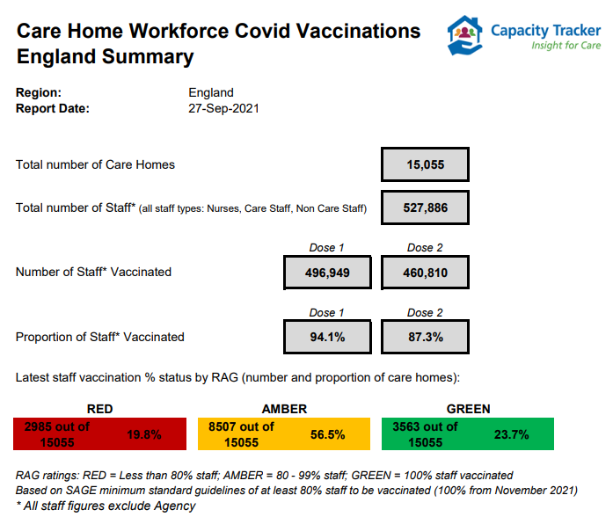

Slide 6
Capacity Tracker ROADMAP
Provider Access & Comparative Analysis
National Delivery Framework & Governance Arrangements
Widen the provider access to enable aggregate regional & national information to be viewed and enable providers to compare their location(s) to regional/national picture
2021
M1
M2
Agreed with DHSC and NHSE
Upgraded UI
Move to Bootstrap 4 for improved user experience
Infection Control Fund 3
Integrate Test & Trace data
Sharing of information to ICS/Regional systems
New Reports plus revision to PPE & visitor questions
New dashboard analysis providing visibility to Home Care as well as Care Home providers
M5
M3
API/Publication
Implement CISCO Telephony
2021-2022
Regional Delivery Boards in Place
M6
Regional & National surveys
Improved Support Centre Efficiency
Regionalisation
To support communication & engagement across provider groups and key stakeholders
Enable H&SC to supplement National CT dataset & reduce burden of duplication (similar to London)
NHSX I-Pad survey & EAHSN Resident Deterioration tool survey
Supporting Elective Restoration/Discharge
M8
Improve sector intelligence in care home vacancy related /occupancy
M10
2022
Workforce pressures
Survey and review of question sets
Public Searching of Vacancies
API Feed from CT to a new dedicated public facing website
Roadmap only illustrates headline changes to Capacity Tracker, other developments are detailed in the product development pipeline which are informed by regional boards

