Slide 1
Capacity Tracker Update
3rd May 2022
The information included in this pack is classified as sensitive and circulation is restricted. Contents must not be shared further.

Slide 2
Capacity Tracker Business Continuity Data (Care Homes with 1 or more Covid case)
Reported within the last 7 Days (as of 09:30 hrs 03/05/2022)
1787 (12.1%) providers reported one or more current Covid case in previous 7 days.
(last week's data: 2239 (15.1%) in previous 7 days)

Slide 3
Capacity Tracker - Workforce data (Care Homes) Reported within the last 7 days (as of 09:30 hrs 03/05/2022)
Workforce Summary
Registered nursing: Total Absence 1,620 (7%), (last week's data: 7%)
Care Providing Staff: Total Absence 19,234 (7%), (last week's data: 7%)

Slide 4
Care Homes – Vacancy data, reported at any time (as of 09:30 hrs 03/05/2022)
14684 (99%) providers updated at any time / 14788 CQC Registered Care Homes
(last week’s data: 99% updated any time)

Slide 5
Care Homes – Covid vaccinations, all results reported (as of 09:30 hrs 03/05/2022)
336,325 residents (96%) and 500,296 staff (97%) have received dose 1 to date. 333,766 residents (95%) and 497,562 staff (97%) have received dose 2 to date.
314,122 residents (90%) and 287,217 staff (56%) have received booster 1 to date. 64,343 residents (18%) have received booster 2 to date.
[last week's data: Dose 1 335,881 residents (96%); 499,991 staff (97%); Dose 2 333,353 residents (95%); 497,263 staff (97%),
Booster 1 313,315 residents (90%); 286,140 staff (56%); Booster 2 347,959 residents (14%)]
Data available at Local Authority level is also available on Capacity Tracker

Slide 6
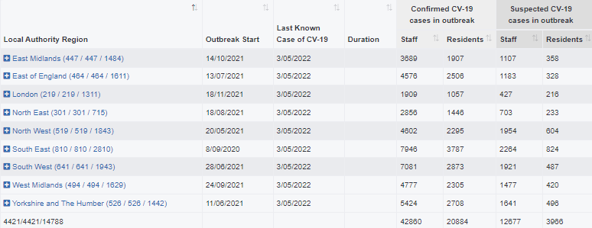
Care Homes – Outbreak data (as of 09:30 hrs 03/05/2022)
37694 outbreaks* have been reported since reporting began on 11/06/2020. Providers may have reported multiple outbreaks during this time (last week's data: 37548)
4421 outbreaks* are still ongoing (last week's data: 5348)
33273 outbreaks* are recovered (last week's data: 32164; 1109 recovered over the last week)
146 outbreaks* were triggered in the last week (last week's data: 3336)at
*NB. Valid outbreaks only – Invalid outbreaks have been excluded. Invalids are those where the provider reported 2 or more cases, resulting in an outbreak trigger, but then subsequently amended their daily figures to less than 2 cases. Note, outbreak numbers may reduce if locations become inactive following a CQC deregistration. Inactive locations are not included in figures. Recovery Time for an Outbreak is 28 days in Capacity Tracker. We are working with the DHSC to reflect the change to 10 days as set out in the revised guidance.

Slide 7
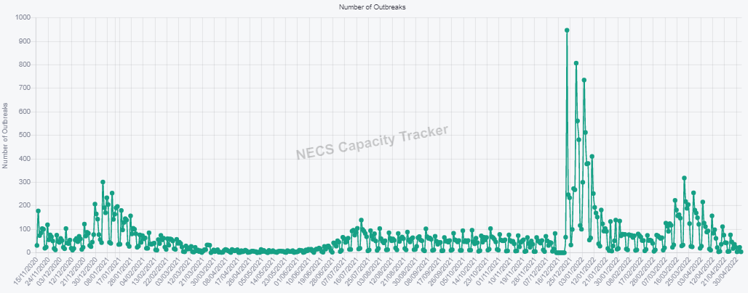
Care Homes – New Outbreaks by ENGLAND Total (as of 09:30 hrs 03/05/2022)
Outbreaks are triggered based on PHE definition: an outbreak starts where the provider reported 2 or more new cases within a 14 day period.

Slide 8
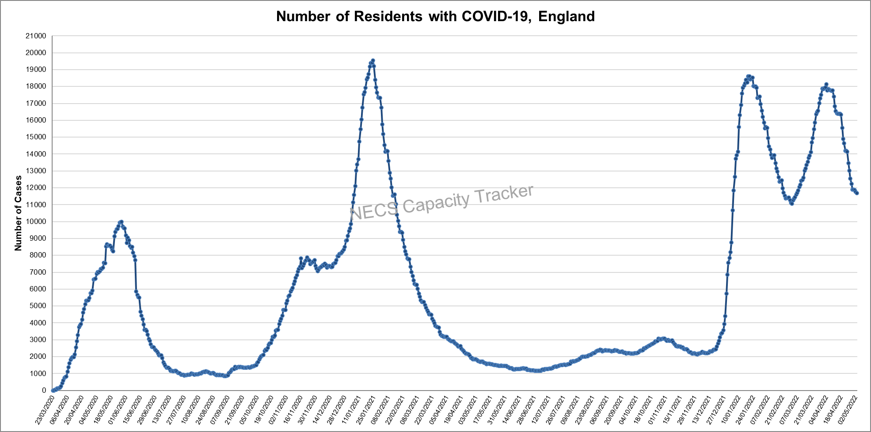
Capacity Tracker: Care Home COVID-19 Cases By ENGLAND Total (as of 09:30 hrs 03/05/2022)
Reported cases peaked nationally during May 2020, January 2021, January 2022 and March 2022.

Slide 9
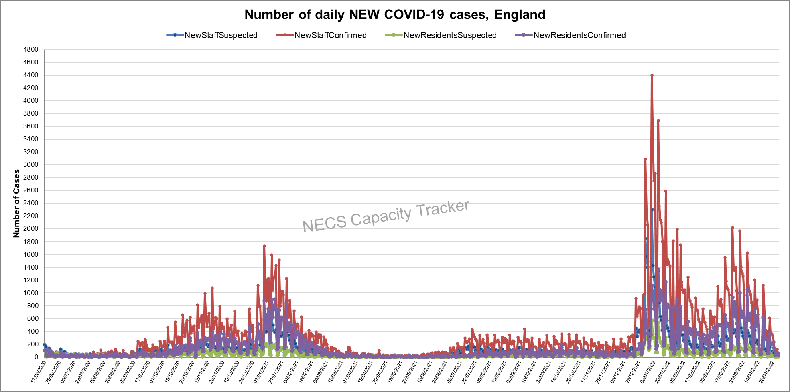
Capacity Tracker: Care Home NEW COVID-19 Cases By ENGLAND Total (as of 09:30 hrs 03/05/2022)
Data since reporting began on 11/06/2020. April 2022 saw decreases after spikes in January and March.

Slide 10
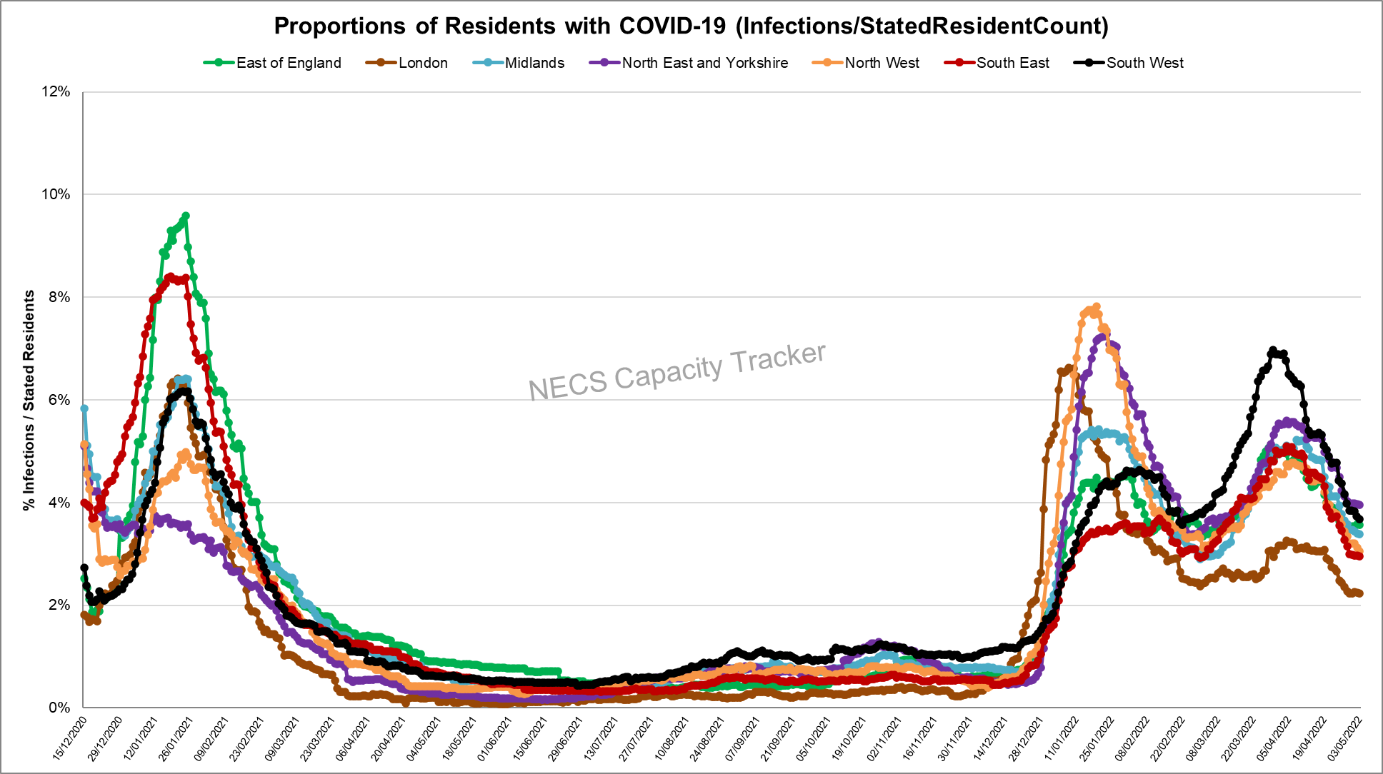
Capacity Tracker: Care Home Infection Rates By Region based on Resident Count
(as of 09:30 hrs 03/05/2022)
Infection rate: Number of Resident cases / Resident Count (reported from 11/12/20)
North East and Yorkshire currently highest with all regions showing decreases in April 2022 after spiking in March 2022.

Slide 11
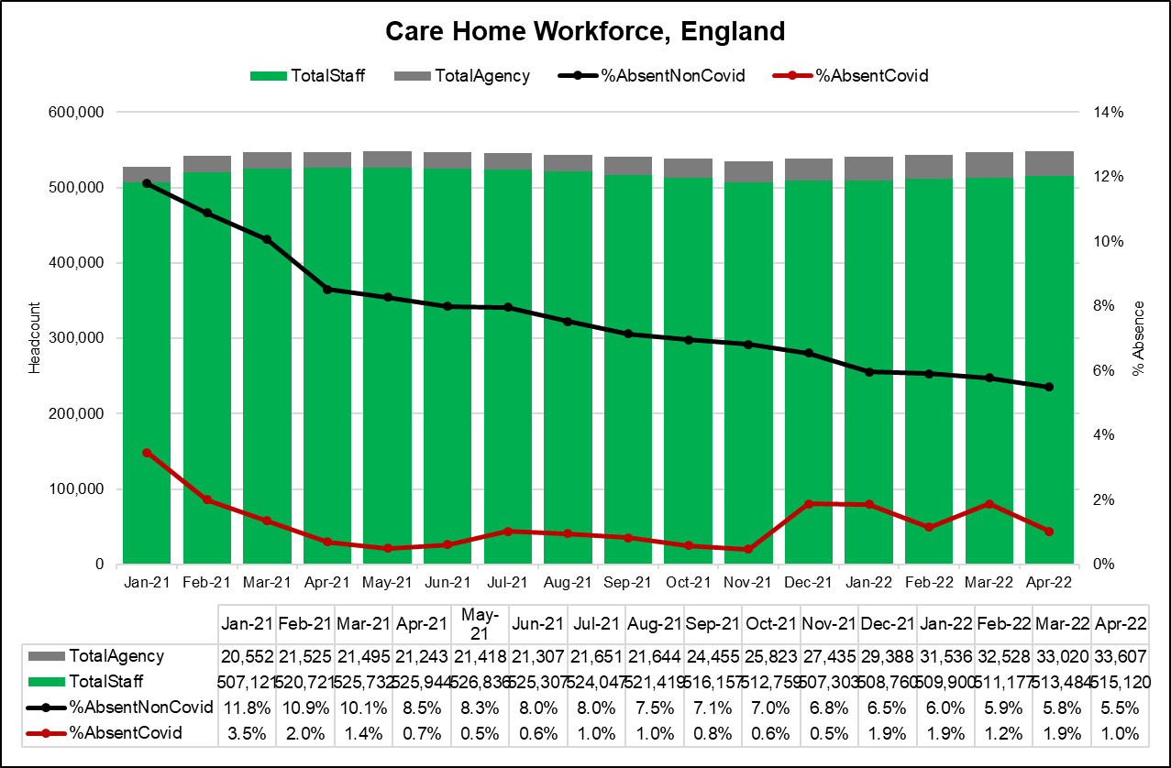
Capacity Tracker: Care Home Workforce Absence, ENGLAND
(as of 09:30 hrs 03/05/2022)
Staff absence rates due to non-covid reasons reduced monthly through 2021, and this trend is continuing in 2022.
Staff absence due to covid related reasons in April 2022 have decreased to 1.0% after an increase in March.

Slide 12
Capacity Tracker: Care Home Workforce Absence, by Region
(as of 09:30 hrs 03/05/2022)
North East and Yorkshire has consistently seen the highest staff absence rates due to non-covid reasons.
South West and North East and Yorkshire are currently showing the highest staff absence due to covid related reasons.

Slide 13
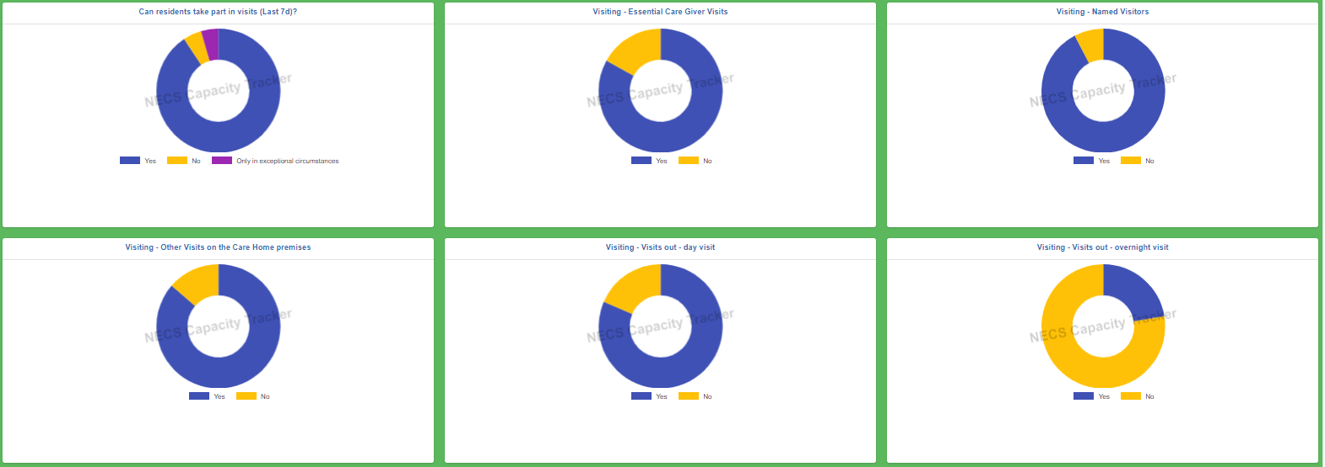
Capacity Tracker: Visiting (as of 09:30 hrs 03/05/2022)
From 14636 locations; 380,501 Staff were tested as part of location testing (last 7 days), 69,840 staff were not tested as part of location testing (last 7 days).

Slide 14
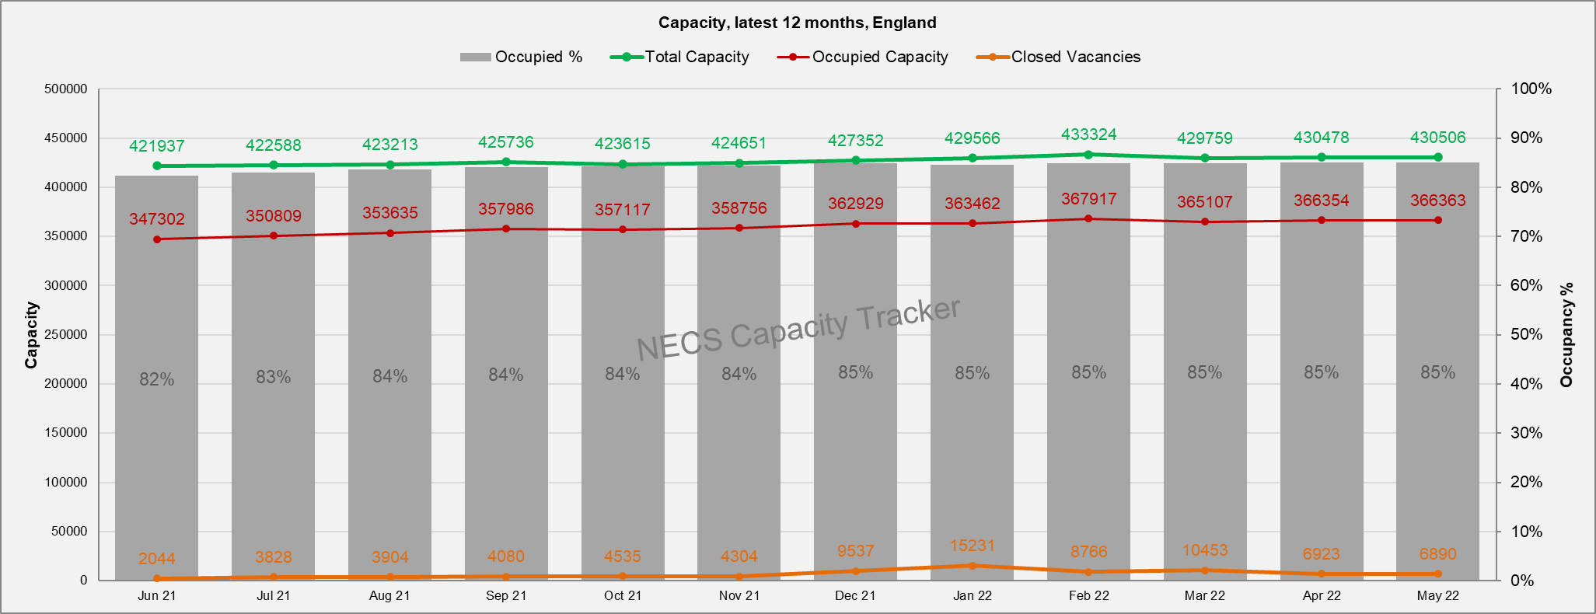
Capacity Tracker: Care Home Monthly Derived Occupancy Rates (England) (as of 09:30 hrs 03/05/2022)
Occupancy rates show an increase from July 2021 with current position at 85% nationally in May to date.
Occupancy / Used Capacity is derived from CQC registered capacity minus declared vacancies.

Slide 15
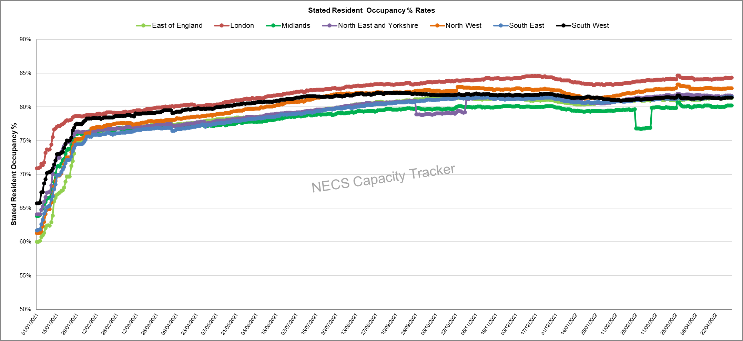
Capacity Tracker: Care Home Daily Stated Occupancy Rates by Region (as of 09:30 hrs 03/05/2022)
Daily rates captured from 11/12/20. Stated resident occupancy rates peaked in mid-December 2021, with London showing an above average occupancy rate.

Slide 16
Homecare

Slide 17
Capacity Tracker Homecare Survey Data
Reported within the last 7 Days (as of 09:30 hrs 03/05/2022)
2052 (21%) providers updated homecare survey data in previous 48hrs; 6713 (68%) in previous 7 days
[last week's data: 4267 in 48 hours (44%), 7224 in 7 days (74%)]

