Slide 1



Capacity Tracker Update
8th March 2022
The information included in this pack is classified as sensitive and circulation is restricted. Contents must not be shared further.

Slide 2
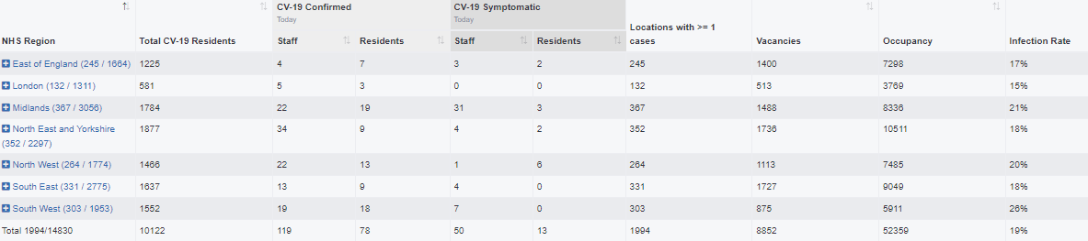
Capacity Tracker Business Continuity Data (Care Homes with 1 or more Covid case)
Reported within the last 7 Days (as of 09:30 hrs 08/03/2022)
1994 (13.5%) providers reported one or more current Covid case in previous 7 days.
(last week's data: 1920 (12.9%) in previous 7 days)

Slide 3
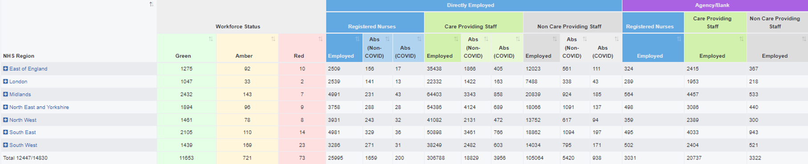
Capacity Tracker - Workforce data (Care Homes)
Reported within the last 7 days (as of 09:30 hrs 08/03/2022)
Workforce Summary
Registered nursing: Total Absence 1859 (7%), (last week's data: 7%)
Care Providing Staff: Total Absence 22785 (7%), (last week's data: 8%)

Slide 4
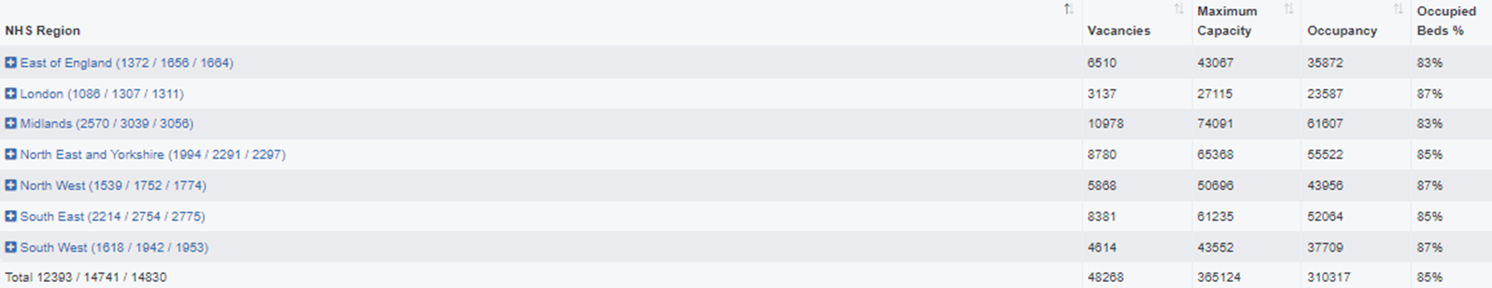
Care Homes – Vacancy data, reported within the last 7 days (as of 09:30 hrs 08/03/2022)
12393 (84%) providers updated vacancies in previous 7 days / 14741 (99%) providers updated at any time / 14830 CQC Registered Care Homes
(last week’s data: 84% in previous 7 days, 99% updated any time)

Slide 5
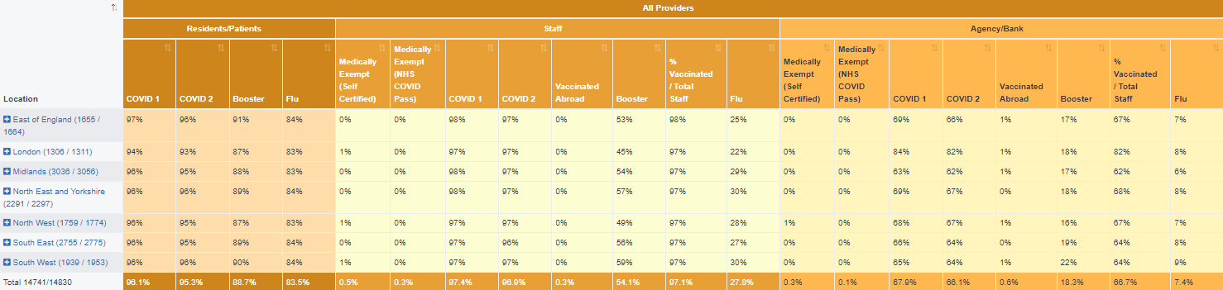
Care Homes – Covid vaccinations, all results reported (as of 09:30 hrs 08/03/2022)
336,450 residents (96%) and 499,894 staff (97%) have received dose 1 to date. 333,817 residents (95%) and 497,052 staff (97%) have received dose 2 to date.
[last week's data: Dose 1 336,200 residents (96%); 499,529 staff (97%); Dose 2 333,566 residents (95%); 496,646 staff (97%)]
2,440 staff medically exempt self cert (0.5%), 1,351 staff medically exempt covid pass (0.3%)
[last week's data: 2,460 staff medically exempt self cert (0.5%), 1,353 staff medically exempt covid pass (0.3%)]
Data available at Local Authority level is also available on Capacity Tracker

Slide 6
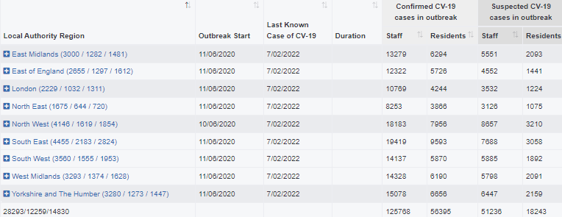
Care Homes – Outbreak data (as of 09:30 hrs 08/03/2022)
32888 outbreaks* have been reported since reporting began on 11/06/2020. Providers may have reported multiple outbreaks during this time (last week's data: 32481)
4595 outbreaks* are still ongoing (last week's data: 5377)
28293 outbreaks* are recovered (last week's data: 27103; 1190 recovered over the last week)
407 outbreaks* were triggered in the last week (last week's data: 292)at
*NB. Valid outbreaks only – Invalid outbreaks have been excluded. Invalids are those where the provider reported 2 or more cases, resulting in an outbreak trigger, but then subsequently amended their daily figures to less than 2 cases. Note, outbreak numbers may reduce if locations become inactive following a CQC deregistration. Inactive locations are not included in figures.

Slide 7
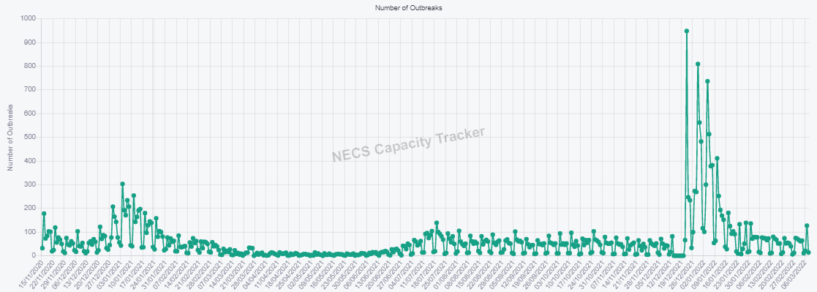
Care Homes – New Outbreaks by ENGLAND Total (as of 09:30 hrs 08/03/2022)
Outbreaks are triggered based on PHE definition: an outbreak starts where the provider reported 2 or more new cases within a 14 day period.

Slide 8
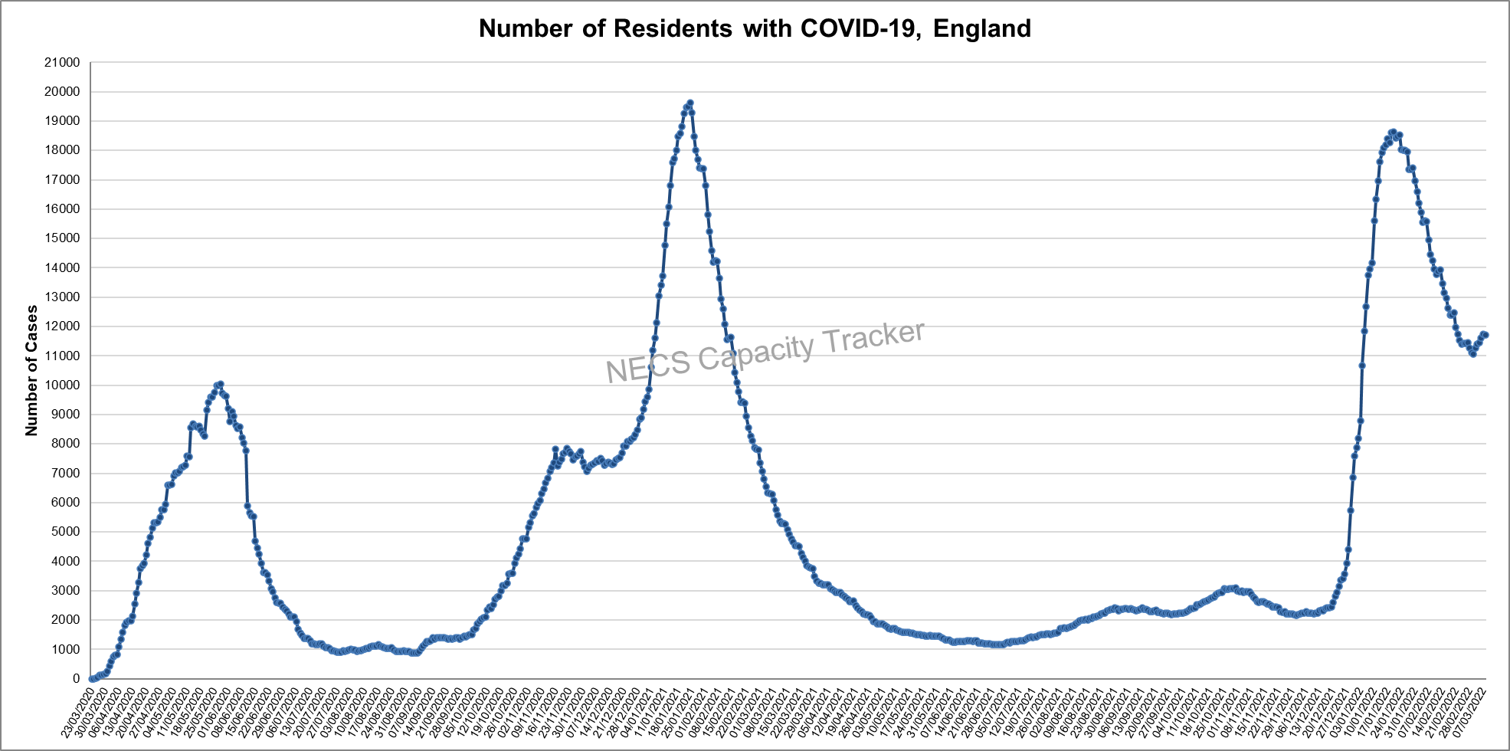
Capacity Tracker: Care Home COVID-19 Cases By ENGLAND Total (as of 09:30 hrs 08/03/2022)
Reported cases peaked nationally during May 2020, January 2021 and January 2022.

Slide 9
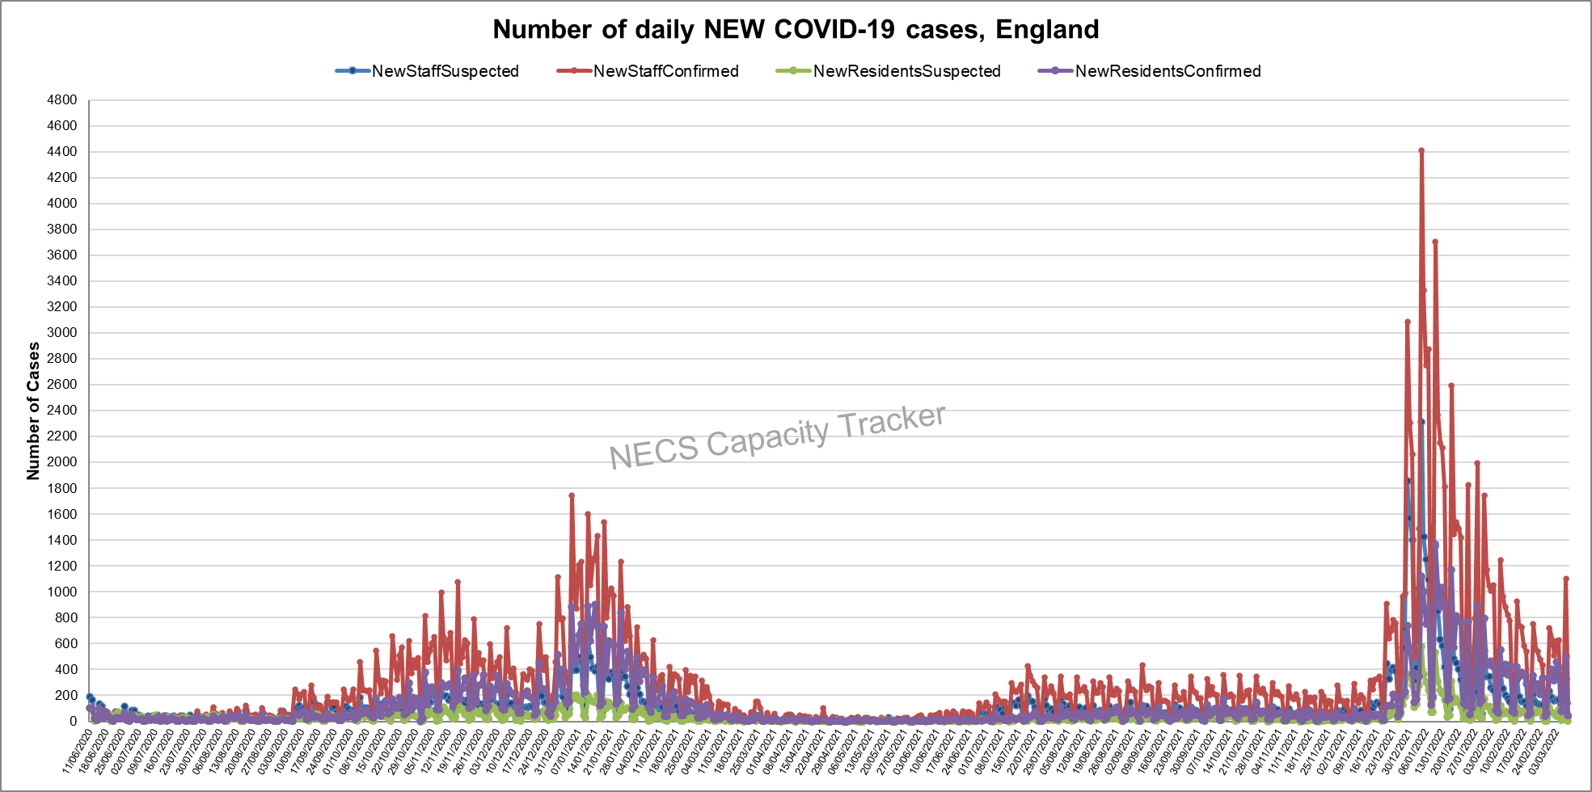
Capacity Tracker: Care Home NEW COVID-19 Cases By ENGLAND Total (as of 09:30 hrs 08/03/2022)
Data since reporting began on 11/06/2020. After large increases in December 2021, 2022 has seen declining volumes.

Slide 10
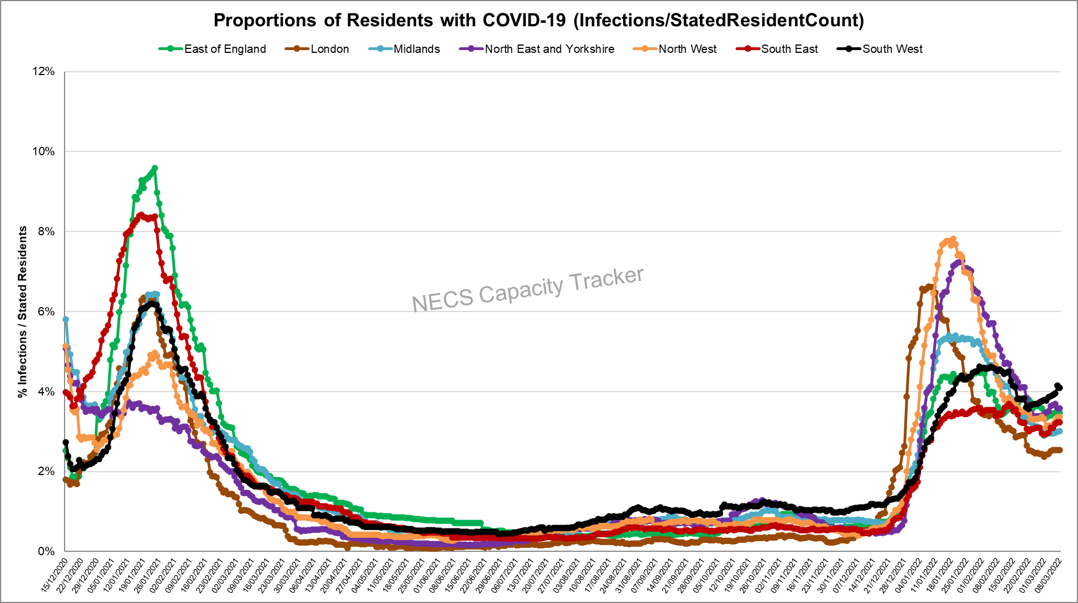
Capacity Tracker: Care Home Infection Rates By Region based on Resident Count
(as of 09:30 hrs 08/03/2022)
Infection rate: Number of Resident cases / Resident Count (reported from 11/12/20)
South West currently highest, all regions are showing increases over the last week.

Slide 11
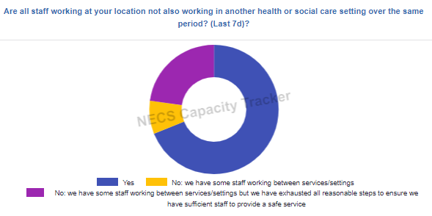
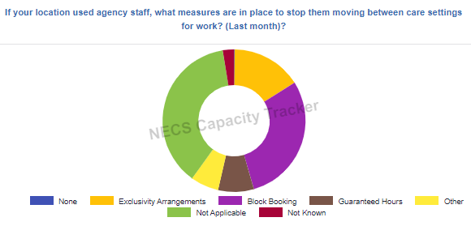
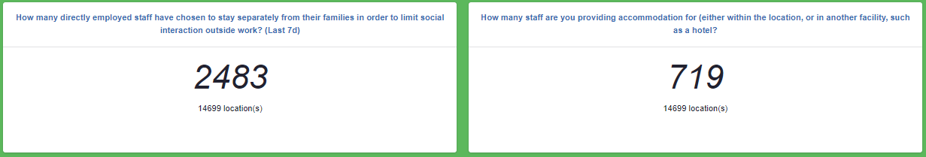
Capacity Tracker: Infection Prevention (as of 09:30 hrs 08/03/2022)

Slide 12
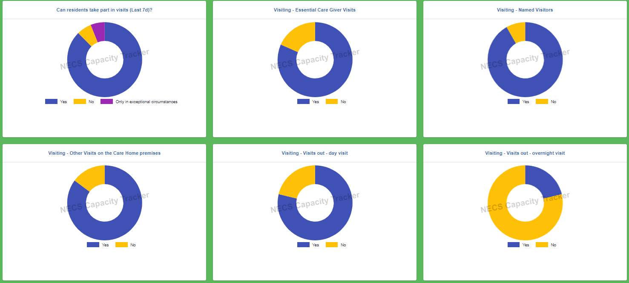
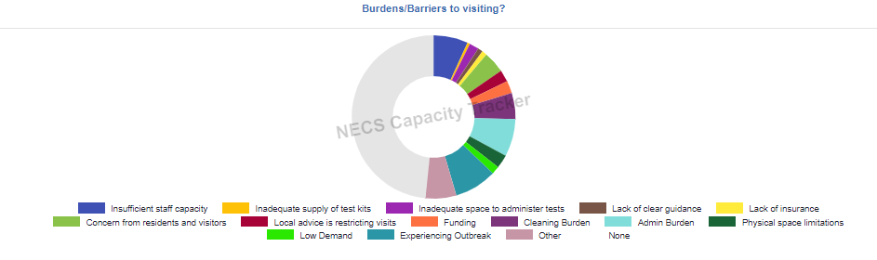
Capacity Tracker: Visiting (as of 09:30 hrs 08/03/2022)

Slide 13
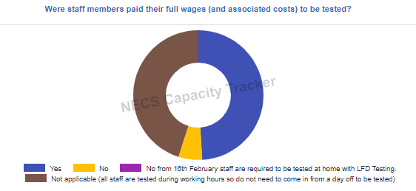
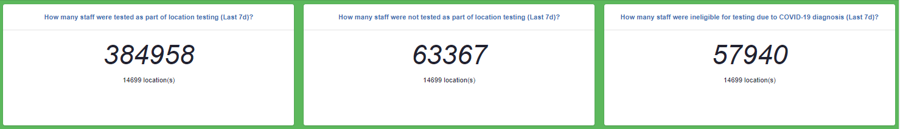
Capacity Tracker: Staff Testing (as of 09:30 hrs 08/03/2022)

Slide 14
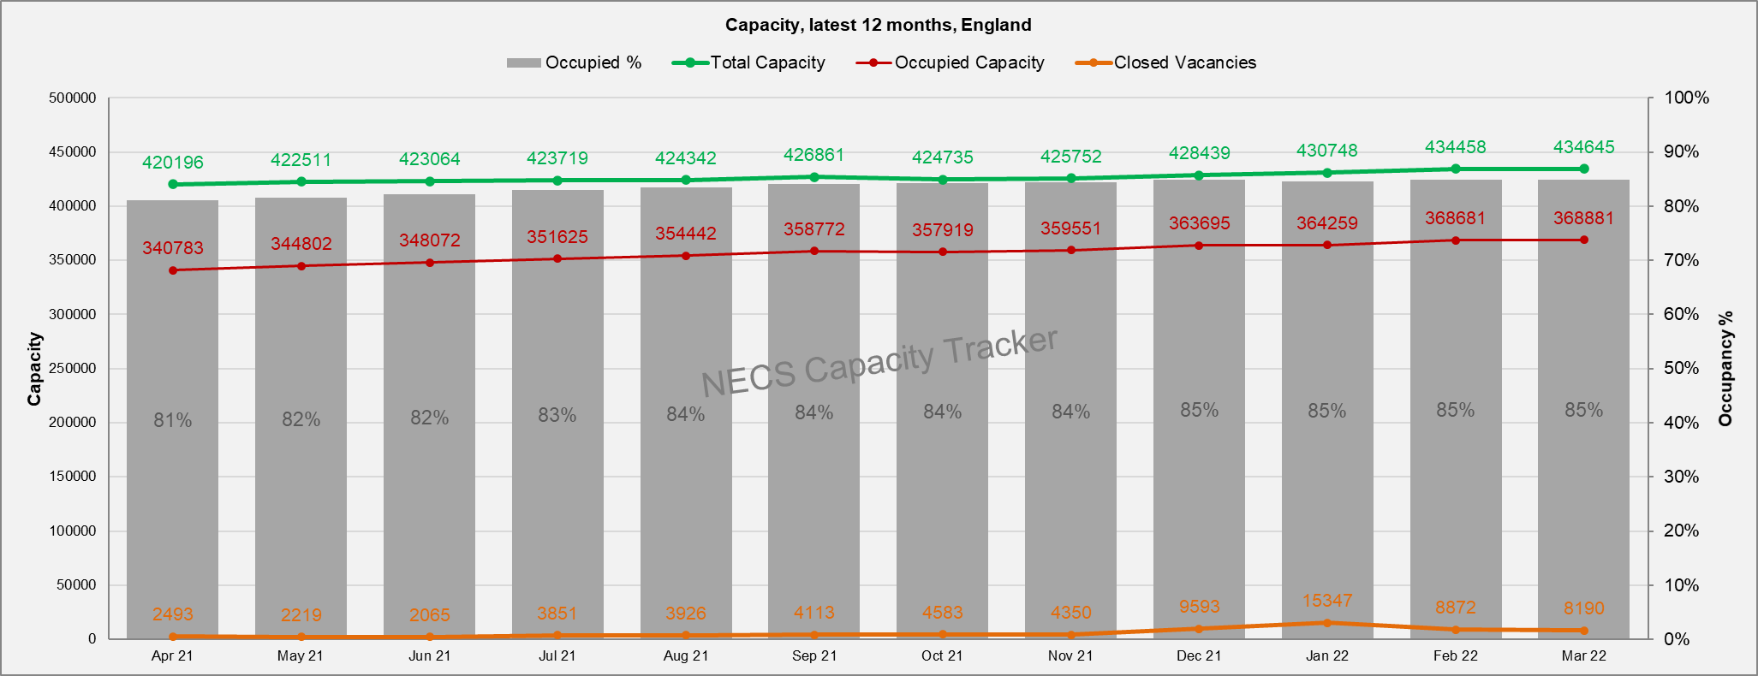
Capacity Tracker: Care Home Monthly Derived Occupancy Rates (England) (as of 09:30 hrs 08/03/2022)
Occupancy rates show an increase from July 2021 with current position at 85% nationally in February to date.
Occupancy / Used Capacity is derived from CQC registered capacity minus declared vacancies.

Slide 15
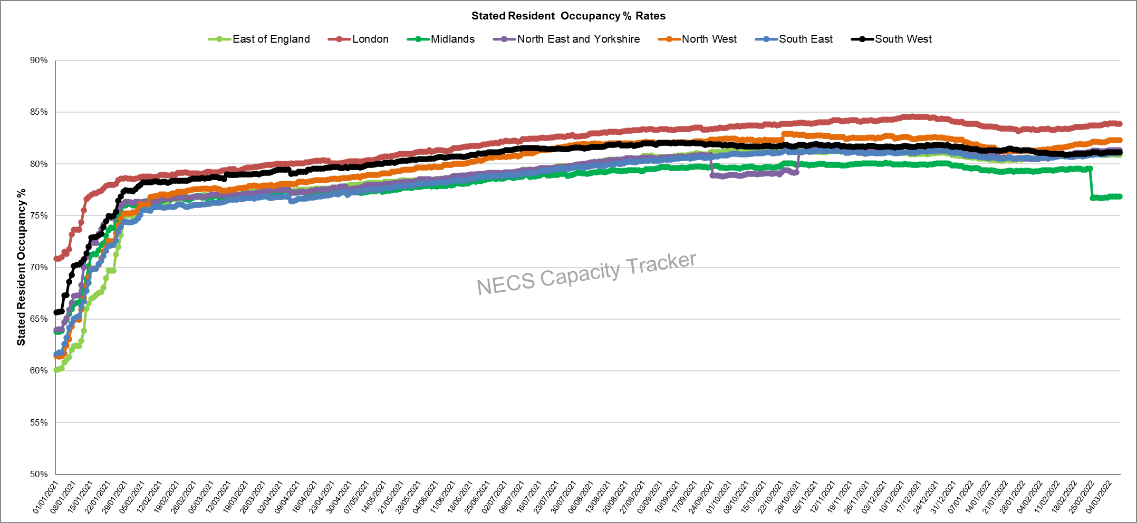
Capacity Tracker: Care Home Daily Stated Occupancy Rates by Region (as of 09:30 hrs 08/03/2022)
Daily rates captured from 11/12/20. Stated resident occupancy rates peaked in mid-December 2021, with London showing an above average occupancy rate.

Slide 16
Homecare

Slide 17
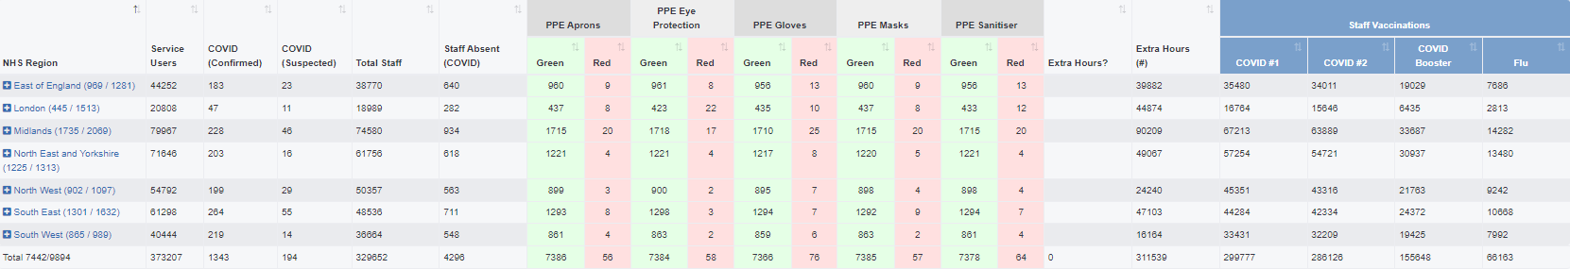
Capacity Tracker Homecare Survey Data
Reported within the last 7 Days (as of 09:30 hrs 08/03/2022)
4841 (49%) providers updated homecare survey data in previous 48hrs; 7442 (75%) in previous 7 days
[last week's data: 4590 in 48 hours (46%), 7337 in 7 days (74%)]

