Slide 1
Capacity Tracker Update
21st December 2021
The information included in this pack is classified as sensitive and circulation is restricted. Contents must not be shared further.

Slide 2
Capacity Tracker Business Continuity Data (Care Homes with 1 or more Covid case)
Reported within the last 7 Days (as of 09:30 hrs 21/12/2021)
867 (5.8%) providers reported one or more current Covid case in previous 7 days.
(last week’s data: 708 (4.7%) in previous 7 days)

Slide 3
Capacity Tracker - Workforce data (Care Homes) Reported within the last 7 days (as of 09:30 hrs 21/12/2021)
Workforce Summary
Registered nursing: Total Absence 1955 (7%), (last week’s data: 7%)
Care Providing Staff: Total Absence 25948 (8%), (last week’s data: 8%)

Slide 4
Care Homes - Vacancy data, reported within the last 7 days (as of 09:30 hrs 21/12/2021)
12898 (87%) providers updated vacancies in previous 7 days / 14831 (99%) providers updated at any time / 14906 CQC Registered Care Homes
(last week’s data: 85% in previous 7 days, 99% updated any time)

Slide 5
Care Homes – Covid vaccinations, all results reported (as of 09:30 hrs 21/12/2021)
338,480 residents (96%) and 500,438 staff (97%) have received dose 1 to date. 335,048 residents (95%) and 494,665 staff (96%) have received dose 2 to date.
[last week’s data: Dose 1 338,110 residents (96%); 500,838 staff (97%); Dose 2 334,396 residents (95%); 494,078 staff (96%)]
2,994 staff medically exempt self cert (0.6%), 910 staff medically exempt covid pass (0.2%)
[last week’s data: 3,140 staff medically exempt self cert (0.6%), 575 staff medically exempt covid pass (0.1%)]
Data available at Local Authority level is also available on Capacity Tracker

Slide 6
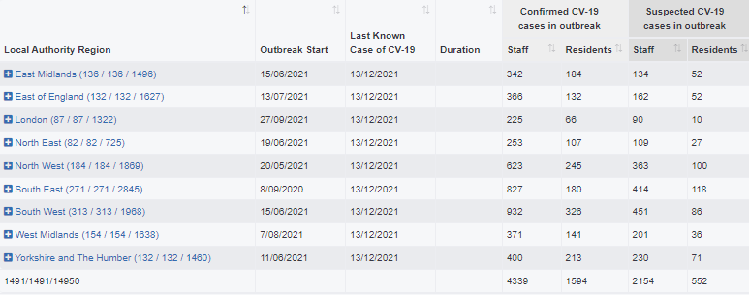
Care Homes – Outbreak data (as of 09:30 hrs 21/12/2021)
Latest data available as at 14/12/21
22462 outbreaks* have been reported since reporting began on 11/06/2020. Providers may have reported multiple outbreaks during this time (last week’s data: 22209)
1491 outbreaks* are still ongoing (last week’s data: 1527)
20971 outbreaks* are recovered (last week’s : 20369; 402 recovered over the last week)
366 outbreaks* were triggered in the last week (last week’s data: 275)at
*NB. Valid outbreaks only – Invalid outbreaks have been excluded. Invalids are those where the provider reported 2 or more cases, resulting in an outbreak trigger, but then subsequently amended their daily figures to less than 2 cases. Note, outbreak numbers may reduce if locations become inactive following a CQC deregistration. Inactive locations are not included in figures.

Slide 7
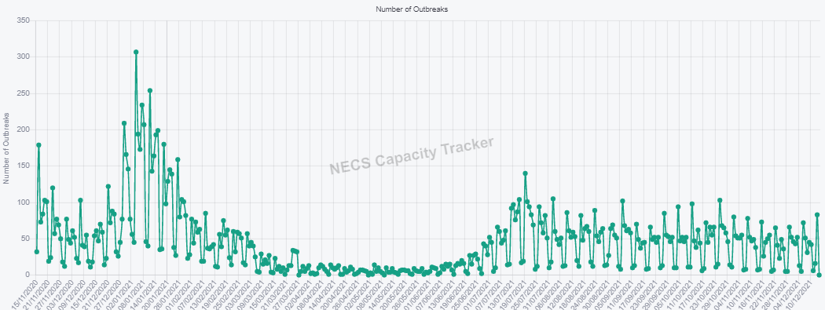
Care Homes – New Outbreaks by ENGLAND Total (as of 09:30 hrs 21/12/2021)
Latest data available as at 14/12/21
Outbreaks are triggered based on PHE definition: an outbreak starts where the provider reported 2 or more new cases within a 14 day period.

Slide 8
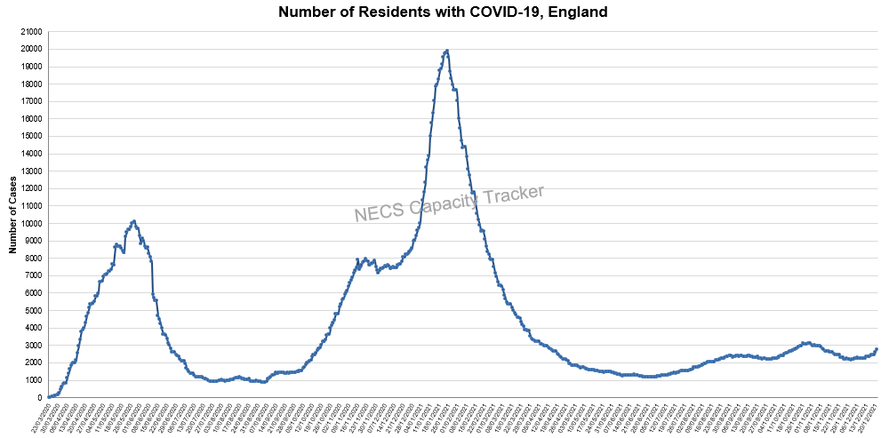
Capacity Tracker: Care Home COVID-19 Cases By ENGLAND Total (as of 09:30 hrs 21/12/2021)
Reported cases peaked nationally during May 2020 and January 2021. Cases have been increasing over the last few weeks.

Slide 9
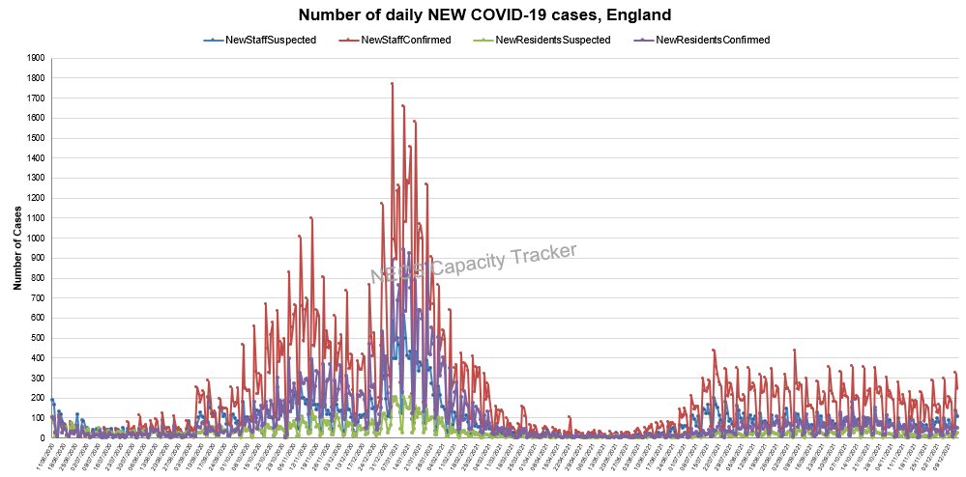
Capacity Tracker: Care Home NEW COVID-19 Cases By ENGLAND Total (as of 09:30 hrs 21/12/2021)
Data since reporting began on 11/06/2020. Recent weeks are showing slight increases attributable to newly confirmed staff cases.

Slide 10
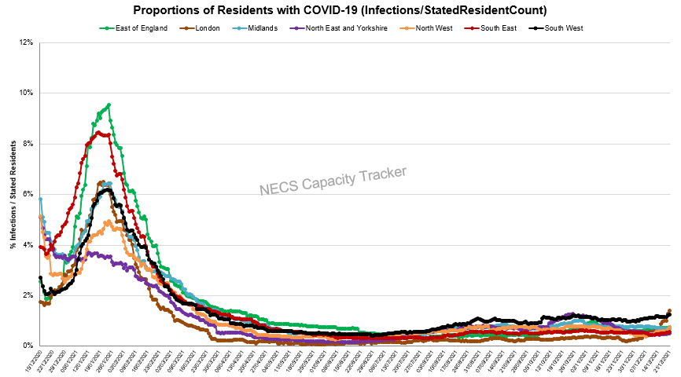
Capacity Tracker: Care Home Infection Rates By Region based on Resident Count
(as of 09:30 hrs 21/12/2021)
Infection rate: Number of Resident cases / Resident Count (reported from 11/12/20)
London is currently highest, with a sharp increase over the last week. Other regions remain consistent with small increases.

Slide 11
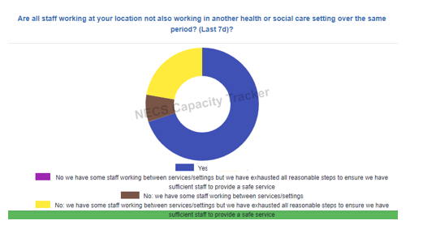
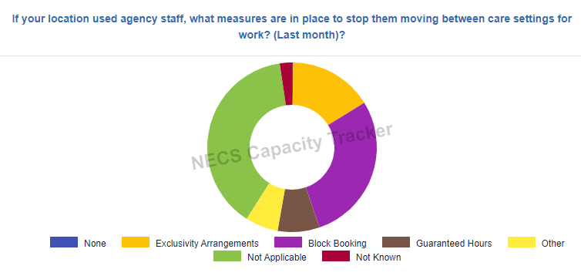
Capacity Tracker: Infection Prevention (as of 09:30 hrs 21/12/2021)

Slide 12
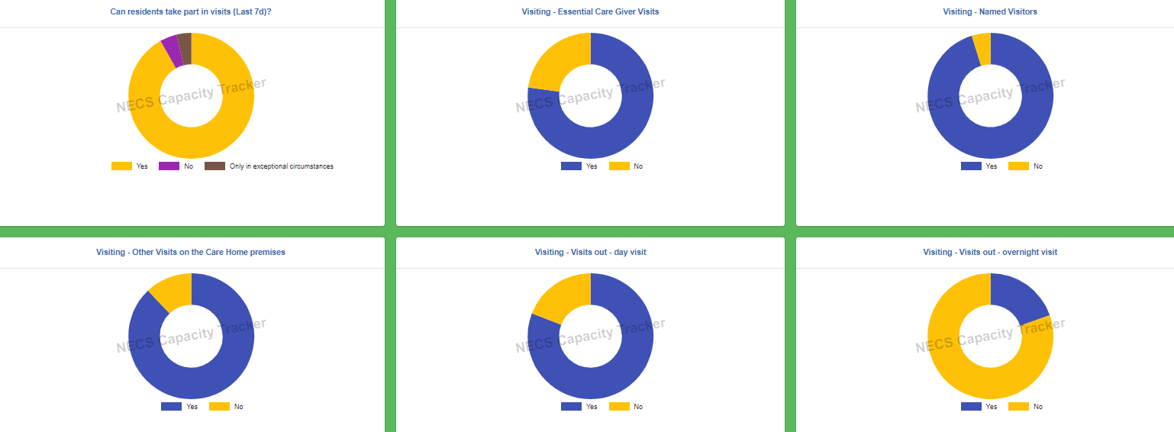
Capacity Tracker: Visiting (as of 09:30 hrs 21/12/2021)

Slide 13
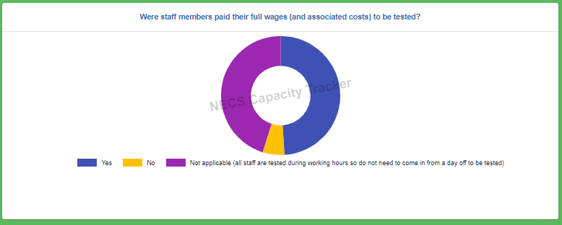
Capacity Tracker: Staff Testing (as of 09:30 hrs 21/12/2021)

Slide 14
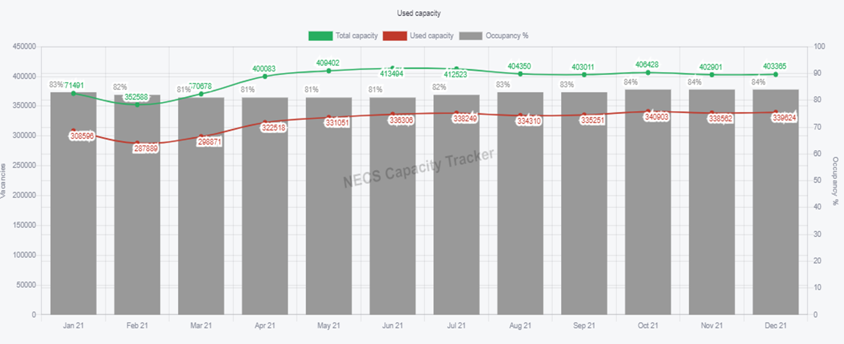
Capacity Tracker: Care Home Monthly Derived Occupancy Rates (England) (as of 09:30 hrs 21/12/2021)
Occupancy rates show an increase from July 2021 with current position at 84% nationally in December to date.
Occupancy / Used Capacity is derived from CQC registered capacity minus declared vacancies.

Slide 15
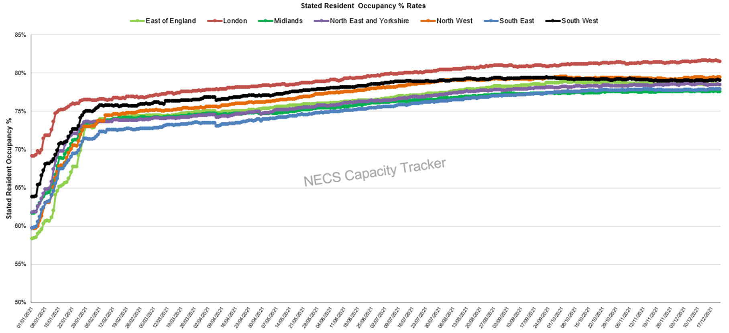
Capacity Tracker: Care Home Daily Stated Occupancy Rates by Region (as of 09:30 hrs 21/12/2021)
Daily rates captured from 11/12/20. Stated resident occupancy rates have remained consistent over recent weeks, with London showing an above average rate.

Slide 16
Homecare

Slide 17
Capacity Tracker Homecare Survey Data
Reported within the last 7 Days (as of 09:30 hrs 21/12/2021)
5240 (53%) providers updated homecare survey data in previous 48hrs; 7519 (76%) in previous 7 days
[last week’s data: 4667 in 48 hours (47%), 7388 in 7 days (75%)]

