Slide 1



Capacity Tracker Update
24th May 2022
The information included in this pack is classified as sensitive and circulation is restricted. Contents must not be shared further.

Slide 2
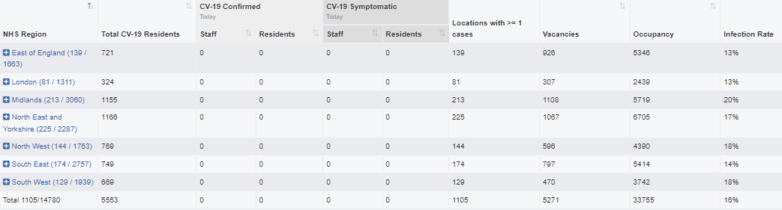
Capacity Tracker Business Continuity Data (Care Homes with 1 or more Covid case)
Reported within the last 7 Days (as of 09:30 hrs 24/05/2022)
1105 (7.5%) providers reported one or more current Covid case in previous 7 days.
(last week's data: 1277 (8.6%) in previous 7 days)

Slide 3
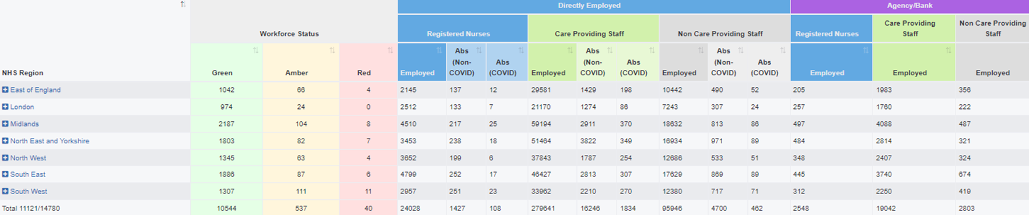
Capacity Tracker - Workforce data (Care Homes)
Reported within the last 7 days (as of 09:30 hrs 24/05/2022)
Workforce Summary
Registered nursing: Total Absence 1,535 (6%), (last week's data: 6%)
Care Providing Staff: Total Absence 18,080 (6%), (last week's data: 8%)

Slide 4
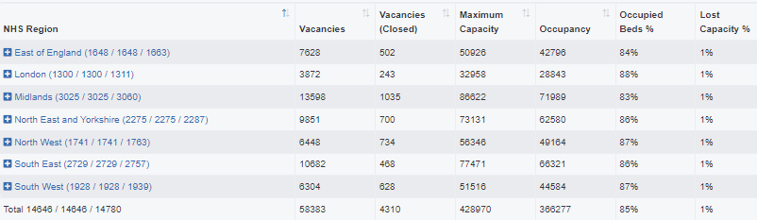
Care Homes – Vacancy data, reported at any time (as of 09:30 hrs 24/05/2022)
14646 (99%) providers updated at any time / 14780 CQC Registered Care Homes
(last week’s data: 99% updated any time)

Slide 5
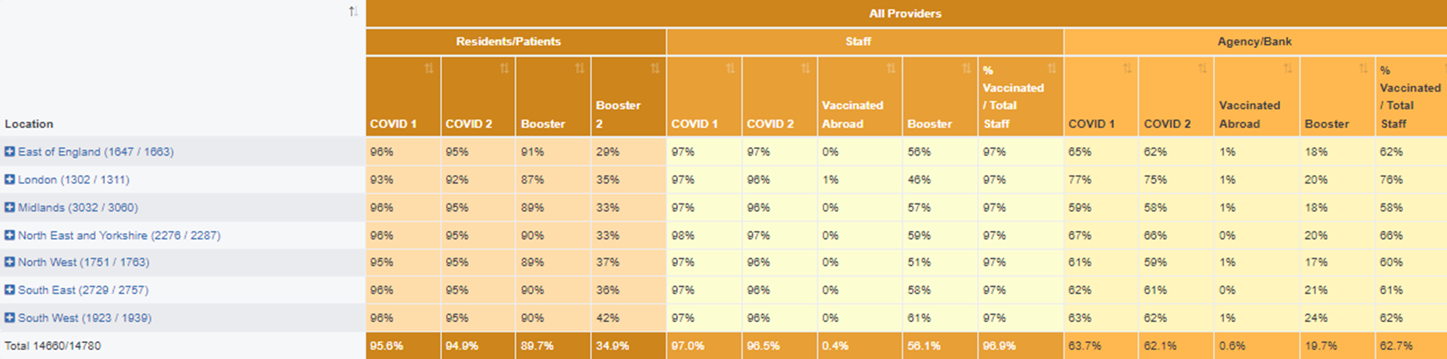
Care Homes – Covid vaccinations, all results reported (as of 09:30 hrs 24/05/2022)
337,636 residents (96%) and 499,893 staff (97%) have received dose 1 to date. 335,151 residents (95%) and 497,266 staff (97%) have received dose 2 to date.
316,585 residents (90%) and 289,068 staff (56%) have received booster 1 to date. 123,161 residents (35%) have received booster 2 to date.
[last week's data: Dose 1 336,858 residents (96%); 499,789 staff (97%); Dose 2 334,367 residents (95%); 497,141 staff (97%),
Booster 1 315,498 residents (90%); 288,159 staff (56%); Booster 2 105,943 residents (30%)]
Data available at Local Authority level is also available on Capacity Tracker

Slide 6
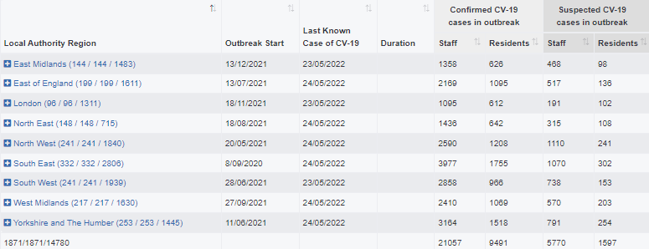
Care Homes – Outbreak data (as of 09:30 hrs 24/05/2022)
38010 outbreaks* have been reported since reporting began on 11/06/2020. Providers may have reported multiple outbreaks during this time (last week's data: 37879)
1871 outbreaks* are still ongoing (last week's data: 2789)
36139 outbreaks* are recovered (last week's data: 35090; 1049 recovered over the last week)
131 outbreaks* were triggered in the last week (last week's data: 96)at
*NB. Valid outbreaks only – Invalid outbreaks have been excluded. Invalids are those where the provider reported 2 or more cases, resulting in an outbreak trigger, but then subsequently amended their daily figures to less than 2 cases. Note, outbreak numbers may reduce if locations become inactive following a CQC deregistration. Inactive locations are not included in figures. Recovery Time for an Outbreak is 28 days in Capacity Tracker. We are working with the DHSC to reflect the change to 10 days as set out in the revised guidance.

Slide 7
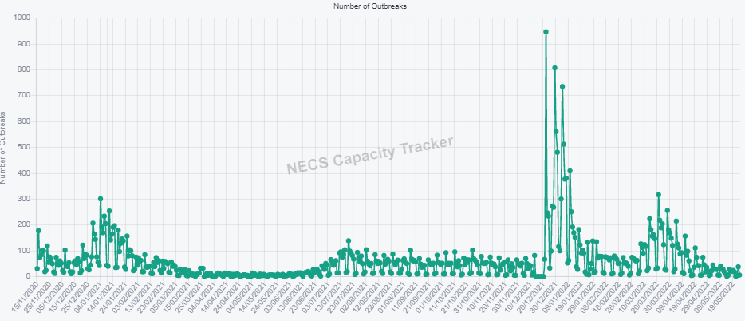
Care Homes – New Outbreaks by ENGLAND Total (as of 09:30 hrs 24/05/2022)
Outbreaks are triggered based on PHE definition: an outbreak starts where the provider reported 2 or more new cases within a 14 day period.

Slide 8
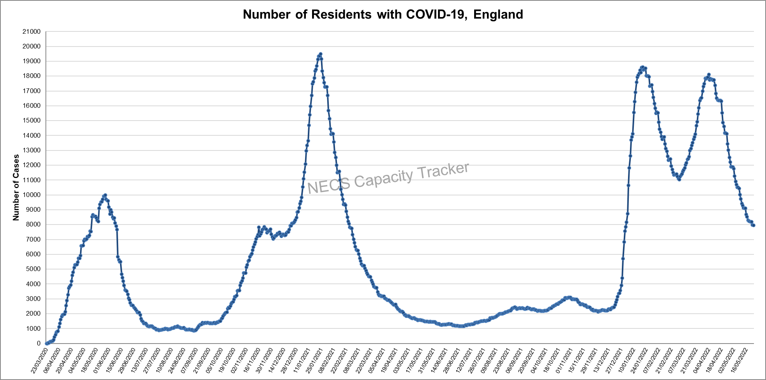
Capacity Tracker: Care Home COVID-19 Cases By ENGLAND Total (as of 09:30 hrs 24/05/2022)
Reported cases peaked nationally during May 2020, January 2021, January 2022 and March 2022.

Slide 9
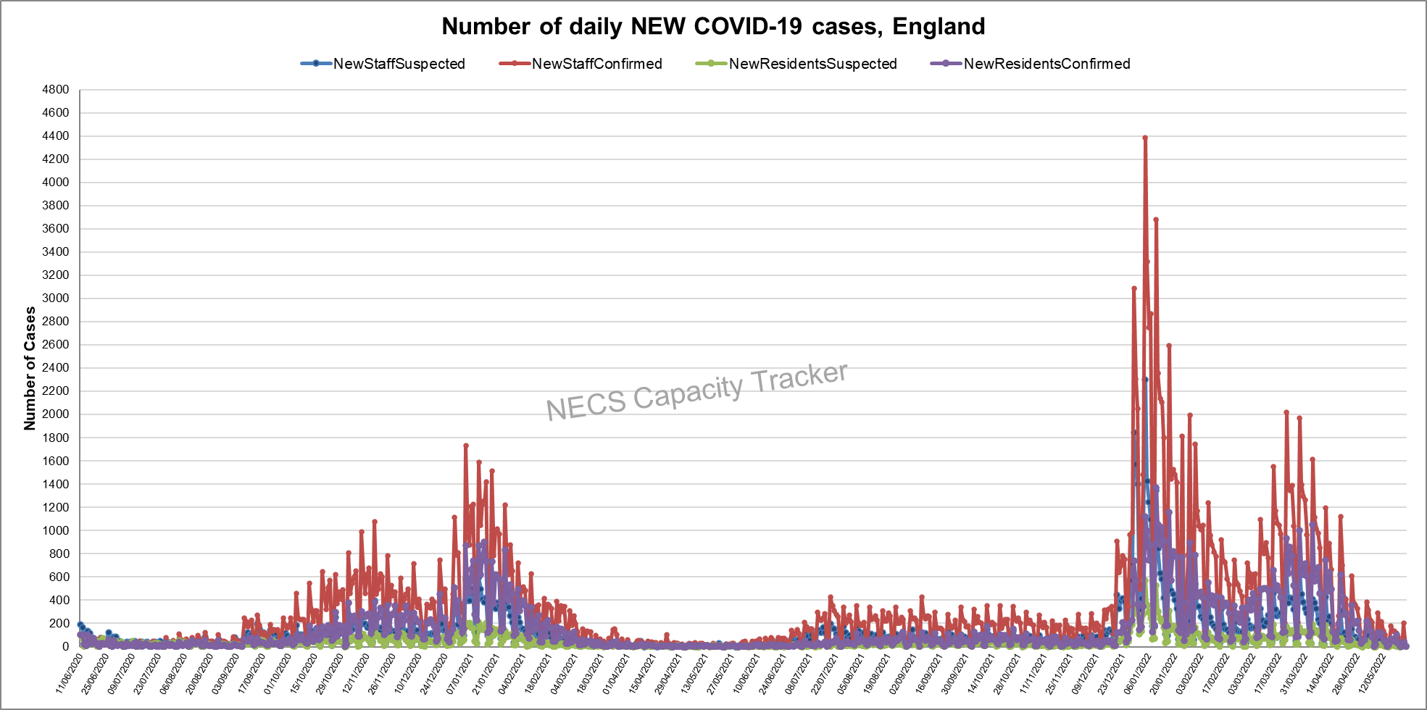
Capacity Tracker: Care Home NEW COVID-19 Cases By ENGLAND Total (as of 09:30 hrs 24/05/2022)
Data since reporting began on 11/06/2020. April 2022 saw decreases after spikes in January and March.

Slide 10
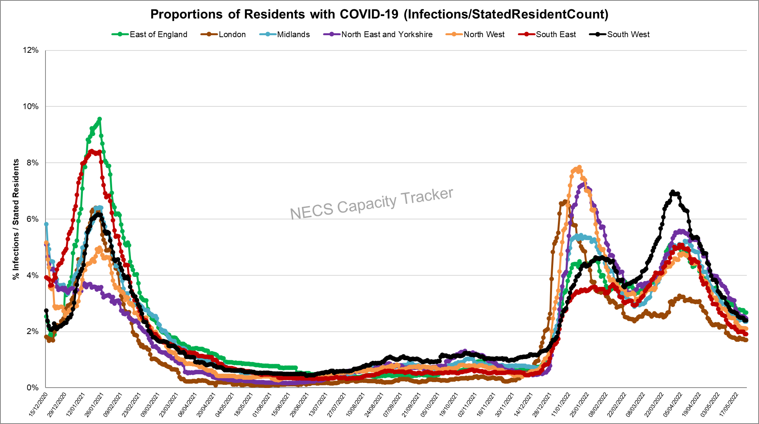
Capacity Tracker: Care Home Infection Rates By Region based on Resident Count
(as of 09:30 hrs 24/05/2022)
Infection rate: Number of Resident cases / Resident Count (reported from 11/12/20)
East of England currently highest with all regions showing decreases in April 2022 after spiking in March 2022.

Slide 11
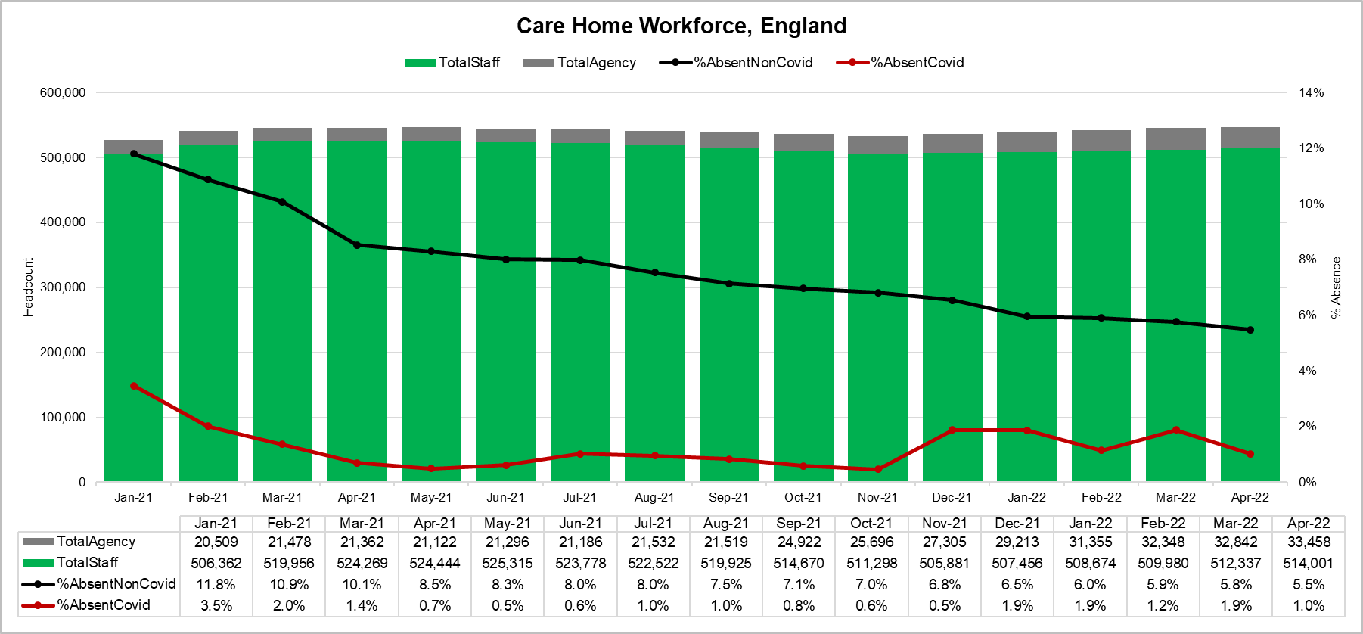
Capacity Tracker: Care Home Workforce Absence, ENGLAND
(as of 09:30 hrs 24/05/2022)
Staff absence rates due to non-covid reasons reduced monthly through 2021, and this trend is continuing in 2022.
Staff absence due to covid related reasons in April 2022 have decreased to 1.0% after an increase in March.

Slide 12
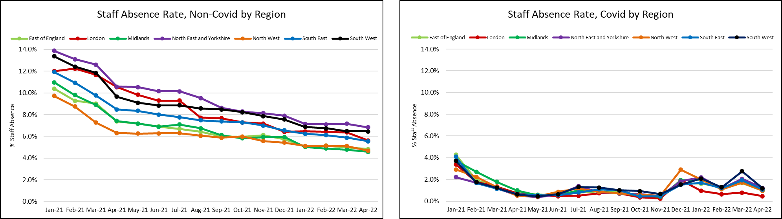
Capacity Tracker: Care Home Workforce Absence, by Region
(as of 09:30 hrs 24/05/2022)
North East and Yorkshire has consistently seen the highest staff absence rates due to non-covid reasons.
South West and North East and Yorkshire are currently showing the highest staff absence due to covid related reasons.

Slide 13
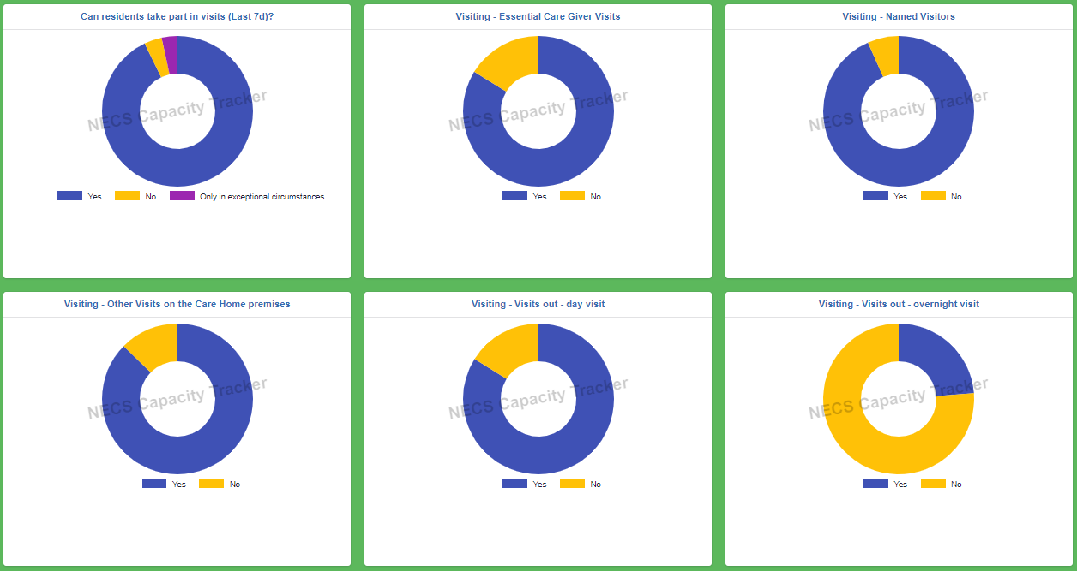
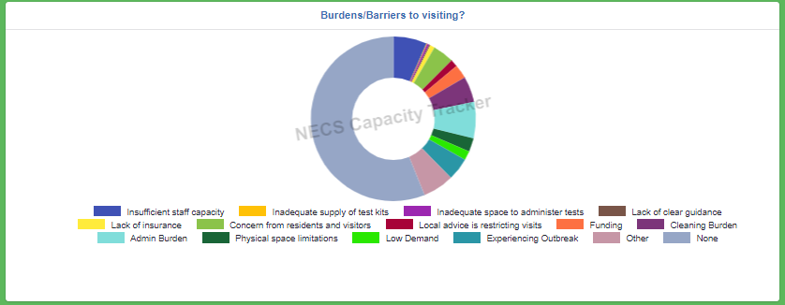
Capacity Tracker: Visiting (as of 09:30 hrs 24/05/2022)
From 14,602 locations; 374,739 Staff were tested as part of location testing (last 7 days), 68,919 staff were not tested as part of location testing (last 7 days).

Slide 14
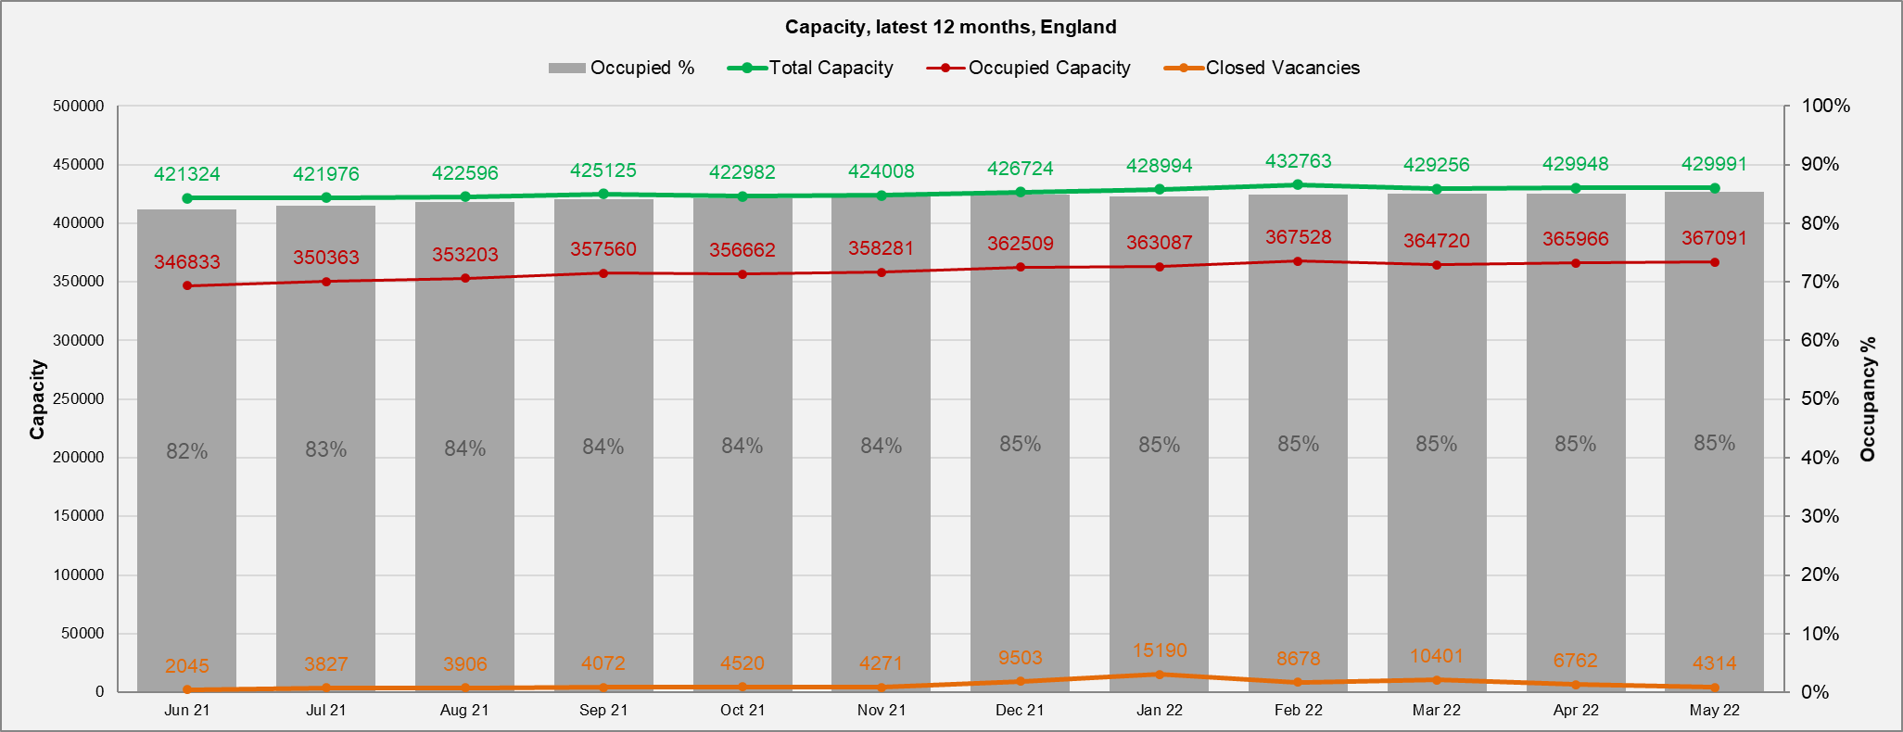
Capacity Tracker: Care Home Monthly Derived Occupancy Rates (England) (as of 09:30 hrs 24/05/2022)
Occupancy rates show an increase from July 2021 with current position at 85% nationally in May to date.
Occupancy / Used Capacity is derived from CQC registered capacity minus declared vacancies.

Slide 15
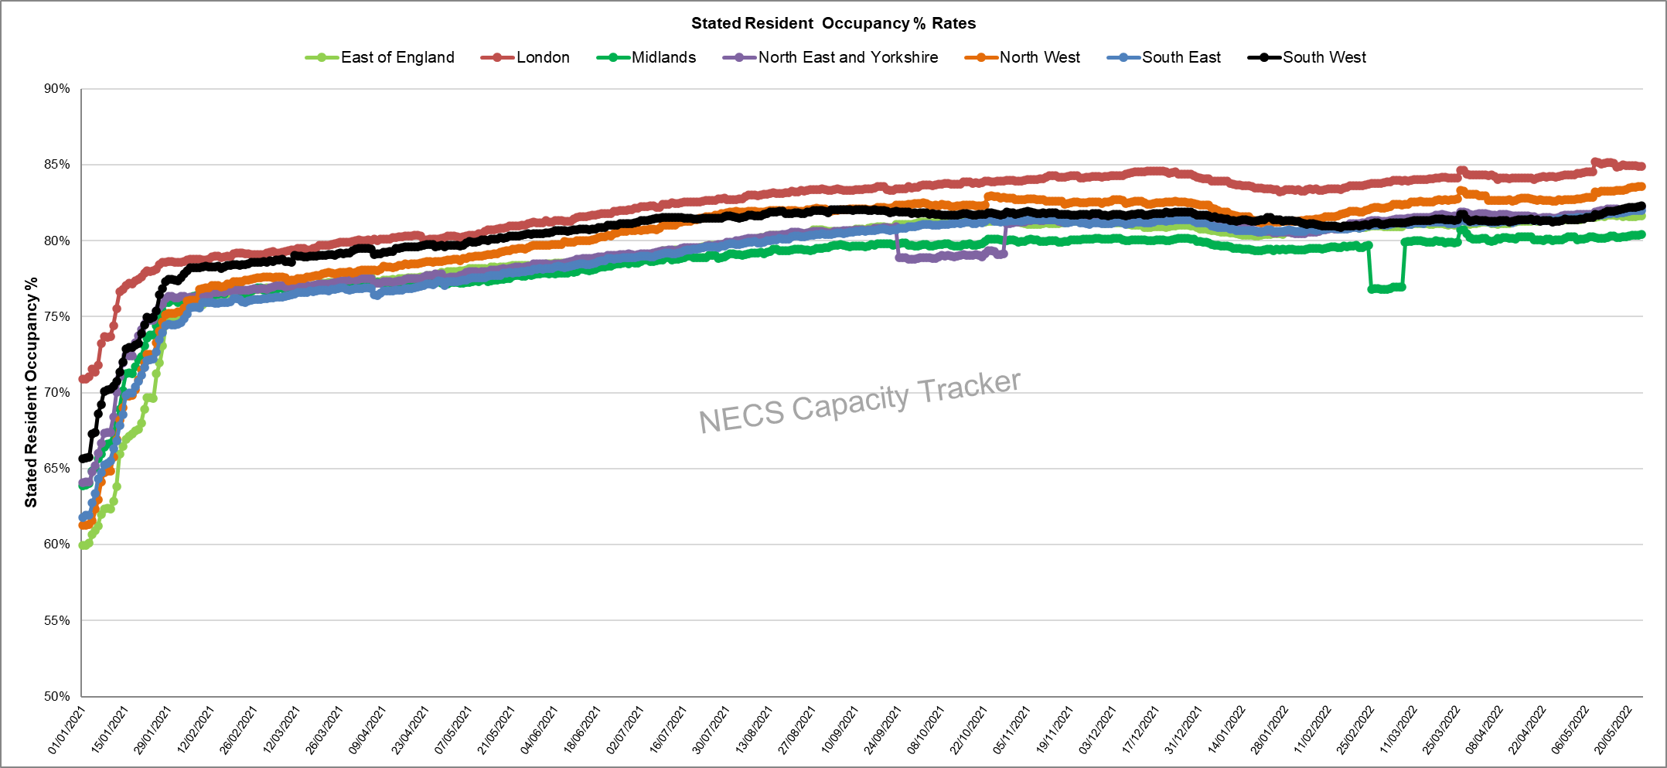
Capacity Tracker: Care Home Daily Stated Occupancy Rates by Region (as of 09:30 hrs 24/05/2022)
Daily rates captured from 11/12/20. Stated resident occupancy rates peaked in mid-December 2021, with London showing an above average occupancy rate.

Slide 16
Homecare

Slide 17
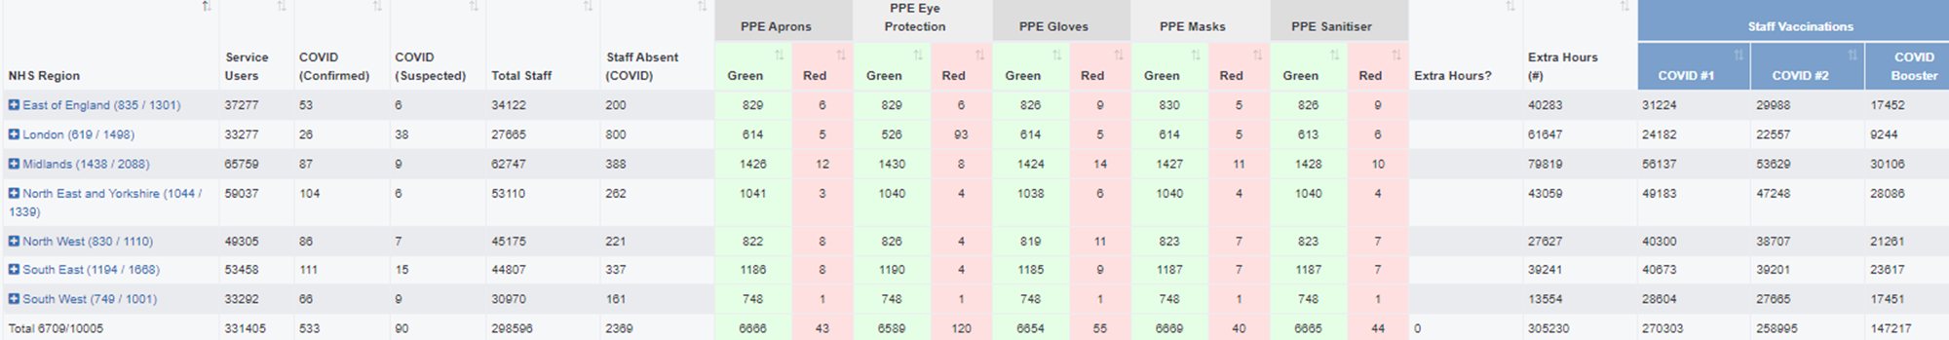
Capacity Tracker Homecare Survey Data
Reported within the last 7 Days (as of 09:30 hrs 24/05/2022)
3617 (36%) providers updated homecare survey data in previous 48hrs; 6709 (67%) in previous 7 days
[last week's data: 3799 in 48 hours (38%), 6560 in 7 days (66%)]

