Slide 1
Capacity Tracker Update
25th January 2022
The information included in this pack is classified as sensitive and circulation is restricted. Contents must not be shared further.

Slide 2
Capacity Tracker Business Continuity Data (Care Homes with 1 or more Covid case)
Reported within the last 7 Days (as of 09:30 hrs 25/01/2022)
3298 (22.2%) providers reported one or more current Covid case in previous 7 days.
(last week's data: 3595 (24.1%) in previous 7 days)

Slide 3
Capacity Tracker - Workforce data (Care Homes) Reported within the last 7 days (as of 09:30 hrs 25/01/2022)
Workforce Summary
Registered nursing: Total Absence 2143 (8%), (last week's data: 8%)
Care Providing Staff: Total Absence 27349 (9%), (last week's data: 10%)

Slide 4
Care Homes – Vacancy data, all results (as of 09:30 hrs 25/01/2022)
14772 (99%) providers updated at any time / 14882 CQC Registered Care Homes
(last week's data: 99% updated any time)

Slide 5
Care Homes – Covid vaccinations, all results reported (as of 09:30 hrs 25/01/2022)
335,929 residents (96%) and 499,589 staff (97%) have received dose 1 to date. 332,978 residents (96%) and 495,843 staff (97%) have received dose 2 to date.
[last week's data: Dose 1 336,090 residents (97%); 499,140 staff (97%); Dose 2 333,114 residents (96%); 495,089 staff (96%)]
2,658 staff medically exempt self cert (0.5%), 1,326 staff medically exempt covid pass (0.3%)
[last week's data: 2,717 staff medically exempt self cert (0.5%), 1,278 staff medically exempt covid pass (0.2%)]
Data available at Local Authority level is also available on Capacity Tracker

Slide 6
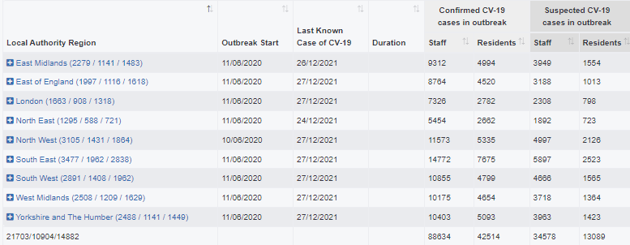
Care Homes – Outbreak data (as of 09:30 hrs 25/01/2022)
30711 outbreaks* have been reported since reporting began on 11/06/2020. Providers may have reported multiple outbreaks during this time (last week's data: 30211)
9008 outbreaks* are still ongoing (last week's data: 8701)
21703 outbreaks* are recovered (last week's data: 21509; 194 recovered over the last week)
500 outbreaks* were triggered in the last week (last week's data: 986)at
*NB. Valid outbreaks only – Invalid outbreaks have been excluded. Invalids are those where the provider reported 2 or more cases, resulting in an outbreak trigger, but then subsequently amended their daily figures to less than 2 cases. Note, outbreak numbers may reduce if locations become inactive following a CQC deregistration. Inactive locations are not included in figures.

Slide 7
Care Homes – New Outbreaks by ENGLAND Total (as of 09:30 hrs 25/01/2022)
Outbreaks are triggered based on PHE definition: an outbreak starts where the provider reported 2 or more new cases within a 14 day period.

Slide 8
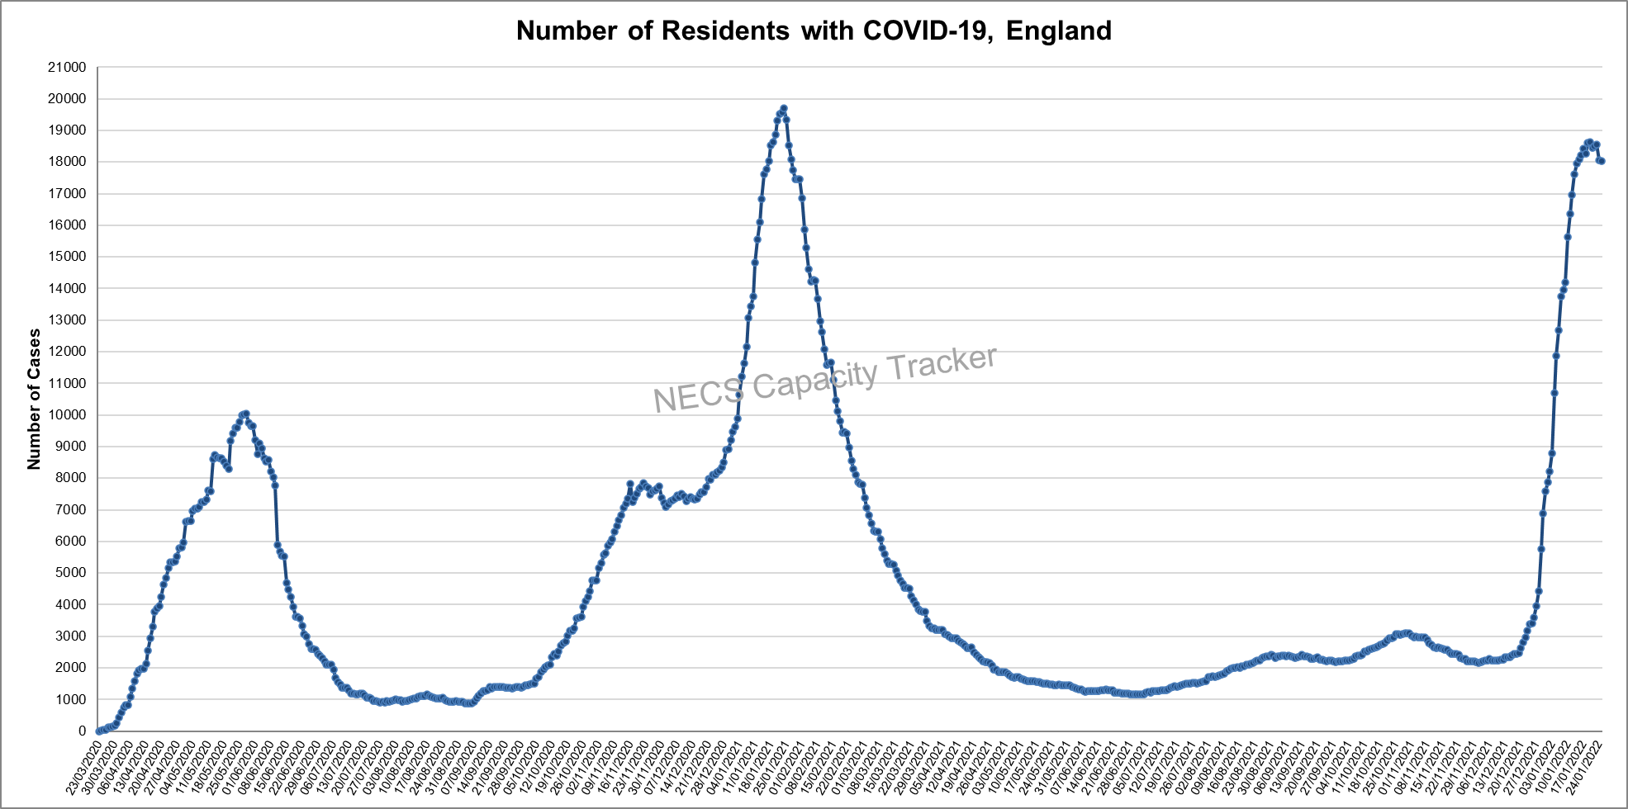
Capacity Tracker: Care Home COVID-19 Cases By ENGLAND Total (as of 09:30 hrs 25/01/2022)
Reported cases peaked nationally during May 2020, January 2021 and January 2022.

Slide 9
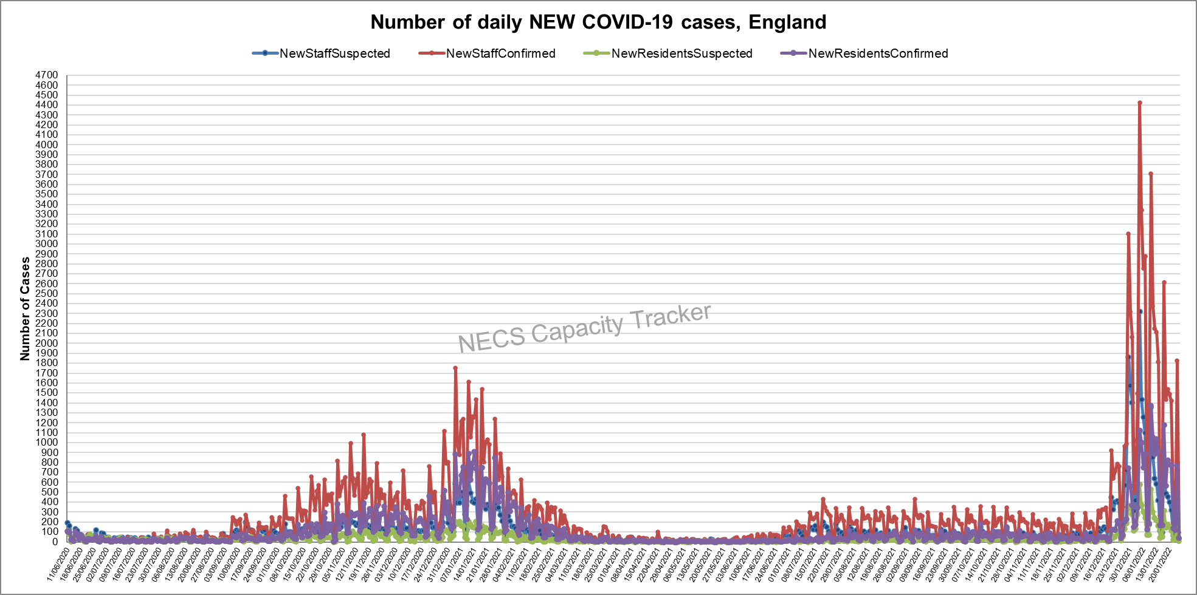
Capacity Tracker: Care Home NEW COVID-19 Cases By ENGLAND Total (as of 09:30 hrs 25/01/2022)
Data since reporting began on 11/06/2020. After large increases in December 2021, January is seeing a decline.

Slide 10
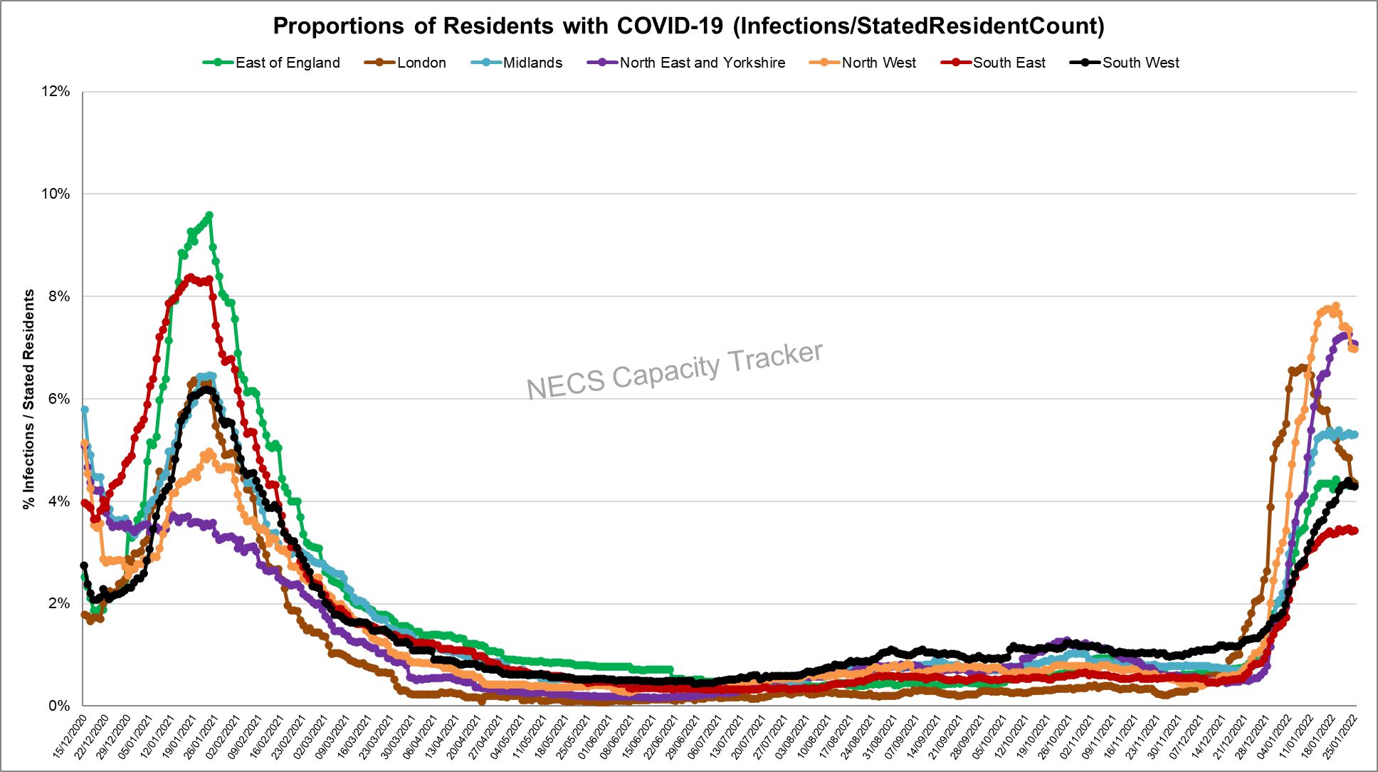
Capacity Tracker: Care Home Infection Rates By Region based on Resident Count
(as of 09:30 hrs 25/01/2022)
Infection rate: Number of Resident cases / Resident Count (reported from 11/12/20)
North West and North East and Yorkshire currently highest, with all regions showing relative consistency week on week.

Slide 11
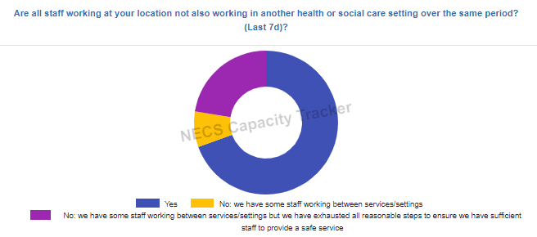
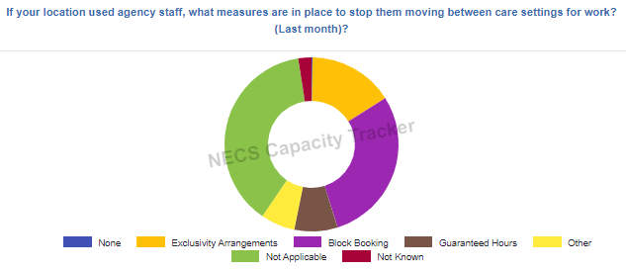
Capacity Tracker: Infection Prevention (as of 09:30 hrs 25/01/2022)

Slide 12
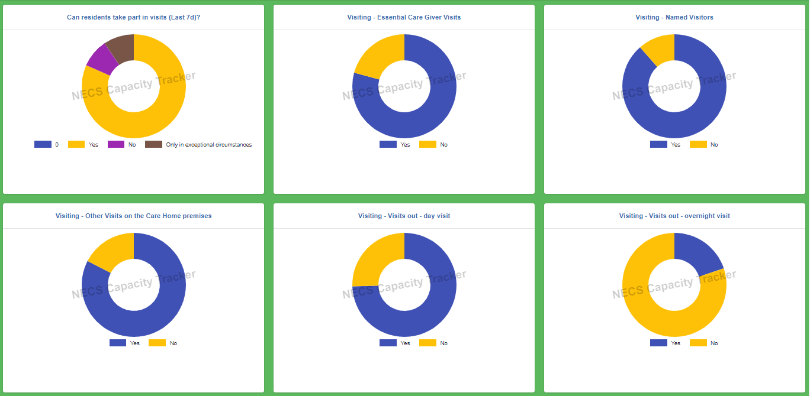
Capacity Tracker: Visiting (as of 09:30 hrs 25/01/2022)

Slide 13
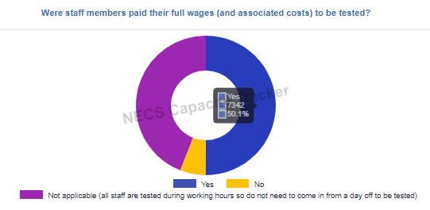
Capacity Tracker: Staff Testing (as of 09:30 hrs 25/01/2022)

Slide 14
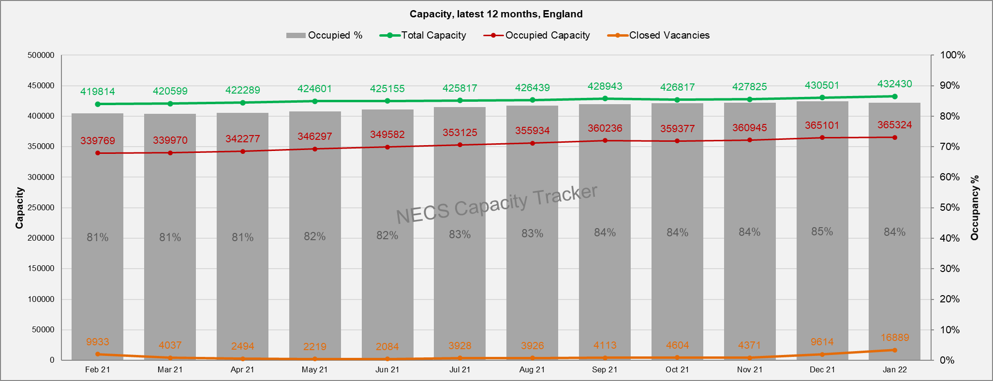
Capacity Tracker: Care Home Monthly Derived Occupancy Rates (England) (as of 09:30 hrs 25/01/2022)
Occupancy rates show an increase from July 2021 with current position at 84% nationally in January to date.
Occupancy / Used Capacity is derived from CQC registered capacity minus declared vacancies.

Slide 15
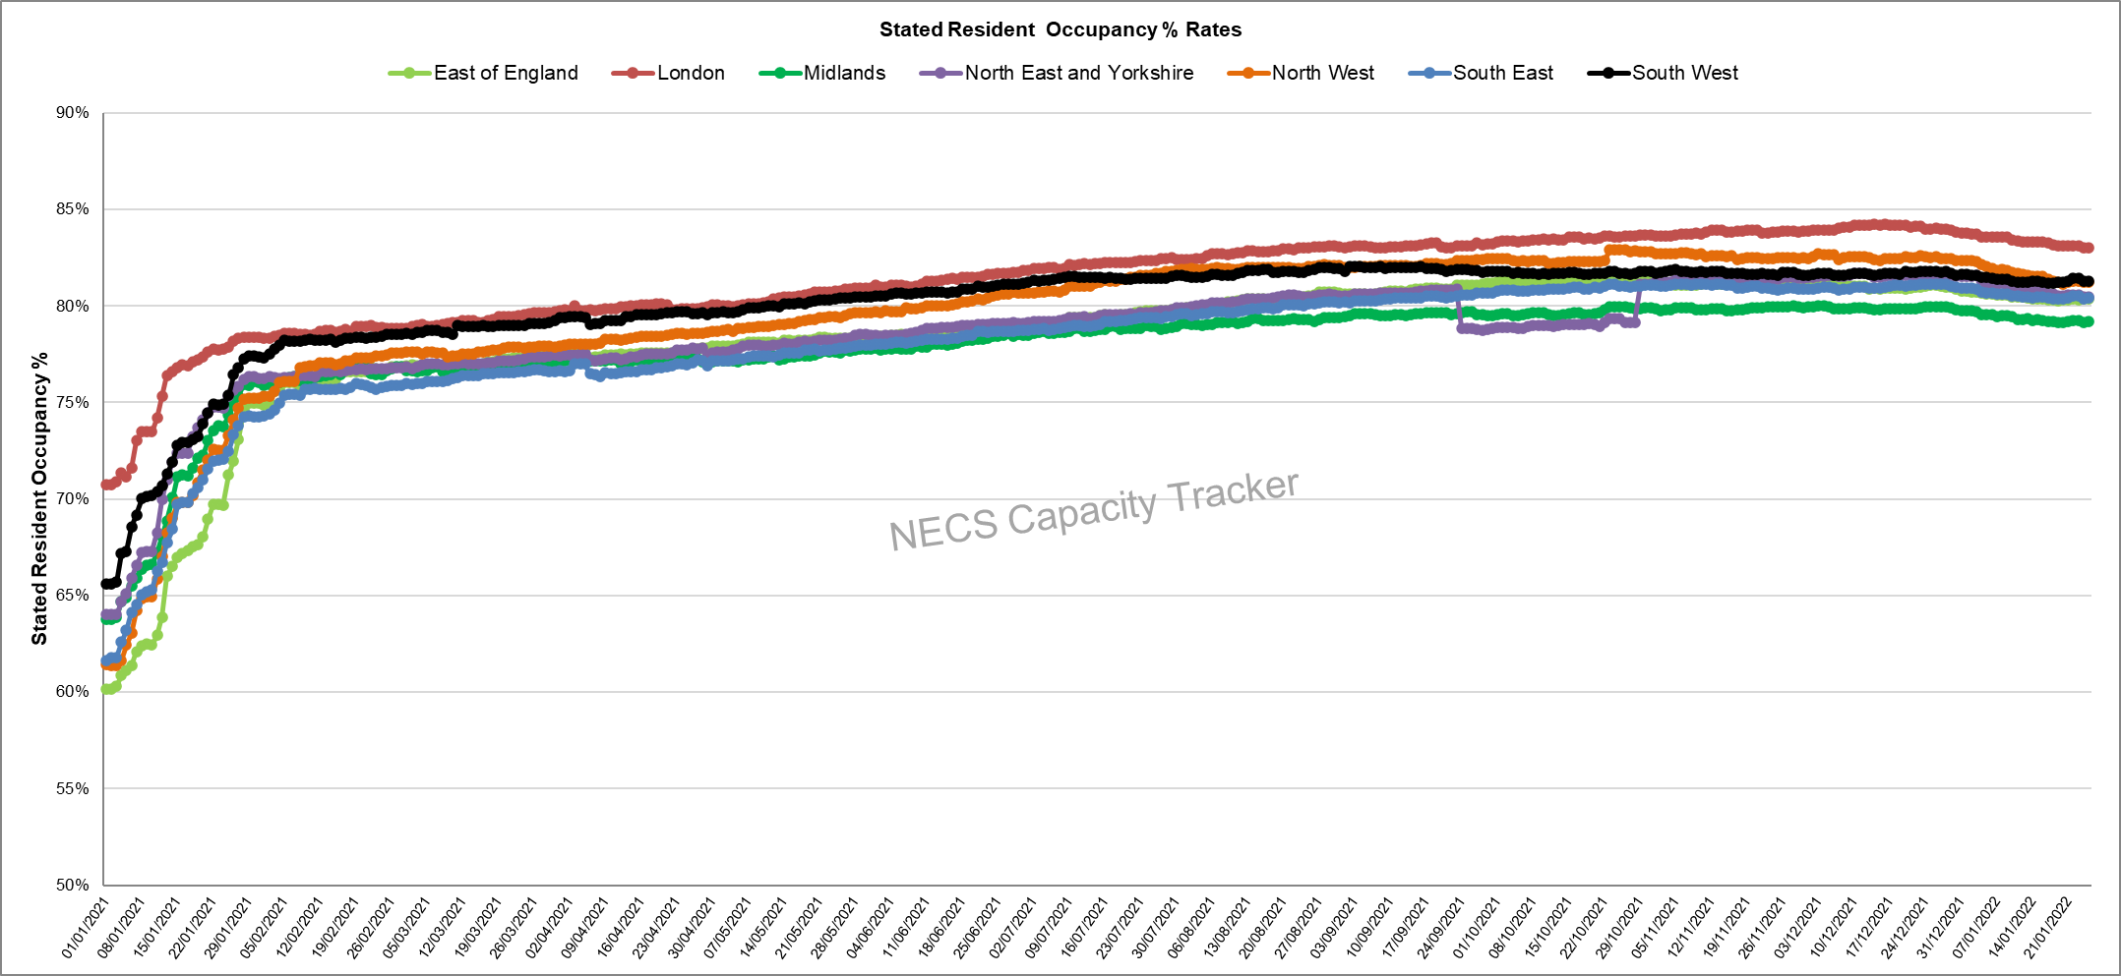
Capacity Tracker: Care Home Daily Stated Occupancy Rates by Region (as of 09:30 hrs 25/01/2022)
Daily rates captured from 11/12/20. Stated resident occupancy rates have decreased over recent weeks, with London showing an above average occupancy rate.

Slide 16
Homecare

Slide 17
Capacity Tracker Homecare Survey Data
Reported within the last 7 Days (as of 09:30 hrs 25/01/2022)
4788 (49%) providers updated homecare survey data in previous 48hrs; 7595 (77%) in previous 7 days
[last week's data: 4895 in 48 hours (50%), 7470 in 7 days (76%)]

