Slide 1



Live Care Home Bed Capacity
September 2018
Ruth Davey
NHS London Purchased Healthcare
Ruth.Davey1@nhs.net | 02036881934
Ruth Holt
Director of Nursing/Independent Care Sector Regional Lead NHS England (North)
ruth.holt3@nhs.net | 07717 480397

Slide 2

Why do we need capacity tools?
The care home market is significant
  16,000 care homes with 460,000 beds
  36% growth in persons aged 85+ will lead to a substantial increase in demand
Care homes face a number of challenges
  Residents have increasingly complex needs
  Rigorous reporting requirements
  Staff turnover and frequent recruitment
  Financial pressures
  Health and social care services use the same care homes
    Sharing information online creates efficiency for everyone
    A joint resource encourages greater partnership working
    Sends a consistent message to the market

Slide 3
The Challenge
Choosing an appropriate care home is an important decision for patients, families and health care staff. It is informed by:
Location Quality Services Availability
For discharge teams, it is time-consuming and frustrating because this information is not always available and can be difficult to collect.
For care homes, responding to multiple capacity requests from different organisations removes staff from care delivery.
National DTOC analysis cites waiting for care home placement or availability as a contributing factor for days delayed.

Slide 4
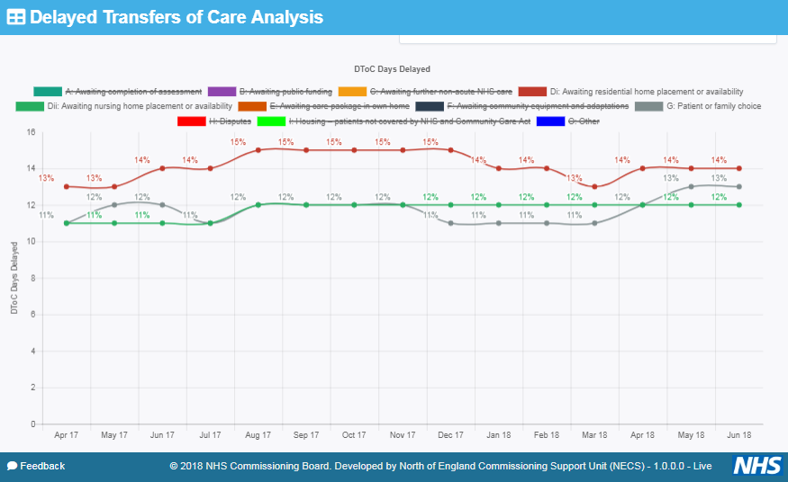
Helping Health & Social Care to Minimise DTOCs
DTOC Days Delayed – National (%)
Awaiting nursing home placement / availability
Awaiting residential home placement / availability
Patient or family choice

Slide 5
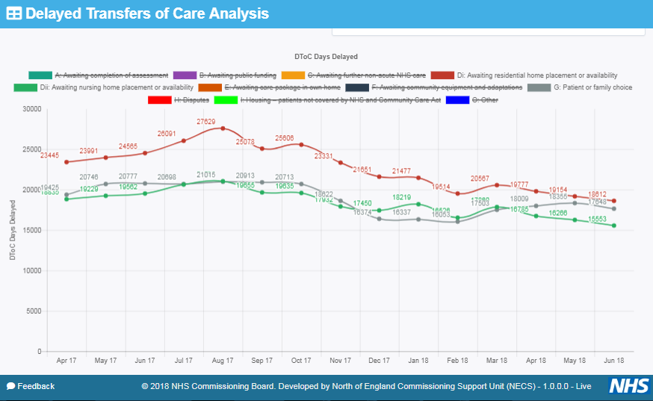
Helping Health & Social Care to Minimise DTOCs
DTOC Days Delayed - National
Awaiting nursing home placement / availability
Awaiting residential home placement / availability
Patient or family choice

Slide 6
The Benefits
Live data available on demand
Central database supports market management
Supports greater partnership working and integration
Improves patient choice
Helps reduce DTOC
Directory of all providers encourages market sustainability
Enables focus on care delivery
Daily updates
Live Bed State Systems are used once the decision has been made that an individual requires care in a care home

Slide 7
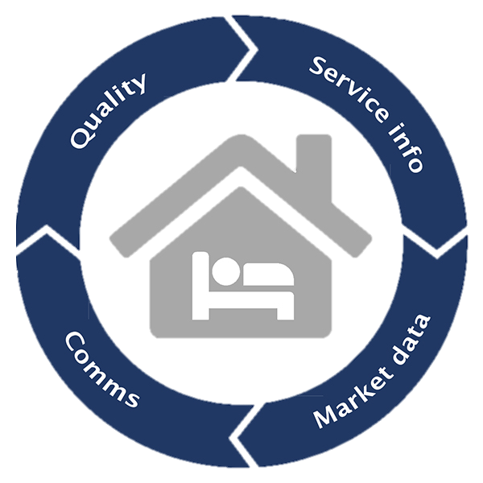
Case Study 1: CarePulse Capacity Management System
CarePulse helps improve patient flow from acute settings and helps reduce DTOCs.
Every care home in London is searchable on the system, but it is not just about vacancies...
CarePulse brings together other service elements for greater efficiency and information sharing to:
  Improve patient flow
  Support care quality monitoring
  Enable market management
  Create provider communication channels

Slide 8
Case Study 1: CarePulse Capacity Management System
Example care home profile

Slide 9
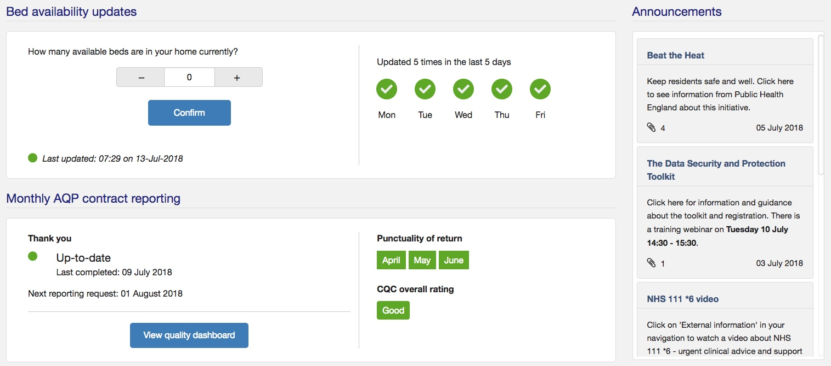
Case Study 1: CarePulse Capacity Management System
Example care home interface

Slide 10
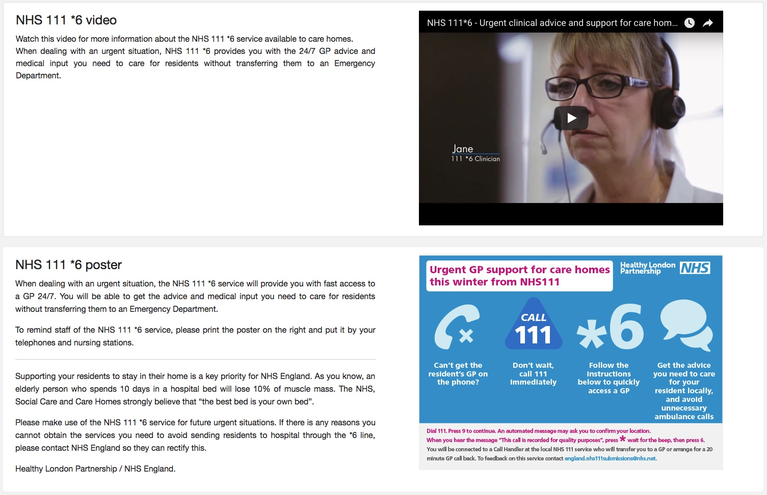
Case Study 1: CarePulse Capacity Management System
Example resource centre content

Slide 11
Case Study 1: CarePulse Capacity Management System
“I use CarePulse on daily basis.”
“Selecting options such as over 65 and dementia makes the placement process easier.”
“Informs my quarterly monitoring meetings with homes.”
“Able to complete out of borough placements quickly.”
“I find it a very useful tool in finding/making placements.”
“Provides up to date quality information.”
“I am able to give a wider choice to families.”
“I use CarePulse to search for homes in particular geographical locations.”
“Easy to use, very user friendly. I like that I can filter by location.”
“Reduces time contacting nursing homes.”
“Quick access to vacancies without having to rely on emails.”
User feedback

Slide 12

Case Study 2: Optimising Patient Flow Using Capacity Tracker
Aim: Reducing Delayed Transfers Of Care
Including stranded & super-stranded patients
Extensive user coverage supports repatriation and expatriation
DTOC benchmarking & monitoring
Compare Trusts by sector & Trust DTOC ‘Storyboard’
We are
NHS Digital IG Toolkit Compliant
100%
Inter –operability
using APIs
we can link into any other information system
Domiciliary Care
in development
‘Home First’ Strategy
DTOC Analytics
Including overlaying Spare Beds with reported DTOCs
Care Home market oversight
Region, sub-region, STP, CCG, Local Authority views
Rapid access to bed vacancies
Including from any mobile device

Slide 13
Developing the Model
There is a mixed economy of e-bed state tools in North Region but our market leader is Capacity Tracker:
5300+ registered users
Including 60 CCGs & 53 LAs nationally
2400+ care homes are registered and update their live bed state
27 CCGs implemented CT across the North Region
There is a pipeline of 10 more CCGs
  By October 2018 Capacity Tracker will provide 60% coverage in North region
  Overall coverage with an e-bed state tool will be 84%
  A Home Care application is in development

Slide 14
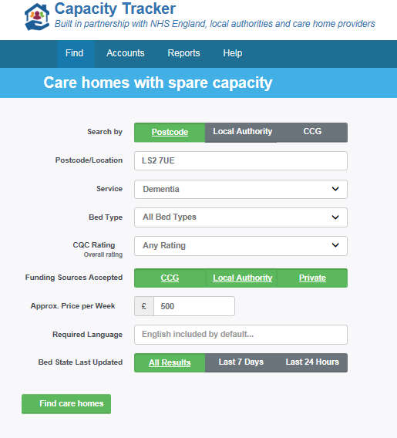
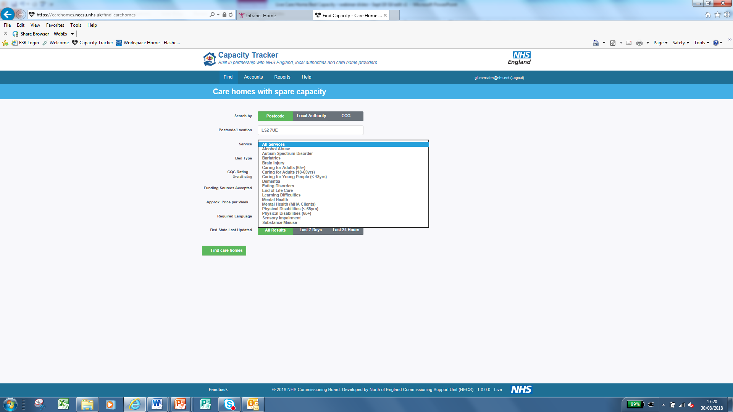
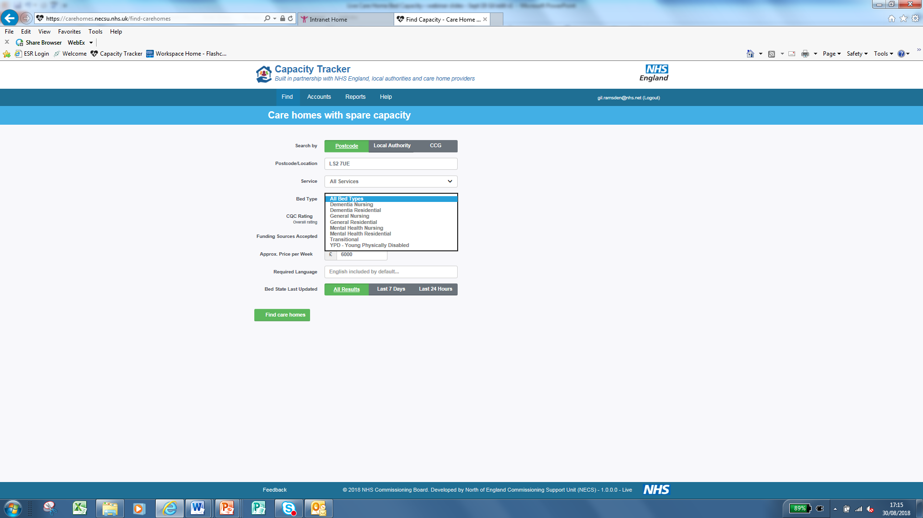
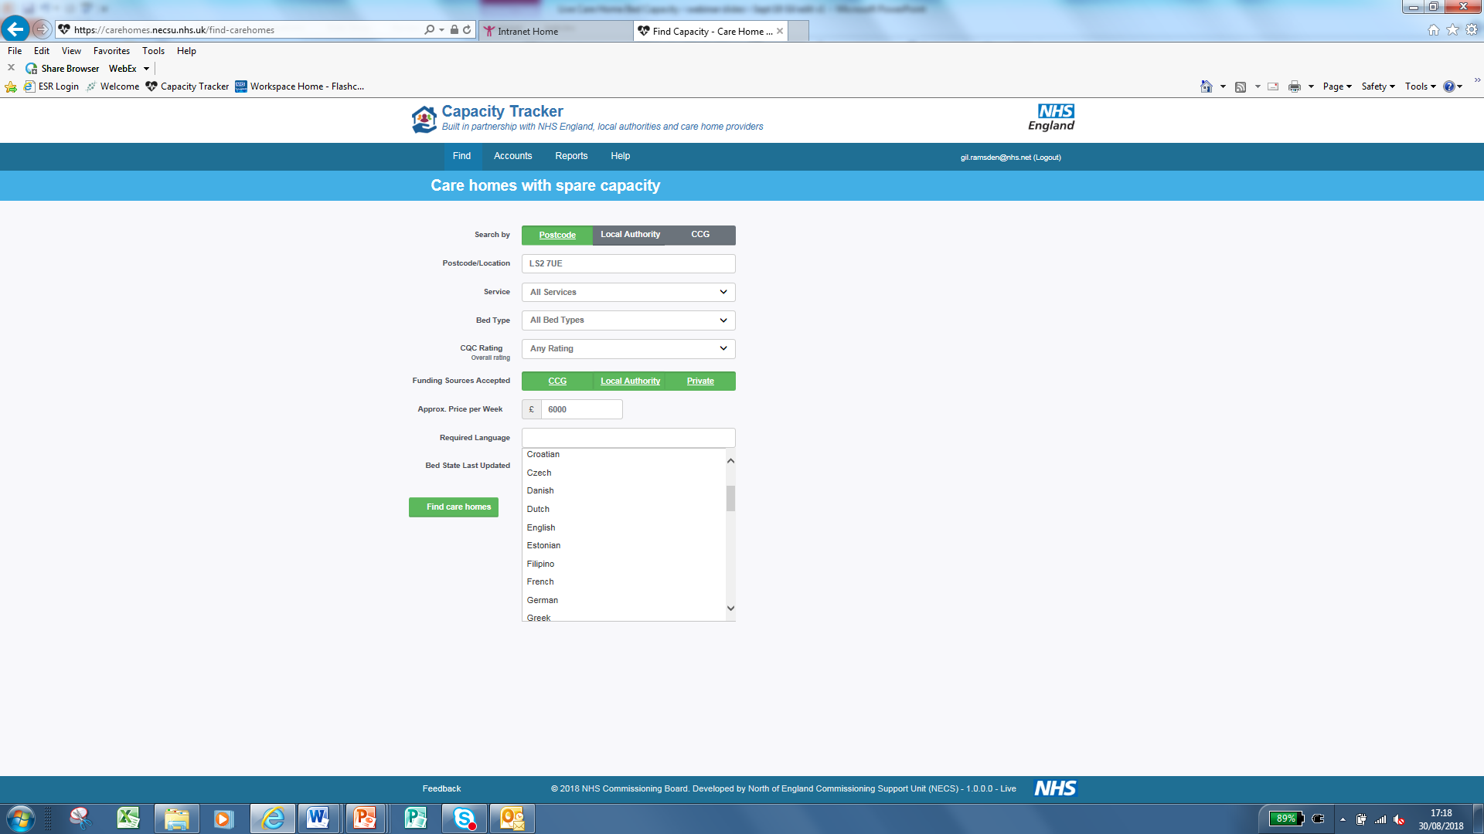
How to find a care home

Slide 15
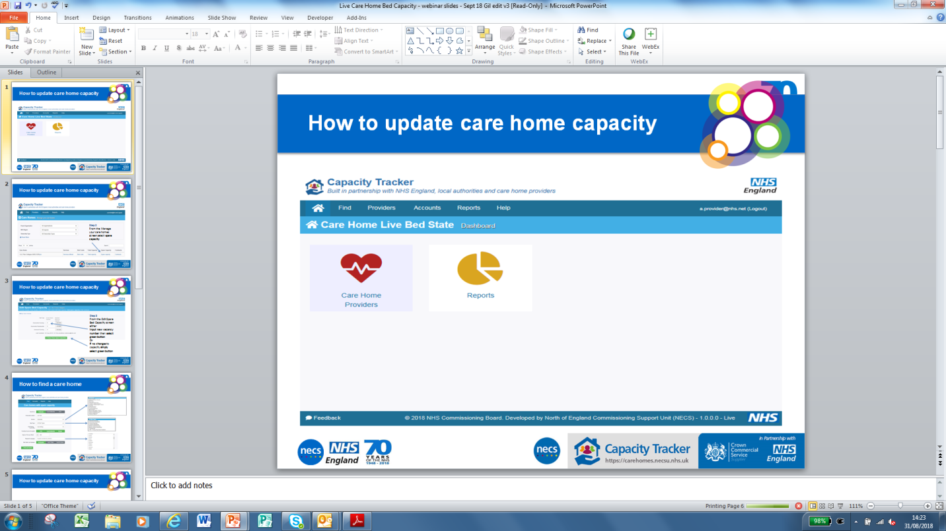
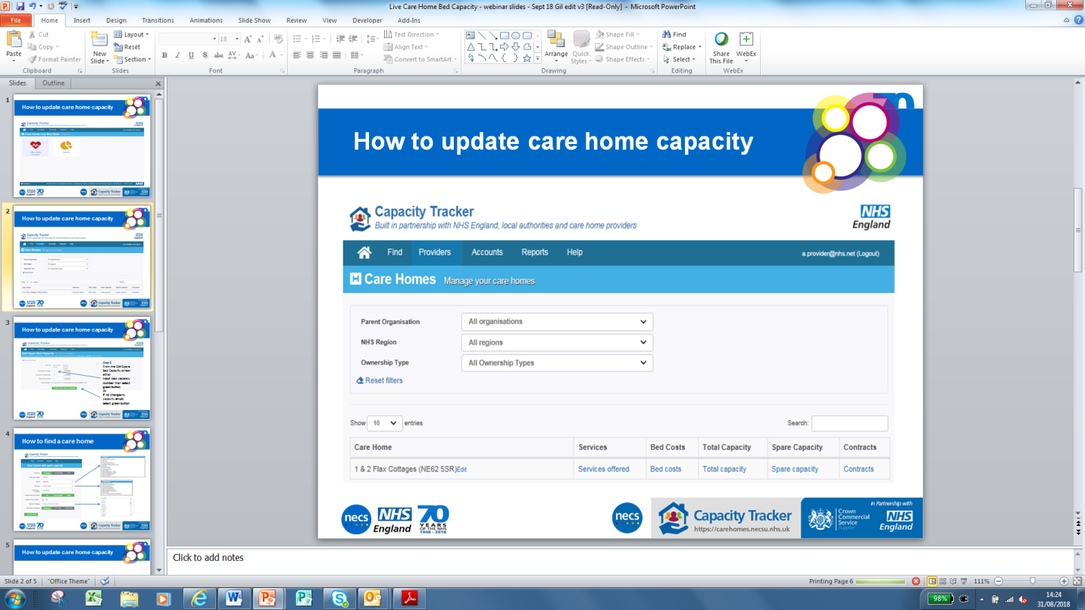
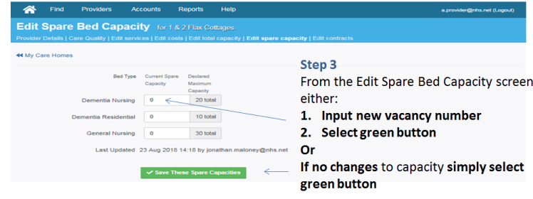
How to update care home capacity in 3 easy steps
Step 2
Step 1
Step 3

Slide 16

Developing the model in Sheffield
Sheffield has 103 care homes
100% use Capacity Tracker
What worked really well | Challenges we faced
We improved engagement and visibility of capacity, flow and demand through partnership working with Sheffield CCG Sheffield City Council Sheffield Teaching Hospitals NHS Foundation Trust | Engaging with the acute trust effectively Embedding Capacity Tracker into business as usual
This meant:
We could: Better support winter pressures Improve overall system visibility | We needed to: Revisit how we engaged with the acute trust

Slide 17
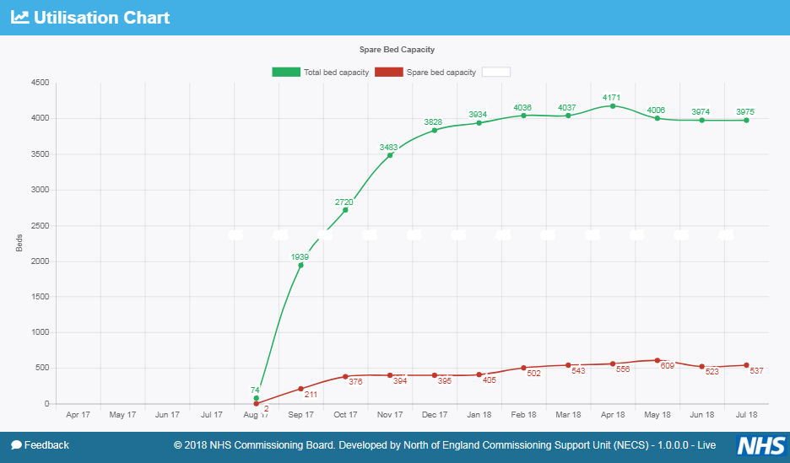
Mobilisation of the Capacity Tracker Across Sheffield
It took about 4 months to fully engage all care homes, but about 50% were on boarded within 2 months
Notes:
Newton Europe’s interventions and the Trust’s review of its discharge systems and processes in early 2017 started to make a significant impact on DTOC rates.
In August 17 Sheffield CCG & City Council started to mobilise the Care Home Live Bed State (now branded as the Capacity Tracker).
Unify data has a 2 month time lag so the first data showing impact would be October
Note the significant improvement in DTOCs due to lack of Residential Home vacancies between August and October
With different initiatives and process changes happening it’s difficult to prove cause and effect

Slide 18
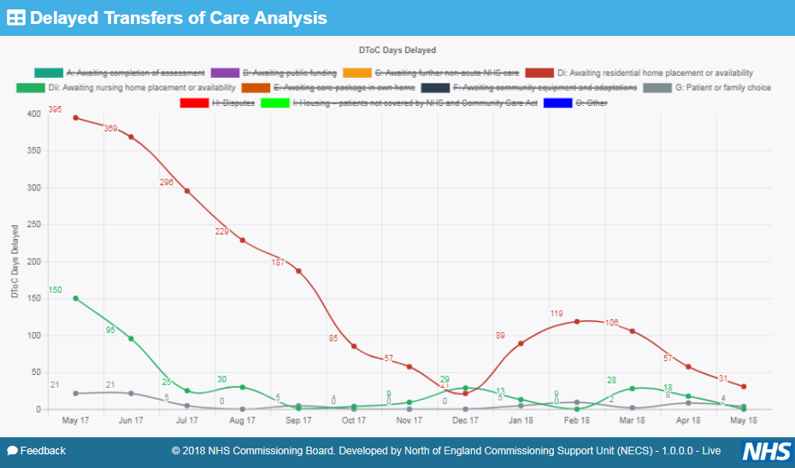
Tangible Benefit of Using Capacity Tracker in Sheffield FT
Awaiting nursing home placement / availability
Awaiting residential home placement / availability
Patient or family choice
Capacity Tracker
Mobilised in August 17
Virtually eliminating DTOCs due to
Nursing, Residential placements
and Patient/Family Choice
This terrific reduction in DTOCs made a huge difference to patients
Notes:
Newton Europe’s interventions and the Trust’s review of its discharge systems and processes in early 2017 started to make a significant impact on DTOC rates.
In August 17 Sheffield CCG & City Council started to mobilise the Care Home Live Bed State (now branded as the Capacity Tracker).
Unify data has a 2 month time lag so the first data showing impact would be October
Note the significant improvement in DTOCs due to lack of Residential Home vacancies between August and October
With different initiatives and process changes happening it’s difficult to prove cause and effect

Slide 19
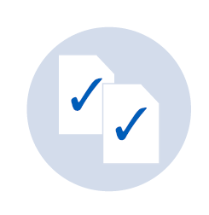
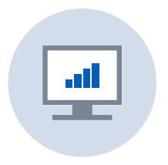
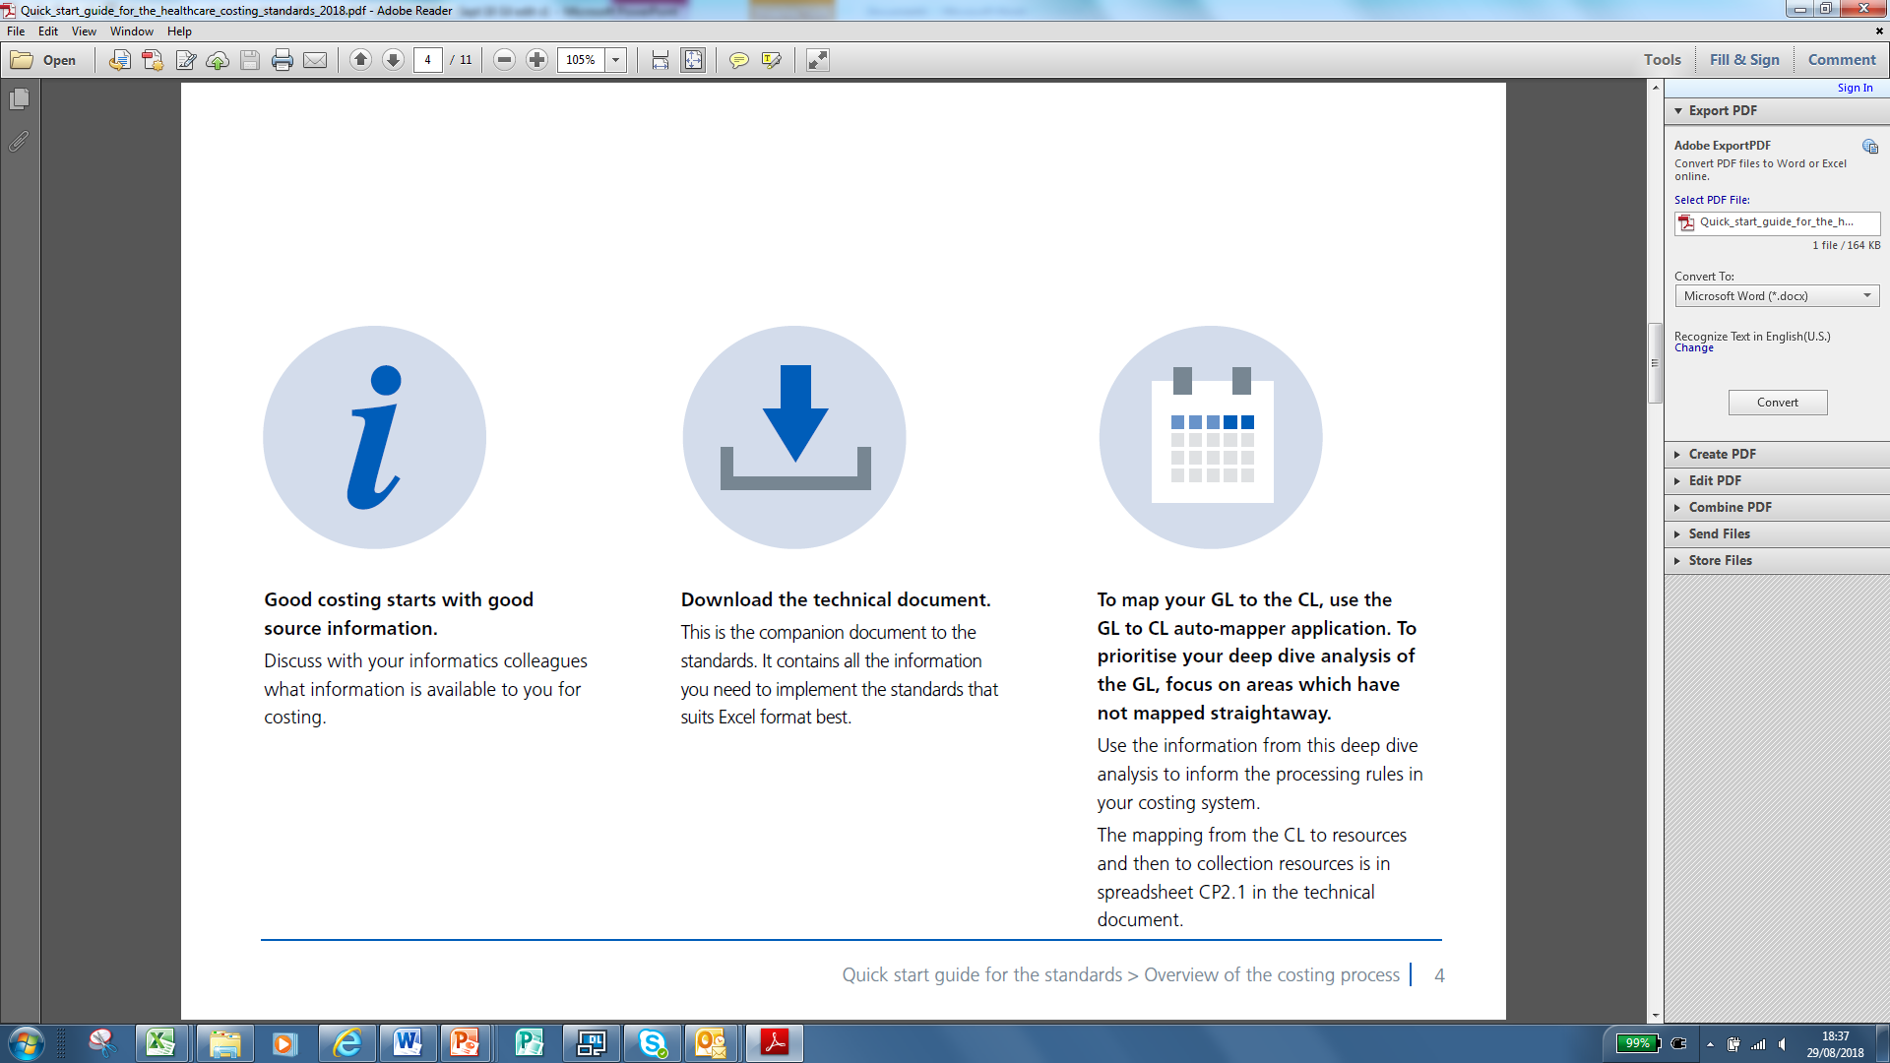
Applying our collaborative co-design approach
Working in collaboration with system colleagues (including care home managers and colleagues from LAs, CCGs and STPs) we:
Identify ‘System Champions’ to facilitate communication – this means the care sector is empowered and engaged through all stages.
Share learning, new knowledge and best practice with our system- user group.
Identify critical issues/successes through weekly WebEx meetings.
Agree the strategy to set ‘the way forward’; it includes a communication and engagement plan.
Set priorities in terms of importance from a short & medium term position.
Develop an action plan addressing key issues and challenges; it has a mobilisation strategy and monitoring procedures built in.
Outline governance processes, including roles, responsibilities and accountabilities, ensuring ‘fit’ with the overall vision for all parties.
Notes:
In collaboration with system colleagues (STP, CCG, LA) agree the strategy which will set ‘the way forward’
Outline clear governance processes, including roles, responsibilities and accountability, ensuring this fits with the overall vision of all parties
Develop an action plan that addresses key issues, challenges, setting priorities in terms of importance from a short term & medium tern position
Identify critical stakeholders, communication and engagement plans
Identify critical ‘system champions’, a pivotal component to facilitate communications - Care Sector are empowered and engaged at all stages
Together agree mobilisation strategy, with the short and longer term elements and monitoring procedures built in
Weekly WebEx meetings identify critical issues/successes
Collaborative meetings monthly
Essential that shared knowledge/best practice disseminated to the system – user groups

Slide 20
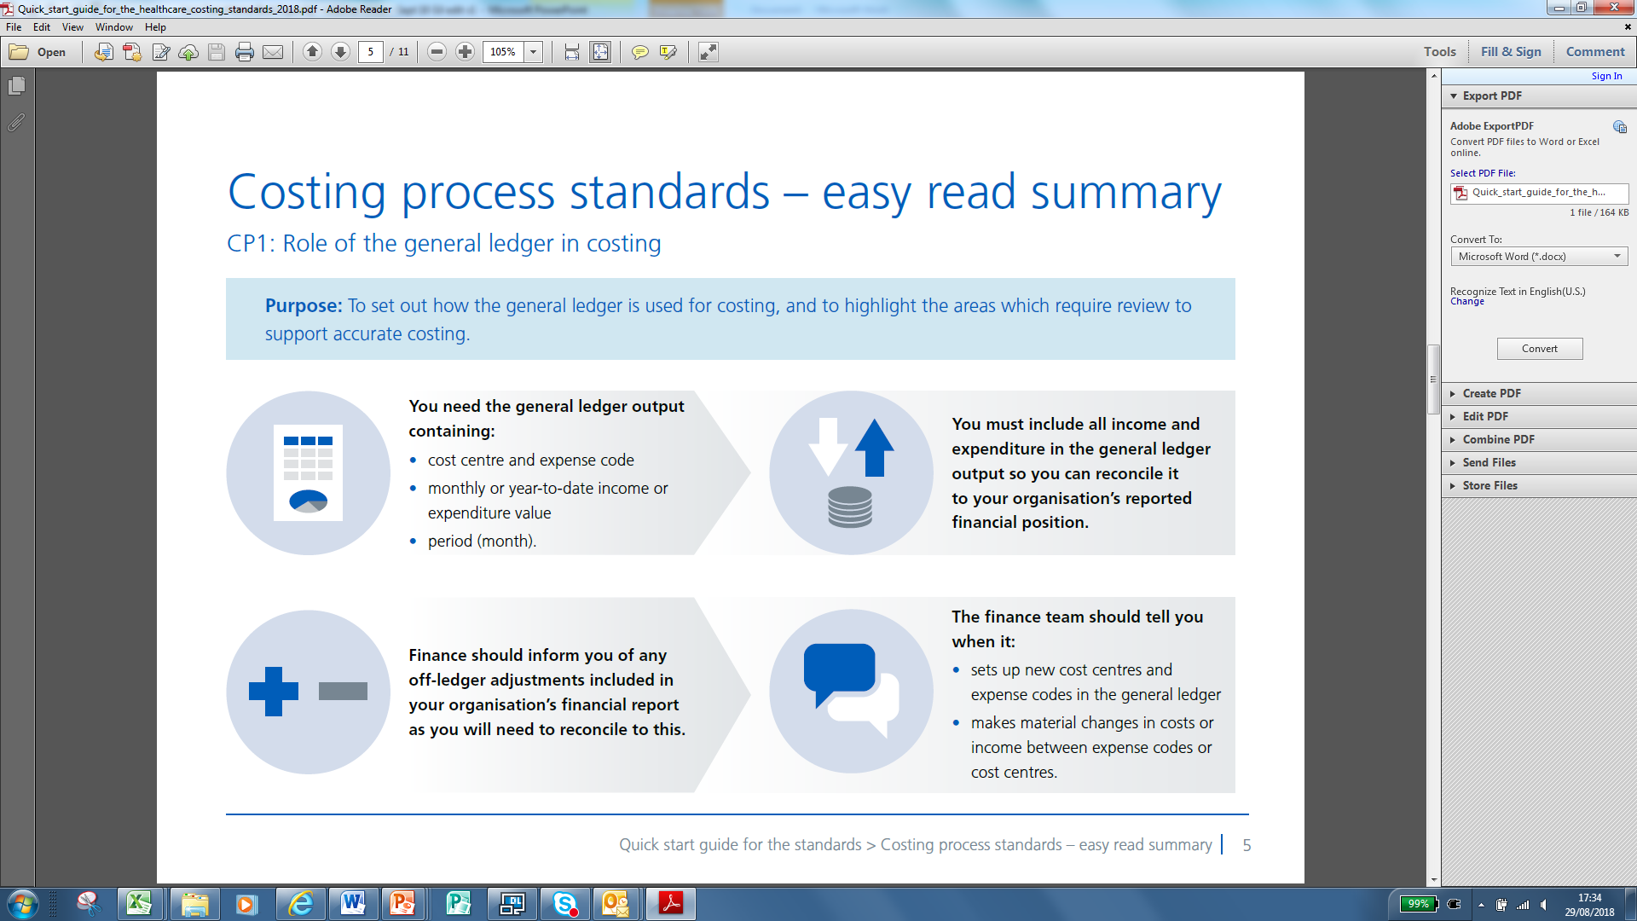
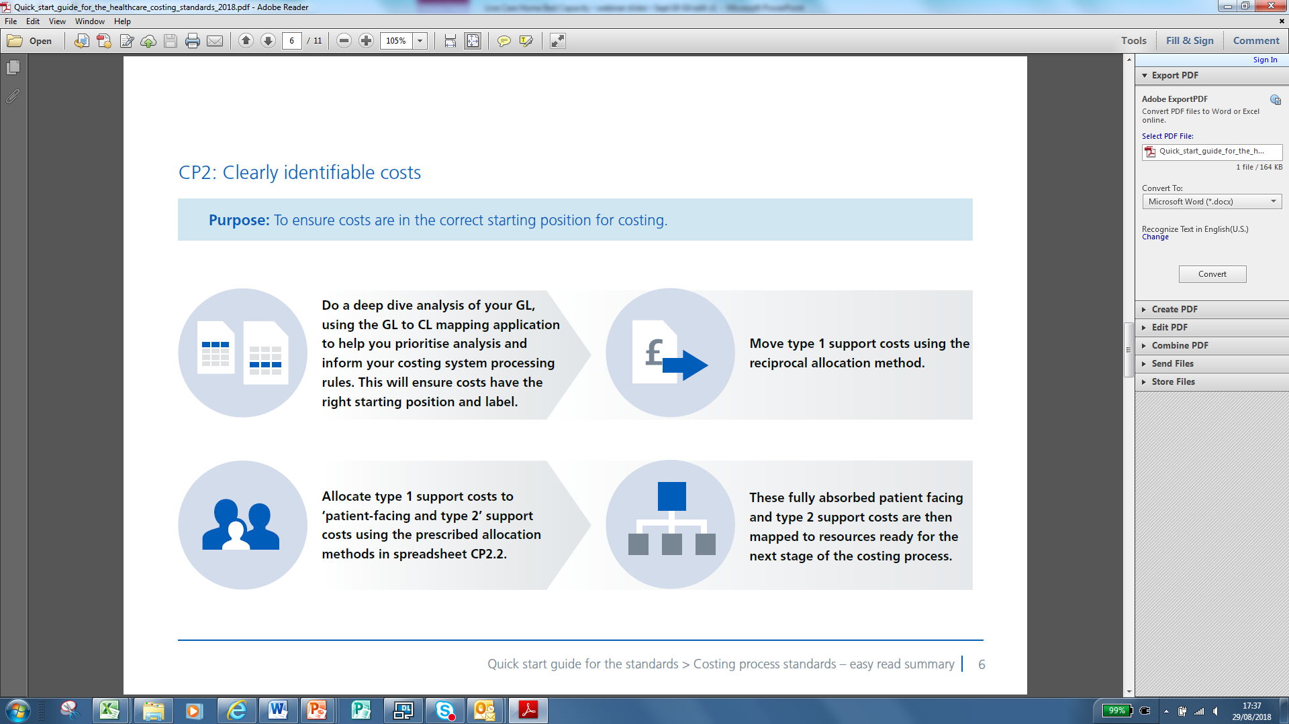
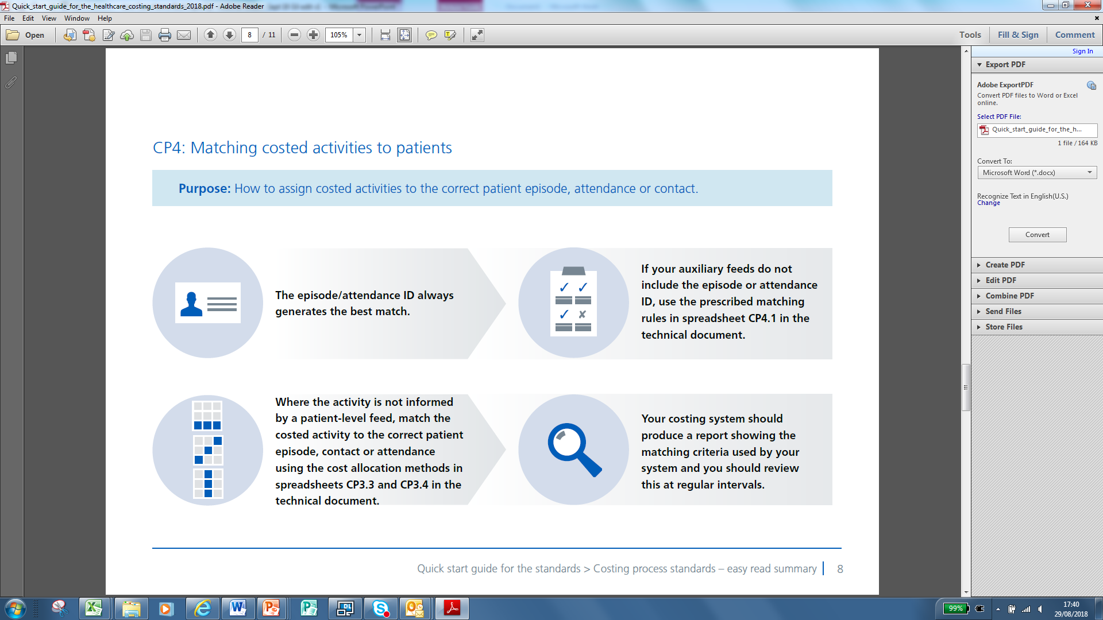
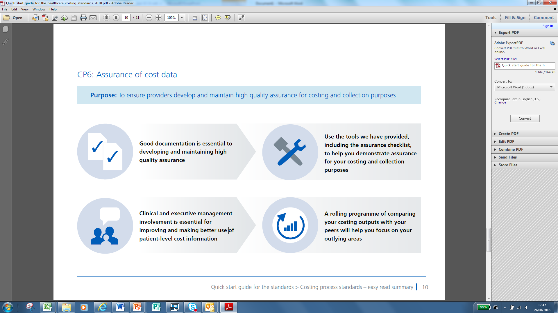
Emerging Benefits
Care homes report that LA & NHS colleagues are making fewer calls enquiring about vacancies; admin time is redeployed into caring activities
The system could be a significant support mechanism for the emerging role of brokerage/resource management
Commissioning teams have used Capacity Tracker to look at demand capacity, and used information to influence commissioning decisions
Work is currently underway to assess the impact on patient pathways
Notes:
Local teams from Sheffield City Council (SCC) are actively engaging with the system
The number of enquiries received from teams about accessing the portal has reduced
Care homes report SCC are making fewer calls to homes
The system could be a significant support mechanism for the emerging role of brokerage/resource management
SCC commissioning teams have used the portal to look at demand capacity
Informs commissioning decisions
Work is currently underway to assess whether there has been any impact on the patient pathway

Slide 21
Case Study 2: Capacity Tracker
Really good system, the number of telephone calls from the hospital has reduced as at one point we were receiving three to four phone calls a day asking what our bed vacancies were. It’s very easy to set up and use.
Registered Manager, Nursing Home
Very positive about it; the fact that as a glance we can find beds to fast-track. Also realising additional benefits like infection outbreaks and impact on system.
Manager CCG
Capacity Tracker is simple to use - but should there be any issue, then we get the necessary support from NECS. We recently stopped the phone arounds to identify vacancies, and this significantly increased the engagement from Care Homes, as they appreciated the Capacity Tracker enabled them to 'advertise' their vacancies free of charge to professionals working with potential residents and their families.
Manager, Local Authority
The portal is easy to use and not time consuming which is always a worry when a new process is implemented. I like the fact that the system reminds me to update it as we are very busy.
Registered Manager, Residential Home

Slide 22

Questions?
Ruth Davey
NHS London Purchased Healthcare
Ruth.Davey1@nhs.net | 02036881934
CarePulse: carepulse.co.uk/registration/
Ruth Holt
Director of Nursing/Independent Care Sector Regional Lead NHS England (North)
ruth.holt3@nhs.net | 07717 480397
Capacity Tracker: https://carehomes.necsu.nhs.uk

