Slide 1

An update from CQC
Sir Julian Hartley
Care England Conference
Thursday 13 March 2025

Slide 2








Reflections
Notes:
Opportunity for you to speak directly to the ASC audience on why you took the role at CQC, your experience and how that aligns with the ASC world

Slide 3





Re-building a trusted approach to our regulation
Leadership and expertise
Reviewing our assessment framework
The changes we’re making are focused on enabling us to complete more and better-quality assessments at a faster pace.
This will provide a more up-to-date view of quality across health and social care.
Inspection and technology
Working in partnership
Notes:
This slide is animated
Setting the scene for acknowleging the challenges CQC has faced over the last year, but there is a plan for moving forward

Slide 4
Leadership and expertise
Recruiting 4 permanent Chief Inspectors
Working to align our assessment teams under Chief Inspectors and around areas of sector expertise
Integrating our Operations and Regulatory Leadership reflecting recommendations from independent reports
Reviewing our assessment framework
We are considering all independent report findings and feedback from our engagement to review our assessment framework.
We have already made changes to our methods for provider regulation. These include:
  Discontinuing scoring at evidence category level
  Reviewing how we use quality statements for each assessment
  Reviewing how we use our professional judgement when producing a final rating
https://www.cqc.org.uk/about-us/improving-how-we-work
Notes:
Leadership and expertise
I was appointed as CEO and we have started recruitment for 4 permanent Chief Inspectors expected to start in the Spring.
They will lead on regulation and improvement in hospitals, primary care, mental health services and adult social care services.
We will align our assessment teams under Chief Inspectors and around areas of sector expertise.
We are further integrating our operations and regulatory leadership teams to reflect recommendations made in the independent reports.
We have invested £2 million to support resourcing our assessment workforce and increasing inspection activity.
Included here:
One foundational improvement – integrating operations and regulatory leadership

Slide 5
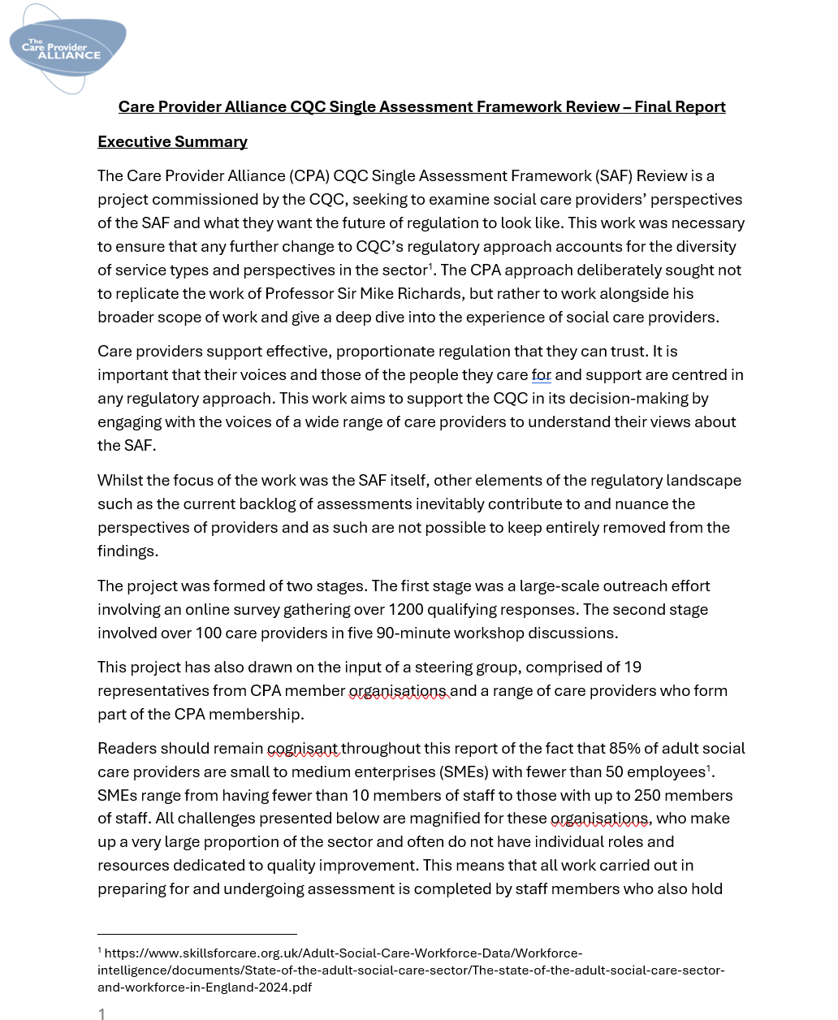
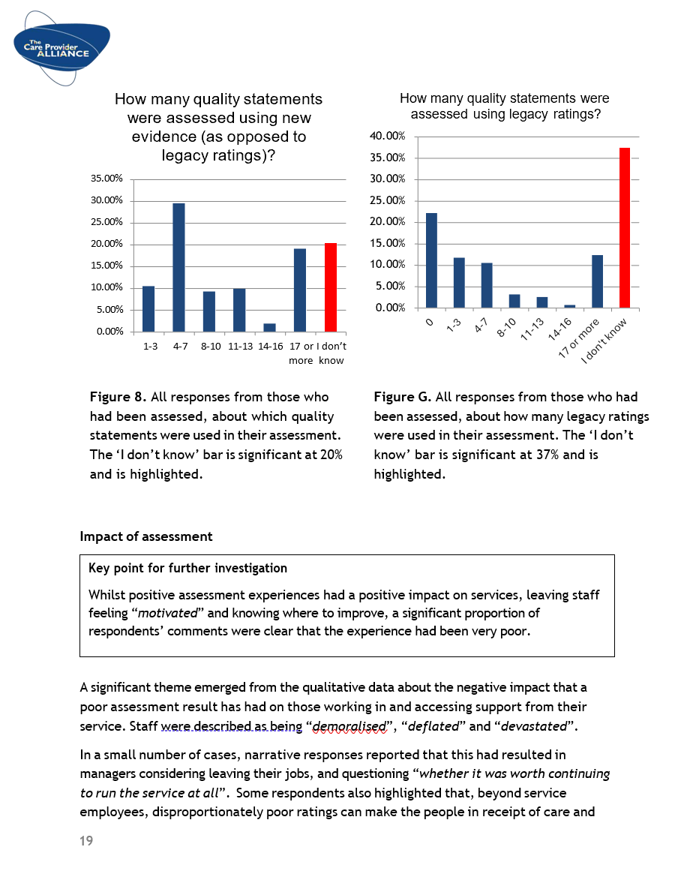
Care Provider Alliance's review
We commissioned the Care Provider Alliance (CPA) to review our single assessment framework alongside the review by Professor Sir Mike Richards.
We are grateful to the members of the CPA who took part in and supported this work.
The review examined the perspectives of adult social care providers of the assessment framework and what they want from regulation by CQC.
It also raised provider concerns about assessment, registration, and backlogs.
11 recommendations in the report and key messages in the survey, which we will now work on in more detail to consider their implementation.
We see good alignment between the recommendations in this report and the work that we have already started to rebuild good regulation.
https://www.cqc.org.uk/news/our-response-care-provider-alliances-review-single-assessment-framework
Notes:
We commissioned the Care Provider Alliance (CPA) last autumn to review our single assessment framework alongside the review by Professor Sir Mike Richards. We are grateful to the members of the CPA who took part in and supported this work.
The review examined the perspectives of adult social care providers of the assessment framework and what they want from regulation by CQC. It also raised provider concerns about assessment, registration, and backlogs.
Our response
There are 11 recommendations in the report and key messages in the survey, which we will now work on in more detail to consider their implementation. Some recommendations will be subject to further discussion, policy change or consultation. The recommendations are detailed below.
We are already taking urgent action on our priority improvement workplan to address concerns about our performance on backlogs, assessment frequency, registration delays, and publication of reports. We see good alignment between the recommendations in this report and the work that we have already started to rebuild good regulation.
As we are currently delivering organisational change and improvement, it will be important to consider the CPA report’s recommendations effectively alongside existing work. We are determined to improve providers’ experience of regulation with the development of a handbook which describes what we expect from providers, what they can expect from CQC, as well as giving our staff the tools and time to do their job. We are strengthening sector leadership in CQC and want to continue to work with the CPA to oversee progress. This report provides a good agenda for shared work over the coming months.
Recommendations
Create a reduced set of quality statements (the specific numbers suggested by providers were all under 20) and assess all providers on a consistent set of statements for every routine inspection. This should reflect a meaningful reduction in the burden that the assessment framework imposes on providers, rather than condensing the same workload into a smaller set of quality statements.
The ‘standard set’ of quality statements applied to each service type may flex to the elements of service delivery most relevant to them
Shared Lives providers were the only group to differ in this regard and would prefer flexible and more frequent assessment drawn from a reduced set of quality statements.
Create guidance for each service type at the quality statement level. Each set of guidance should include specific examples of what good and outstanding looks like and highlight where an aspect of a quality statement is not applicable to the service type.
Use the information in the Provider Information Return to plan a timeline, CQC staffing, and priorities for assessment.
Share this assessment plan, including evidence requests, with providers and give them advance notice of inspection.
Evidence requests, assessment timelines, and number of inspectors must be reasonable and proportional in their scale of demands on services.
Ensure that evidence included in decision-making has been corroborated rather than taken at face value, to produce a balanced appraisal of the service and is not wholly focused on finding issues or risk.
Detail efforts made to triangulate information in the report.
Increasing the rate of inspections does not help providers or the public if the assessment process and report are not meaningful and reflective of the findings on the day of inspection.
Re-write the reports of providers who have been assessed in the period of time between the implementation of the SAF and the stabilisation of the regulatory approach to a consistent and meaningful process.
Develop a shared, meaningful approach to co-production with providers for use in further work to be completed during CQC’s ongoing recovery programme.
Re-introduce a single point of contact/named inspector for providers
Train inspectors, with the involvement of care providers, to understand and respect each type of care service and the people that they support.
Establish an independent body to mediate all complaints and challenge processes.
Ensure that this is fully accessible and able to support smaller providers who may not have the same level of resource to commit to these processes.
Ensure that all changes in regulatory approach thus far and in future are effectively communicated to all inspectors to reduce inconsistencies in implementation. Communications to providers about changes expected at CQC should be accompanied by achievable timescales for completion.

Slide 6
The action we’re taking
Sector Feedback
Immediate Actions
Unblocking ‘stuck’ assessments
Enabling new assessments
Backlog of IOC Cases and Notifications
Registration Backlog and transfer from Reg Platform
Dr Penny Dash Report
Sir Mike Richards report
Foundational Improvements
Operations and Regulatory Leadership Integration
Assessment Framework
Systems (including Regulatory Platform)
Organisational Data, Ratings and Register
Care Provider Alliance Report
The CQC Way
A new “agreement” with our people and sector
to help us align on our WHY, WHAT and HOW.
Colleague Feedback
Notes:
There is a need for us to make immediate improvements now.
There are providers waiting for assessments or registrations to be completed, members of the public who need to know what the quality of care is like in their area, and stakeholders who rely on our judgements.
So, to make sure we’re doing the right thing now, we’re making improvements in 4 areas we know are causing the most pain right now:
Ensuring we can publish reports of assessments that have taken place, and providers have been waiting too long for
Increasing the number of assessments we are completing each month, so we give providers up to date ratings and ensure the public understand the quality of care in services in their area
Clearing our registration backlog so new services can start delivering care and we support increased capacity in the system
And making sure we’ve acted promptly on information of concern and notifications.
We know people will want a timeline for improvements in each of these areas. What we can say at the moment is that in the last few weeks we have seen the number of registrations waiting over 10 weeks come down, the number of assessments that providers have been waiting a significant time to publish reduce from around 500 to around 300 and initial steps taken to enable more assessments through a streamlined approach.
At the same time as delivering these immediate actions, we will also deliver a foundational piece of work to re-focus on our purpose and ensure we have the right values that guide our work.
Specifically on inspection and technology
We have commissioned an independent review to look specifically at our technology so that we have the right systems and tools in place to support our regulatory activity.
The review of our technology will also help us to set next steps on how we can improve data quality and consistency.
We committed to making sure we have the right systems and tools in place to support our regulatory activity.
We are taking some immediate actions to make sure we can publish reports, carry out more assessments, clear our registration backlog, and make sure that we’ve acted promptly on information of concern and notifications.
Our immediate focus is on taking the key actions internally to fix and improve our processes.

Slide 7
Working in partnership – The CQC Way
1000s of colleagues, providers and stakeholders have come together – thank you
We’ll use these views to set out a charter for how CQC will work and what you should expect
These expectations will be a public commitment to work better and more effectively
This work can only be a success if it is genuinely co-designed with colleagues, providers and stakeholders having the opportunity to be part of it
Looking forward – develop proposals that set out:
  Why CQC exists - reconnecting to our core purpose
  What we aim to achieve - setting medium and long-term priorities for our assessment and improvement work, addressing immediate needs, while ensuring we deliver effective regulation in the long term
  How we work - setting shared values, and clear behavioural expectations for how CQC colleagues work together and how CQC works with providers
We’ll then engage again on these draft proposals with our staff, people who use services, providers and other stakeholders
By working this way, we will ensure that the output of this work reflects the needs of everyone involved in delivering good quality regulation
https://carequalitycomm.medium.com/an-update-on-the-cqc-way-58b26e658148
Notes:
All of us need regulation that gives the public an up-to-date view of quality and supports providers and the system to improve.
But to do that well we need absolute clarity on CQC’s purpose, consensus around the values and behaviours you should expect from a regulator and the right principles that underpin a successful regulatory approach. In essence a new collective vision for what good quality regulation looks and feels like.
Over the last 2 weeks we’ve brought together 1000s of colleagues, providers and stakeholders to start the work on agreeing what that vision should be and how we get from where we are now to where we need to be.
Thank you to everyone who has been involved so far.
Once we’ve reviewed all the feedback we’ve gathered through this process, we will use these views to set out a charter that describes how CQC will work to deliver its purpose and what you should expect as a colleague, provider, stakeholder, or member of the public. These expectations will be a public commitment to work better, more effectively and return to being a good regulator.
This work can only be a success if it is genuinely co-designed with colleagues, providers and stakeholders having the opportunity to be part of this. I’m committed to ensuring everyone's views and contributions count.
What have we heard
The sessions we’ve held have helped our understanding of your hopes for good quality regulation, fears about not delivering that right now and what we need to do to improve. We heard:
From CQC colleagues - the importance of having an open culture at work and the right tools to do the job well and deliver the impact that brought them to CQC.
From providers - how valuable regular and timely assessments are, how much they need the right relationship approach with CQC, and how we need to make our assessment approach simpler and clearer.
From people who use services - the positive impact good quality regulation can have on their lives, their experience of health and social care, and outcomes they receive.
Looking forward
Over the next 2 weeks we’ll be looking at all the feedback shared through these events, and feedback shared with us over the last 18 months, to develop draft proposals for a new framework that sets out:
Why CQC exists: Reconnecting to our core purpose of making sure health and social care services provide people with safe, effective, compassionate, high-quality care and encouraging care services to improve
What we aim to achieve: Setting medium and long-term priorities for our assessment and improvement work, addressing immediate needs, while ensuring we deliver effective regulation in the long term
How we work: Setting shared values, and clear behavioural expectations for how CQC colleagues work together and how CQC works with providers
We’ll engage again on these draft proposals with our staff, people who use services, providers and other stakeholders, seeking feedback through an online engagement platform and through more face-to-face events.
This journey will continue to be something we take forward together and in partnership with the organisations we regulate and public we serve.
Look out for more information on how to get involved with this phase of engagement soon.

Slide 8

Timely access to good care continues to be a struggle for many and inequalities persist
Notes:
While its right we focus on improving the way CQC works, we also have a responsibility to share what we find as a regulator, and I want to take a couple of moments to share some key points from our latest State of Care report.
Getting the right care, at the right time and in the right place is important for everyone.

Slide 9

State of Care – focus on adult social care
Waiting for adult social care
The need for social care continues to increase including when people are discharged from hospital.
Supply has not always kept up with pace meaning more people are not getting the support they need to maximise their independence.
April 2024 - waits for care home beds and home-based care accounted for 45% of delays in discharging people who had been in hospital >14 days = an avg. 4000 per day
When people’s care is funded by LAs, the availability of services is
increasingly struggling to keep up with overall level of demand.
Since 2017/18, the number of new requests for support has
increased by 9%.
Increased new requests for adult social support in 2022/23 was
not matched by numbers of requests granted. Result: 27% less
requests granted since 2017/18.
Notes:
Context:
We want to get back to what we need to deliver as a regulator
Our annual State of Care report is our statutory report to Parliament. In this report, you’ll find information on trends in health and social care. I wanted to share the highlights, focusing specifically on adult social care;
Waiting for adult social care
We see how the need for social care continues to increase, including needs when people are discharged from hospital. However, supply has not always kept pace, meaning more people are not getting the support they need.
Where people’s care is funded by local authorities, the availability of services is increasingly struggling to keep up with the overall level of demand. The latest available data from NHS England shows that in 2022/23, for the first time, local authorities received over 2 million requests for adult social care support from new clients (people who are not currently receiving long-term support). Our analysis shows that since 2017/18, the number of new requests for support has increased by 9%. The increase in the number of new requests for local authority adult social care support in 2022/23 was not matched by the number of requests granted with long-term care or short-term care to maximise people’s independence. The number of new requests that did not result in a service being provided has increased by 27% since 2017/18.
In April 2024, waits for care home beds and home-based care accounted for 45% of delays in discharging people who had been in an acute hospital for 14 days or more, with nearly 4,000 people delayed on an average day.
Care for autistic people and people living with a learning disability
An area of key concern that we highlighted in our State of Care report, is care for autistic people and people living with a learning disability.
Our cross-sector policy position on restrictive practice makes clear that in all services we expect care to be person-centred and that providers promote a culture that supports recovery, builds trust, and protects and promotes the safety, wellbeing and human rights of all people using services.
Through our inspections and the information we receive, we know that people with a learning disability and autistic people are too often subject to various forms of restrictive practice, including the inappropriate use of chemical restraint and extreme restraint in the form of intubation.
On average, around 15% to 20% more residents had restraint or restriction in their care plan in care homes where over half of residents had been recorded as autistic or having a learning disability compared with care homes where no residents were recorded as being autistic or having a learning disability.
However, despite the challenges described in this report, outstanding adult social care providers are putting people at the heart of all decision making. Analysis of a small sample of inspection reports published in 2023/24 of services rated as outstanding highlights that person-centred care, delivered with compassion and integrity, still makes a big difference to people’s lives. One prominent theme from our analysis was that these outstanding services placed a focus on understanding people on an individual level to provide care and support that best meets their needs.

Slide 10

State of Care – focus on adult social care
Workforce
Estimated staff vacancy rates in care homes continued to fall throughout 2023/24, reducing to 5.4% by the end of the year. Lowest rate of staff vacancies in care homes in the last 3 years [CQC’s PIR]
However, age of workforce is a concern across all regions. Nationally, 27% of workers who provide direct care are aged over 55 and likely to leave the workforce relatively soon
Care for autistic people and people living with a learning disability
This is an area of key concern for us
On average, around 15-20% more residents had restraint or
restriction in their care plan in care homes where over half of
residents had been recorded as autistic or having a learning
disability compared to care with homes with no residents recorded
as being autistic or having a learning disability
Notes:
Workforce
Data that care homes have submitted to us through our provider information return shows that estimated staff vacancy rates in care homes continued to fall throughout 2023/24, reducing to 5.4% by the end of the year. This is the lowest rate of staff vacancies in care homes in the last 3 years.
The age of the workforce is a concern across all regions: nationally, 27% of workers who provide direct care are aged over 55, and therefore likely to leave the workforce relatively soon.
Increases in international recruitment showed signs of levelling off over 2023/24, and there has been a steep fall in the number of overseas workers applying for health and care worker visas – representing an 81% decrease in the period April to July 2024 compared with the same period in 2023.
In 2023/24, we amade 106 referrals to partner agencies regarding concerns about modern slavery and labour exploitation – nearly 3 times as many as last year.
Care for autistic people and people living with a learning disability
An area of key concern that we highlighted in our State of Care report, is care for autistic people and people living with a learning disability.
Our cross-sector policy position on restrictive practice makes clear that in all services we expect care to be person-centred and that providers promote a culture that supports recovery, builds trust, and protects and promotes the safety, wellbeing and human rights of all people using services.
Through our inspections and the information we receive, we know that people with a learning disability and autistic people are too often subject to various forms of restrictive practice, including the inappropriate use of chemical restraint and extreme restraint in the form of intubation.
On average, around 15% to 20% more residents had restraint or restriction in their care plan in care homes where over half of residents had been recorded as autistic or having a learning disability compared with care homes where no residents were recorded as being autistic or having a learning disability.
However, despite the challenges described in this report, outstanding adult social care providers are putting people at the heart of all decision making. Analysis of a small sample of inspection reports published in 2023/24 of services rated as outstanding highlights that person-centred care, delivered with compassion and integrity, still makes a big difference to people’s lives. One prominent theme from our analysis was that these outstanding services placed a focus on understanding people on an individual level to provide care and support that best meets their needs.

Slide 11

Advocating for adult social care
Access to personalised community social care and a choice on how care and support is given
Access to robust data
A sustainable social care workforce
Prevention
Proper integration with community health services when needed
Market oversight
Notes:
This slide allows you an opportunity to link back to the audience and connect with how we as a regulator continue to advocate for ASC. You likely won’t have time to cover all of these areas in detail, but context below if needed.
As the independent regulator of health and social care, we are in a unique position to offer intelligence from our regulatory and wider thematic work.
Prevention, access to personalised community social care, access to robust data, a sustainable social care workforce, a choice how care and support is given, and proper integration with community health services when needed are all a part of reforming adult social care, creating the national care service, and the wider system it works within.
In our 10 Year Plan consultation response we spoke of how joined-up working, targeted digital developments to address inequalities and robust training and investment in the health and social care workforce are vital improvements to be made to deliver quality care to those that need it.
Reforms to the adult social care sector as a whole will rely on wider work than what can be introduced via government policy. The Care Quality Commission have a wider strategic aim to use our regulatory work to encourage innovation and improvement across the health and social care sectors.
We have also had extensive discussions with the Department regarding workforce and market sustainability, strengthening the Care Act 2014 and improving technology and data access, all of which we hope to see as focused themes within this commission. In our approach to regulation, we take a national and local approach, in particular seeing how placed-based approaches can make a difference in local authority and integrated care systems, and the role of devolution in relation to provision.
Our own strategy focuses on people and communities, safety through learning and improving services and care. An example of work incorporating these themes is the development of our cross-sector dementia strategy shaped by the central question, ‘How can CQC use its role to improve the experience of using health and social care services for people living with dementia and their carers?’ The first phase of our project has involved speaking with a range of stakeholders, including people with lived experience of dementia and their carers.
Adult social care services include a range of diverse and complex settings, including those for autistic people and people with a learning disability. Our guidance Right support, right care, right culture is a resource we would expect services who provide care to autistic people and people with a learning disability to adhere to, ensuring settings maximise people’s choice and independence, provide person centred care and that the attitudes and behaviours of leaders and staff empower people to lead confident and inclusive lives. This guidance applies to already-existing services and new services, and should be taken into account by commissioners, thus acting as a tool that can support the shaping of the adult social care market and mental health commissioning within a community.
As well as having the right settings to deliver care, reducing unnecessary hospital admissions and enabling well-timed discharge and ensuring autistic people and people with a learning disability have their needs effectively met requires a proactive, collaborative approach between health and social care services.
Our Independent Care (Education) and Treatment Review (IC(E)TR) programme also aims to minimise the long-term segregation of autistic people and people with a learning disability. It is directly shining a light on the lack of good quality community provision for this group when accessing care and support for their needs.
Proper and proportionate oversight of the social care market is a crucial dimension for creating quality, sustainability and continuity of care. Our market oversight function has a wealth of understanding and evidence for regulation and oversight.

Slide 12






Stay informed and stay in touch
Provider Bulletin
https://www.cqc.org.uk/news/newsletters-alerts/email-newsletters-cqc or Search: CQC bulletin
Social
@CQCProf @CQCProf
youtube.com/user/cqcdigitalcomms
facebook.com/CareQualityCommission
Digital platform
https://cqc.govocal.com/en-GB/ or Search: GoVocal CQC
Podcasts
Wherever you listen to podcasts
Search: CQC Connect
Blogs
https://medium.com/@CareQualityComm
or Search: Medium CQC
Notes:
There are lots of ways you can keep up with our activity, in addition to usual relationships and contacts.
We will continue to engage through our established channels, including our Regulatory Approach Advisory Group, online engagement sessions and our online participation platform. Opportunities to engage are shared through our provider bulletins.
Improving how we work
We have created a new area on our website to help you stay up to date with how we are improving how we work. This includes the latest news on our improvement work, how we're working with you, opportunities to help shape our work, an update on inspection report publishing, and more.

Slide 13





Sir Julian Hartley
Chief Executive
@CQCProf
youtube.com/user/cqcdigitalcomms
facebook.com/CareQualityCommission

