Slide 1

Smell and memory
Sophie Clapp, Boots UK and Victoria Tischler, University of Surrey
Notes:
SC or VT
Introduction and plan for the session.
Bring the project to life through the film.

Slide 2
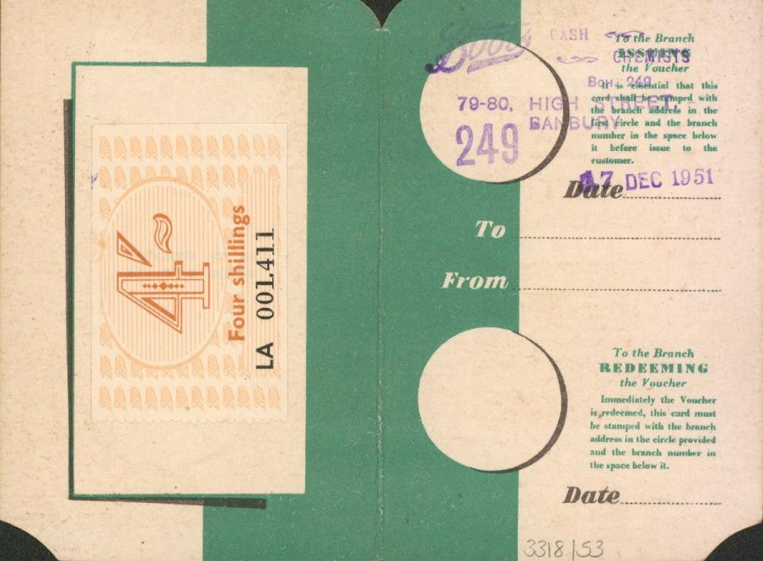
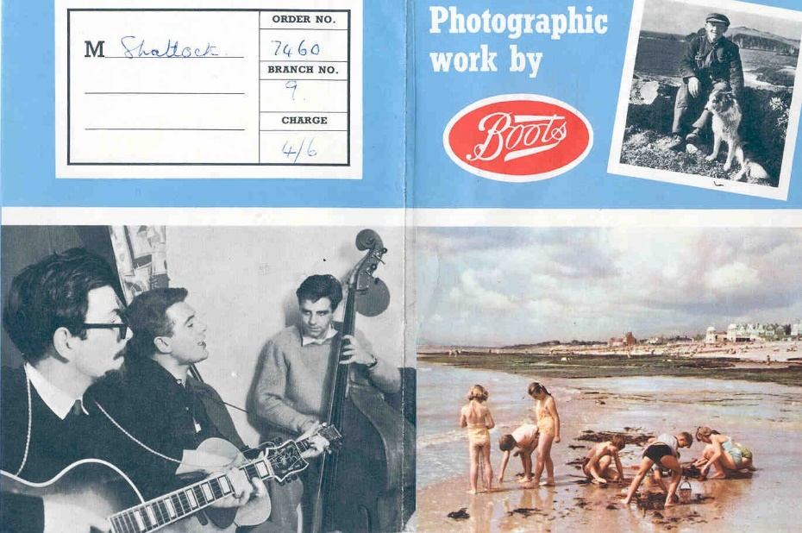
Notes:
SC - Value of using Business Archives – everyday items at certain moments in life.
Variety of material.

Slide 3
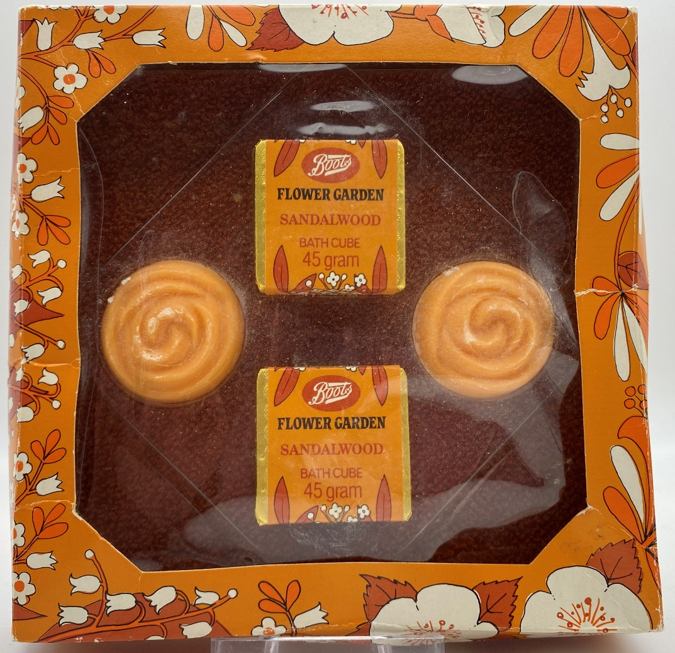
Notes:
Key moment for me and the personal/forgotten recollection associated with this item

Slide 4
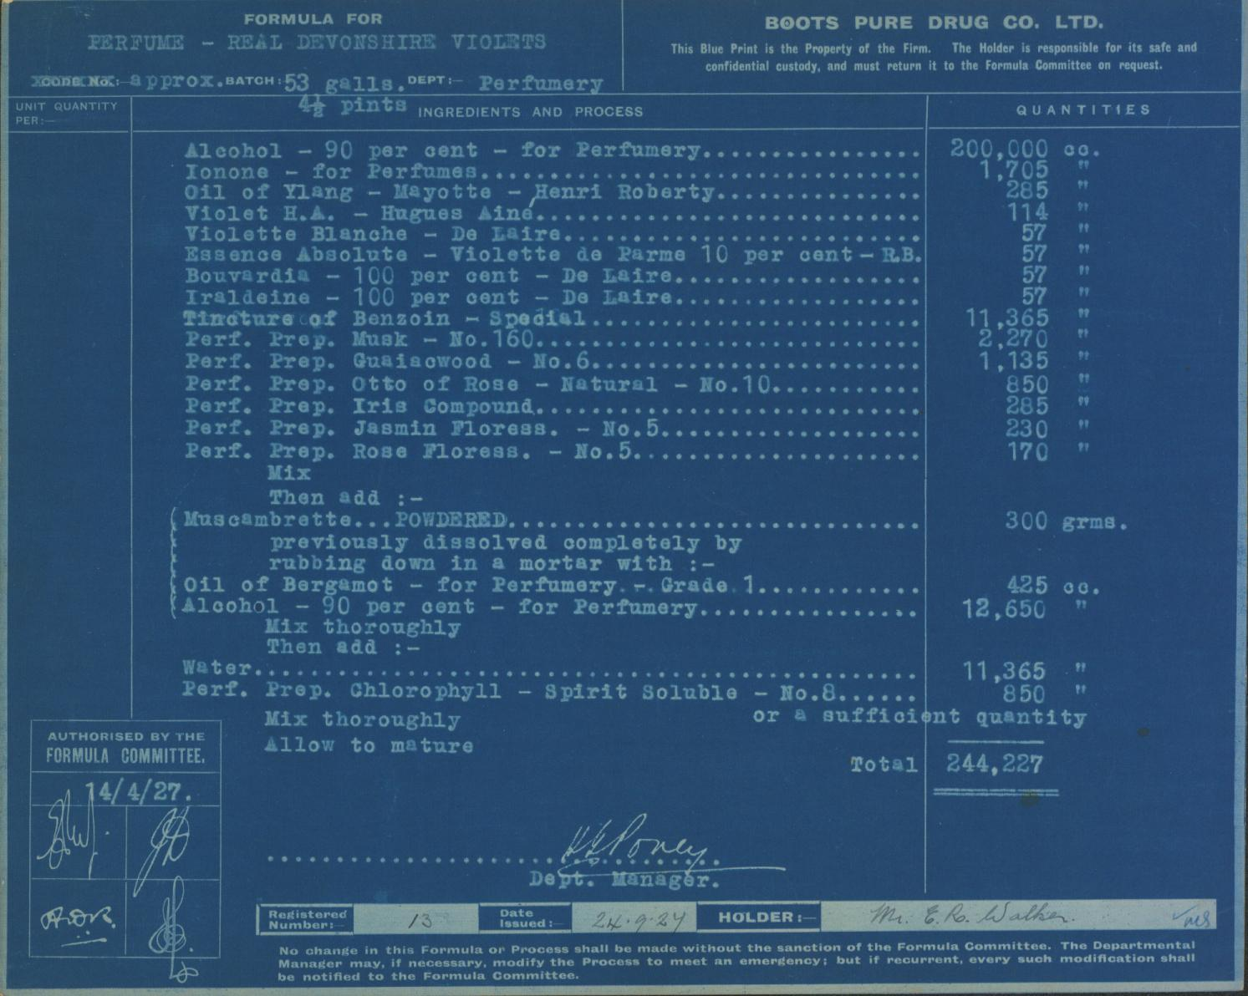
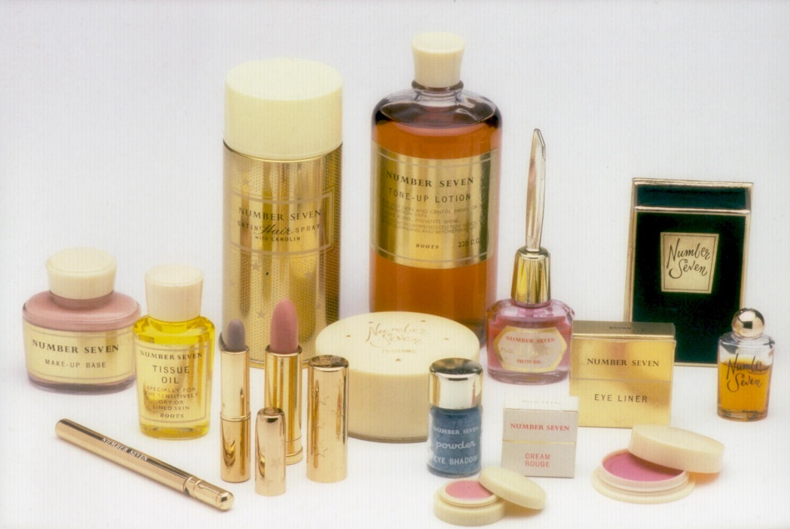
Notes:
Ability to re-create smell using archives
Inclusion of perfume in old products.

Slide 5

Power of smell
Olfaction (sense of smell) linked to
  emotional processing
  autobiographical memory
“when from a long-distant past nothing subsists . . . the smell and taste of things remain poised for a long time . . . and bear unfaltering, in the tiny and almost impalpable drop of their essence, the vast structure of recollection.” (Proust, 1928)
Lack of research – aromatherapy, object handling, Snoezelen
Notes:
VT – significance of smell

Slide 6
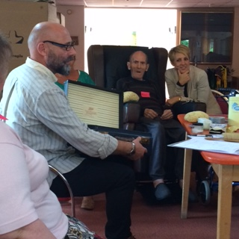
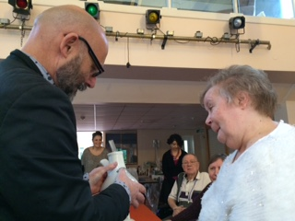
Notes:
SC – Skylark project
Development of the boxes – themed sessions
Spark conversation rather than a memory test.

Slide 7
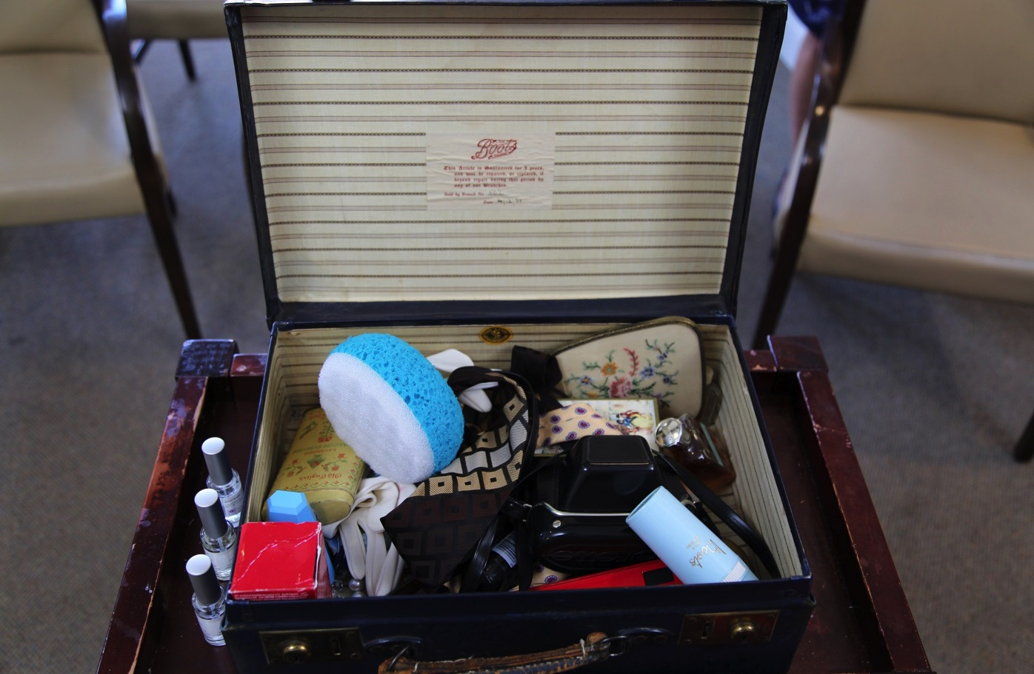
Key insights
Engagement - emotional involvement
Curiosity - value of olfactory stimuli
Opportunity for self-expression
“Multisensory Mementos from Boots boxes, with a focus on olfactory stimulation, can be an engaging, enjoyable and effective psychosocial intervention for people with dementia.”
Notes:
VT – clinical evaluation and findings

Slide 8
Further research
Olfactory profiles (Wellcome Trust)
Multisensory stimulation: olfaction and dementia – Federica d’Andrea PhD study
Realist review
Design multi-sensory intervention
Feasibility study with people living with dementia
Notes:
VT – further research/PhD findings

Slide 9
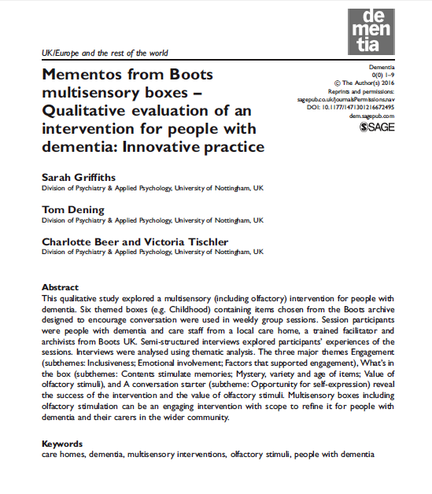
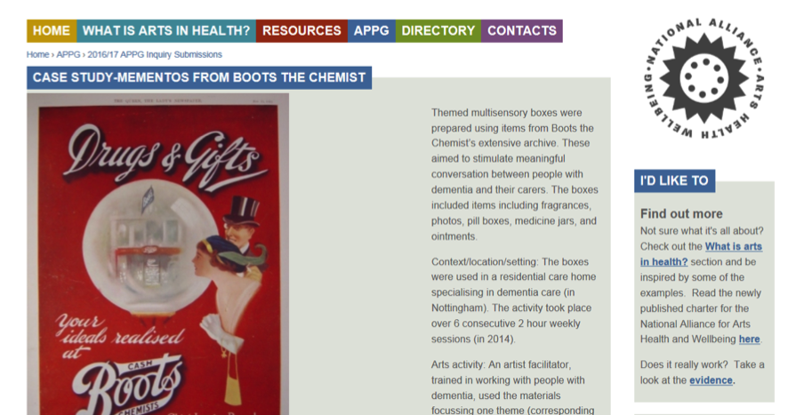
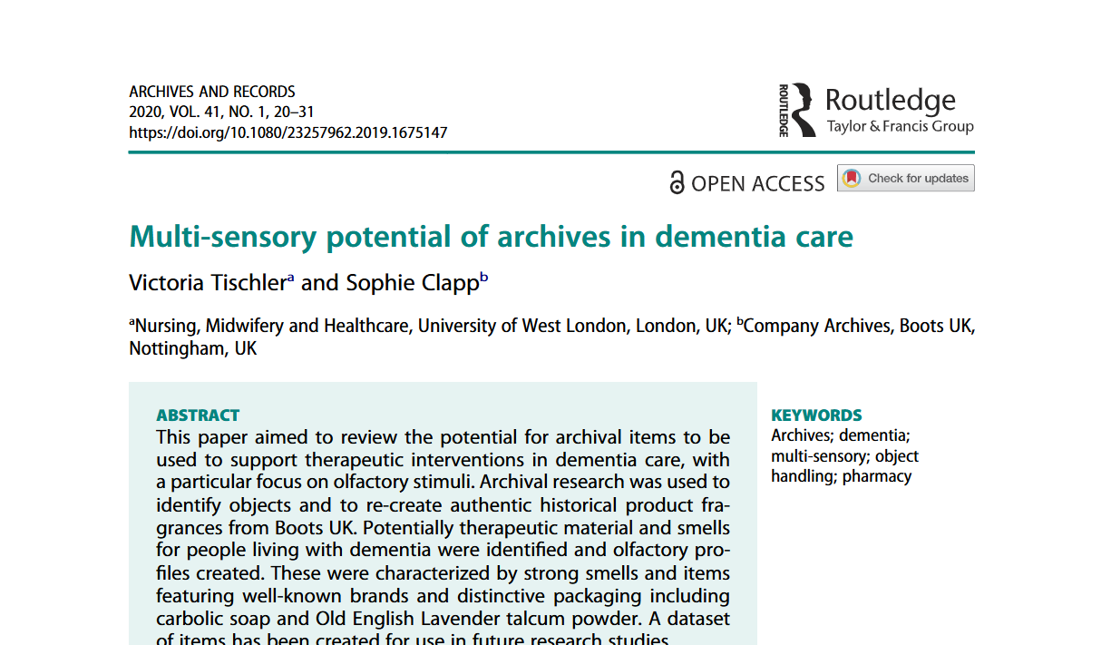
Notes:
VT – shared findings in publications

Slide 10
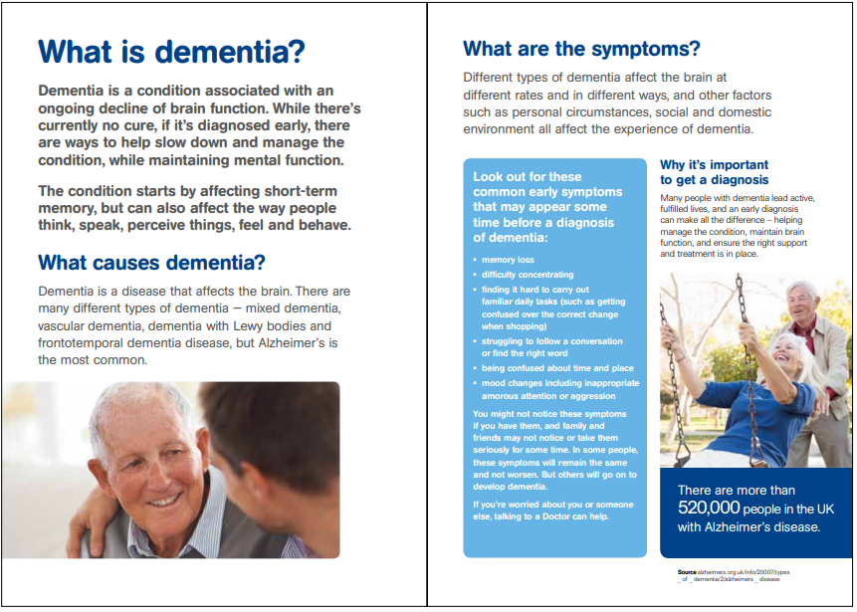
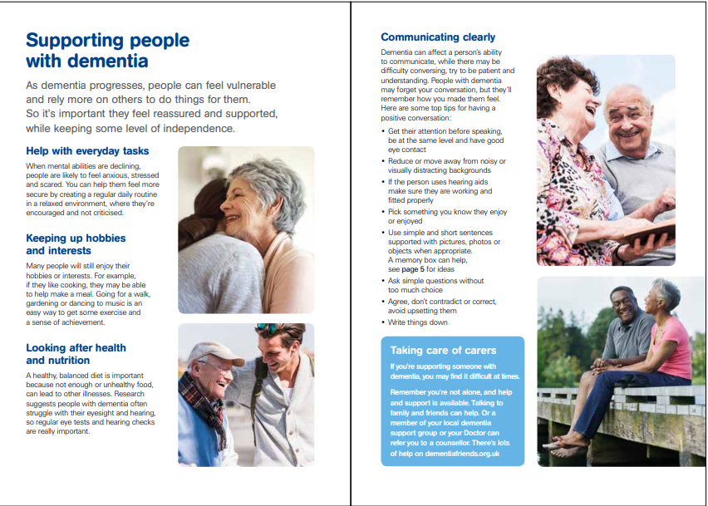
Notes:
SC – 2018 campaign
DAW – online resources based on our findings encouraging people to create their own resources.
Practical guide on what can be used.

Slide 11
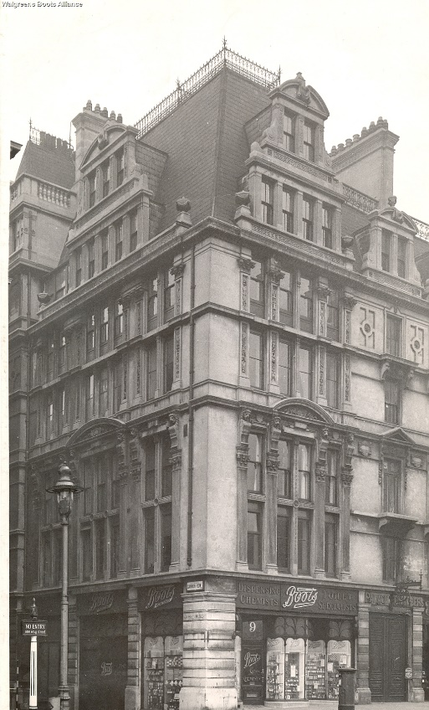
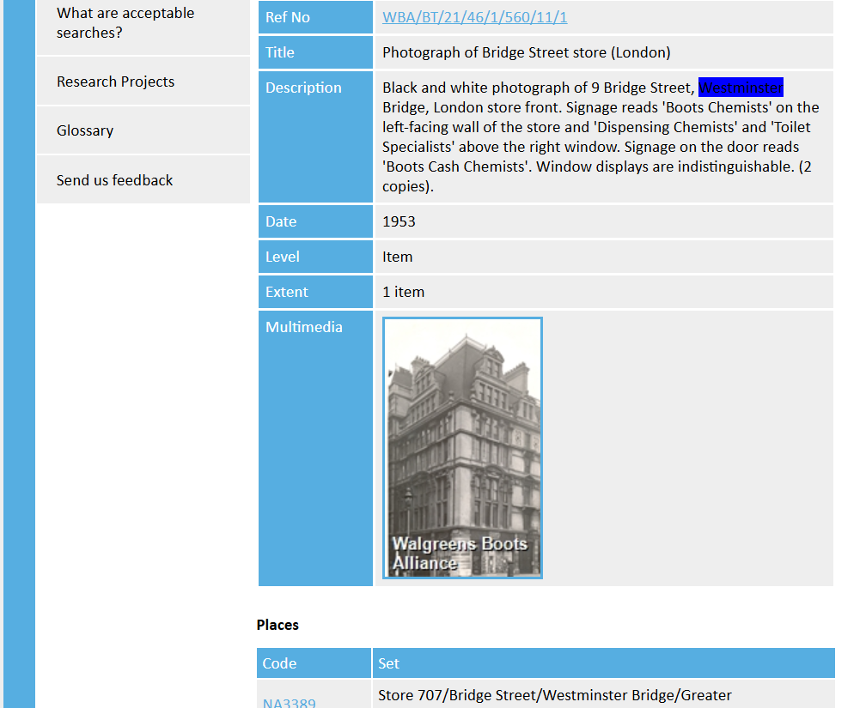
Online resources
archives.walgreensbootsalliance.com

Slide 12
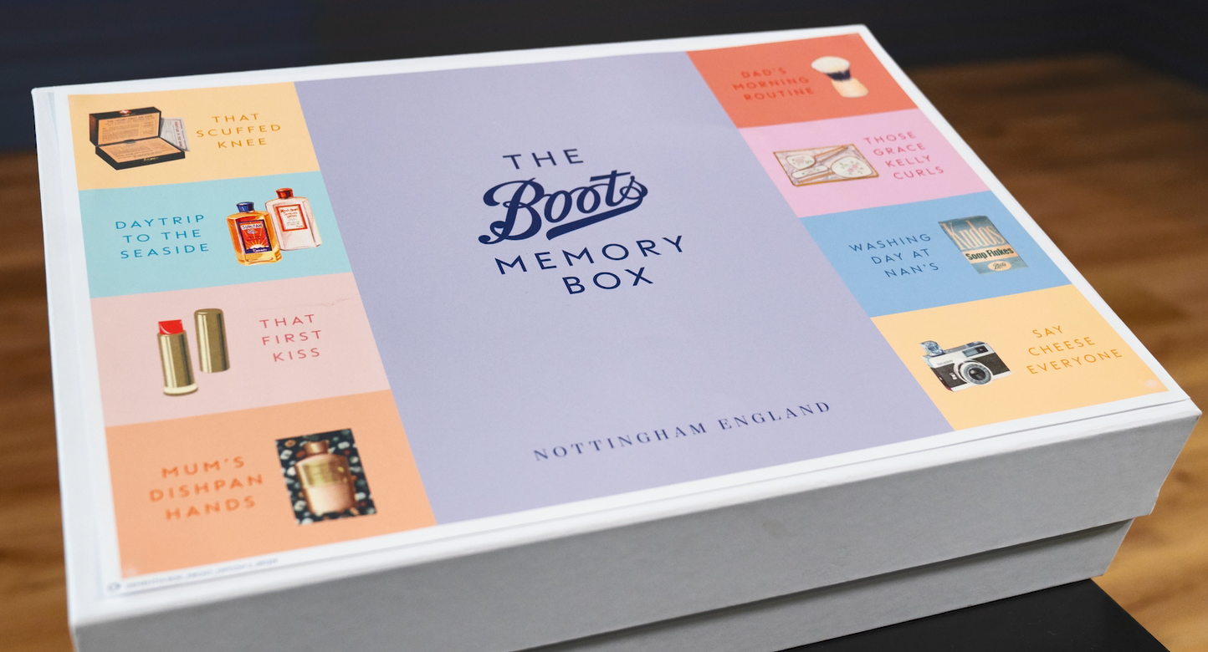
Future plans – memory boxes
Notes:
SC – Memory box plans

Slide 13
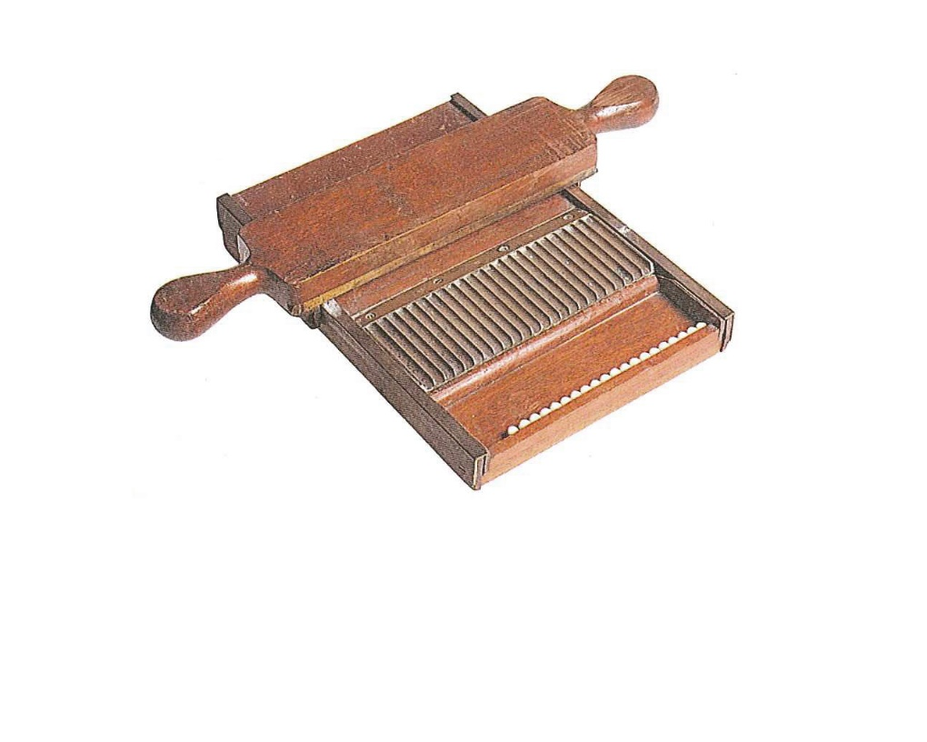
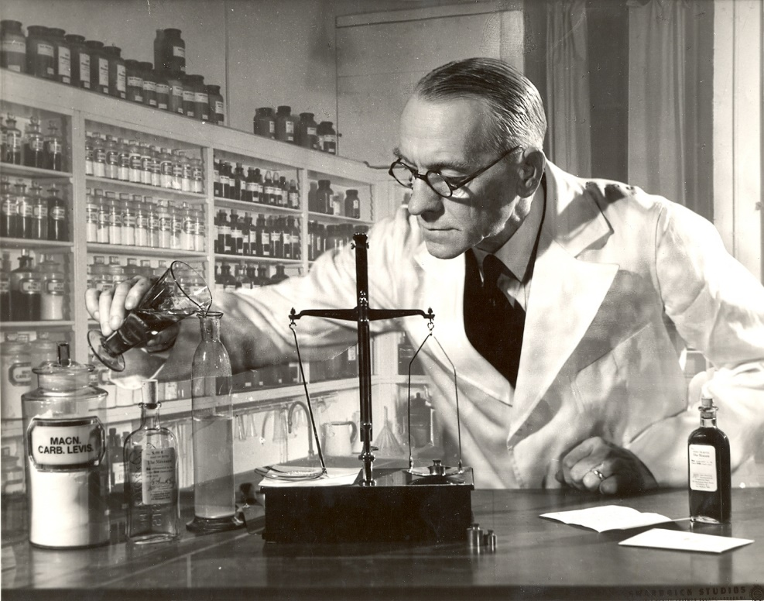
Future plans - research
Notes:
VT – further research – occupational focus on pharmacy

Slide 14
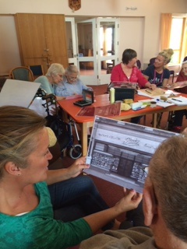
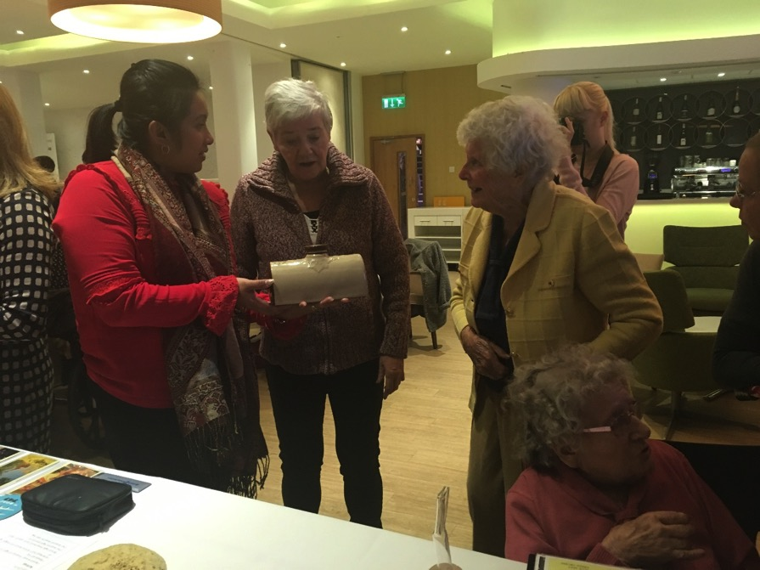
See for yourselves……
Notes:
VT – further research – occupational focus on pharmacy

Slide 15
Questions

