Slide 1
What to focus on in 2025 to maintain and improve your CQC rating.
Mick Feather
Care Business Manager

Slide 2

Mick Feather
Care Business Manager
Agenda
Ratings Calculator Tool
50 CQC reports 2024
What do they tell us?
What to look out for?
Getting inspection ready in 2025!
Agenda

Slide 3
Penny Dash report
Poor operational performance
7,000 Inspections 2023/24
16,000 Inspections 2019/20
The backlog in registrations was a particular problem for small providers setting up new health and social care services.
Oldest social care rating is nearly 9 years and oldest rating for NHS hospitals is around 10 years.
Significant challenges with the Provider Portal
From 18 November CQC will no longer be accepting registration applications via the provider portal.
They are carrying out development work to improve it!
Loss of credibility within the Health and Care sectors
Concerns around the Single Assessment Framework
An average of 14.2 quality statements are reviewed per assessment.
Lack of clarity regarding how ratings are calculated and concerning use of the outcome of previous inspections to calculate a current rating
Dr Penelope Dash
Report October 2024 - https://www.gov.uk/government/publications/review-into-the-operational-effectiveness-of-the-care-quality-commission-full-report/review-into-the-operational-effectiveness-of-the-care-quality-commission-full-report
Penny Dash report
Notes:
Link to bulletin: https://content.govdelivery.com/bulletins/gd/UKCQC-397786a?wgt_ref=UKCQC_WIDGET_3
The above words were written as part of an introduction to Ian’s blog in the previous slide.

Slide 4
CQC Intention
“By early summer we’ll be sharing our plans around the frequency of assessments – giving you a clearer idea of when you might reasonably expect a visit. Our intention is to review all of the quality statements in a key question where it was previously rated as inadequate or requires improvement. We’re keen to see improvements and enable people to move up to good and outstanding.”
Quote from ‘CQC Update Bulletin’
Chief Inspector of Adult Social Care and Integrated Care – James Bullion
30th April 2024
CQC Intention
Notes:
Link to bulletin: https://content.govdelivery.com/bulletins/gd/UKCQC-397786a?wgt_ref=UKCQC_WIDGET_3
The above words were written as part of an introduction to Ian’s blog in the previous slide.

Slide 5
Ratings calculator
25% - 38% = Inadequate
39% - 62% = Requires Improvement
63% - 87% = Good
Over 87% = Outstanding

Slide 6
Ratings calculator

Slide 7
50 CQC Reports 2023
August 2023 – September 2023
Top 10 areas
Quality Assurance (WL)​
1. Risk assessments (S)​
2. Medication management (S)​
3. MCA (E)​
4. Care plans (S+R)​
5. Recruitment (S)​
6. Staffing levels (S)​
7. Incident recording (S)​
8. Environment (S)​
Safeguarding (S)​
CQC Reports – ​
June 2023 – October 2023
33 Residential/Nursing Care
11 Domiciliary Care Agencies
6 Supported Living Services
3 Residential Care (LD)
8 out of 10 areas relate directly with SAFE key question

Slide 8
50 CQC Breaches 2023
Top 10 breaches
Top 10 areas
Reg 17 Quality Assurance (36)
Reg 12 Risk Assessments (18)
Reg 12 Medication (5)
Reg 19 Recruitment (5)
Reg 9 Person Centered (4)
Reg 18 Staffing levels (4)
Reg 11 Consent (4)
Reg 15 Premises (4)
Reg 13 Safeguarding (3)
Reg 18 CQC Nots ( 2)
Quality Assurance (WL)
Risk assessments (S)
Medication management (S)
MCA (E)
Care plans (S+R)
Recruitment (S)
Staffing levels (S)
Incident recording (S)
Environment (S)
Safeguarding (S)
Over 70% of reports had a Regulation 17 breach

Slide 9
50 CQC Breaches 2024
Top 6 breaches
Top 5 areas
Reg 17 Quality Assurance (40)
Reg 12 Risk Assessments (27)
Reg 12 Medication (13)
Reg 18 Staffing (10)
Reg 19 Recruitment (9)
Reg 13 Safeguarding (6)
Quality Assurance (WL)
2. Risk assessments (S)
3. Medication management (S)
4. Recruitment (S)
5. Staffing (S)
Over 80% of reports had a Regulation 17 breach

Slide 10
Culture – Related Quality Statements
SAFETY
Learning culture
We have a proactive and positive culture of safety based on openness and honesty, in which concerns about safety are listened to, safety events are investigated and reported thoroughly, and lessons are learned to continually identify and embed good practices.
WELL-LED
Shared direction and culture
We have a shared vision, strategy and culture. This is based on transparency, equity, equality and human rights, diversity and inclusion, engagement, and understanding challenges and the needs of people and our communities in order to meet these.
50 CQC reports 2024

Slide 11
Culture SAFE + WELL-LED Reg 10 Reg 12 Reg 17
Staff did not always feel encouraged and supported to raise concerns with the management team.
Leaders did not always demonstrate a positive, compassionate, listening culture that promoted trust and understanding.
Staff did not always feel that their voice would be heard and those who did speak up would be supported without fear of detriment.
The provider did not have effective systems that assessed or monitored the day-to-day culture of the service, and this meant they had not identified the warning signs of a closed culture.
We were not assured leaders acted with openness, honesty and transparency at the service.
Staff did not all say they felt confident about raising any issues as they did not feel historically when they had raised issues they had been listened to or that their concerns were acted upon.
CQC report quotes from 2024
50 CQC reports 2024

Slide 12
Learning culture SAFE Reg 12 Reg 16 Reg 17
We have a proactive and positive culture of safety based on openness and honesty, in which concerns about safety are listened to, safety events are investigated and reported thoroughly, and lessons are learned to continually identify and embed good practices.
What this quality statement means
Safety is a top priority that involves everyone, including staff as well as people using the service. There is a culture of safety and learning. This is based on openness, transparency and learning from events that have either put people and staff at risk of harm, or that have caused them harm.
Risks are not overlooked or ignored. They are dealt with willingly as an opportunity to put things right, learn and improve.
People and staff are encouraged and supported to raise concerns, they feel confident that they will be treated with compassion and understanding, and won’t be blamed, or treated negatively if they do so.
Raising concerns helps to proactively identify and manage risks before safety events happen.
Incidents and complaints are appropriately investigated and reported.
Lessons are learned from safety incidents or complaints, resulting in changes that improve care for others.
50 CQC reports 2024

Slide 13
Incident/Accident reporting
We were not assured a full oversight of accident and incidents was embedded in the home.
The staff had not always recorded incidents and accidents.
The provider did not always have an effective system in operation to analyse patterns and trends in accidents and incidents.
Accidents and incidents were recorded and showed trends and patterns had been identified. However, there was a lack of evidence to show what actions had been taken to mitigate future risks.
The provider did not have effective systems in place to learn from incidents.
Staff were not clear with how to report and record incidents.
We found staff had not always documented accidents and incidents accurately.
CQC report quotes from 2024
50 CQC reports 2024

Slide 14
Safe and effective staffing
SAFETY
We make sure there are enough qualified, skilled and experienced people, who receive effective support, supervision and development. They work together effectively to provide safe care that meets people’s individual needs.
Including
Safe recruitment (including DBS)
Staffing levels and skills mix
Skills and qualifications/revalidation
Learning, development and competency
Support, supervision
Performance management
Volunteers and unpaid carers
50 CQC reports 2024

Slide 15
Safe and effective staffing SAFE Reg12 Reg 18 Reg 19
People were not always supported by sufficient numbers of staff to meet their needs.
Supervision records we reviewed were often generic and did not give staff feedback on their performance.
We did not see a detailed analysis if fluctuating staffing levels contributed to the risk of falls and incidents.
Staffing levels were not adequate on the day of inspection.
We found significant shortfalls in the providers processes to ensure they met their requirements and provided safe and effective staffing.
Staff had not received all training relevant to their role and we were not assured staff were always skilled and competent.
The provider failed to follow their own policy in relation to supervision and appraisal of staff.
CQC report quotes from 2024
50 CQC reports 2024

Slide 16
Recruitment SAFE Reg 19
Recruitment checks were not always carried out in line with requirements. The provider failed to obtain satisfactory evidence of conduct in all relevant roles.
Robust recruitment processes were not in place. Internal policy and procedure did not reflect current legislation and best practice.
We saw gaps in recruitment files, such as incomplete application forms where forms had not been signed or dated and references received had not been verified or dated.
We found discrepancies in 6 staff files such as evidence for right to work, full employment history and unexplained gaps, an application form, interview records, health checks, verification of reasons for leaving previous employments.
Some staff had not recorded their full employment history as per best practice guidance.
CQC report quotes from 2024
50 CQC reports 2024
Notes:
Handout Reg 19 sec 3

Slide 17
Medication Management SAFE Reg 12 Reg 9
People’s medicines records were not always accurate or up to date.
We reviewed protocols for medicines prescribed on an “as and when required” (PRN) basis and found they did not detail how people would present if they required their medicines and were unable to communicate this.
People’s medicines were not securely stored, and temperature monitoring was not within the recommended range.
Best practice guidance states prescribed transdermal patches should be rotated to different application sites to mitigate the risk of skin irritation. Prescribed transdermal patch rotation was not being used.
Body maps were found to be in place but did not have the correct guidelines of where creams should be applied.
CQC report quotes from 2024
50 CQC reports 2024

Slide 18
Involving people to manage risks
SAFETY
We work with people to understand and manage risks by thinking holistically so that care meets their needs in a way that is safe and supportive and enables them to do the things that matter to them.
What this quality statement means
People are informed about any risks and how to keep themselves safe.
Risks are assessed, and people and staff understand them.
There is a balanced and proportionate approach to risk that supports people and respects the choices they make about their care.
Risk assessments about care are person-centred, proportionate, and regularly reviewed with the person, where possible.
50 CQC reports 2024

Slide 19
Risk Assessments SAFE Reg 12 Reg 11 Reg 9
The provider had not managed risks to people’s safety effectively or acted promptly to learn from safety incidents.
Individualised detailed guidance had not been provided to staff about how to mitigate risks and provide safe care.
People did not have up to date and accurate risk assessments in place.
Staff and leaders could not always demonstrate they understood how to manage people’s individual risks.
Not all risks for people were identified and recorded in relation to their care and support needs.
Risk assessments were generic and did not include enough information about the individual.
Some staff were unable to explain how risks associated with people’s care were managed to keep people safe.
CQC report quotes from 2024
50 CQC reports 2024

Slide 20
Governance, management and sustainability
Quality statement – WELL-LED
We have clear responsibilities, roles, systems of accountability and good governance. We use these to manage and deliver good quality, sustainable care, treatment and support. We act on the best information about risk, performance and outcomes, and we share this securely with others when appropriate.
What this quality statement means
There are clear and effective governance, management and accountability arrangements. Staff understand their role and responsibilities. Managers can account for the actions, behaviours and performance of staff.
The systems to manage current and future performance and risks to the quality of the service take a proportionate approach to managing risk that allows new and innovative ideas to be tested within the service.
Data or notifications are consistently submitted to external organisations as required.
There are robust arrangements for the availability, integrity and confidentiality of data, records and data management systems. Information is used effectively to monitor and improve the quality of care.
Leaders implement relevant or mandatory quality frameworks, recognised standards, best practices or equivalents to improve equity in experience and outcomes for people using services and tackle known inequalities.
Quality Assurance
Notes:
Includes - Roles, responsibilities and accountability/ Governance, quality assurance and management/ Cyber security and data security and protection toolkit (DSPT)
Emergency preparedness, including climate events / Sustainability, including financial and workforce/ Data security/data protection/ Statutory and regulatory requirements
Workforce planning/ External recommendations, for example safety alerts/ Records/digital records

Slide 21
Quality Assurance WELL LED Reg 17
Themes and trends were not always identified through the provider’s systems currently in place.
The provider’s governance processes were not effective in identifying and addressing concerns in the quality and safety of people’s care.
The quality of some audits undertaken was poor.
The provider did not have oversight of the service.
Processes for identifying, capturing and managing organisational risks and issues were ineffective and did not drive improvement.
There was no quality assurance framework in place that would enable the provider to measure the quality of care accurately.
Managers did not provide assurance that governance processes were robust and there was a lack of evidence around how improvements were being prioritised and driven forward.
CQC report quotes from 2024
50 CQC reports 2024

Slide 22
CQC Single Framework (considerations)
QS –WELL-LED-Workforce equality, diversity and inclusion
We value diversity in our workforce. We work towards an inclusive and fair culture by improving equality and equity for people who work for us.
QS –WELL-LED-Learning, improvement and innovation
We focus on continuous learning, innovation and improvement across our organisation and the local system. We encourage creative ways of delivering equality of experience, outcome and quality of life for people. We actively contribute to safe, effective practice.
QS –CARING-Workforce wellbeing and enablement
We care about and promote the wellbeing of our staff, and we support and enable them to always deliver person centred care.
Focus for 2025
Notes:
Quality Statement: Workforce wellbeing and enablement. We listen to and understand people’s needs, views and wishes. We respond to these in that moment and will act to minimise any discomfort, concern or distress.
Evidence categories set by CQC Specific evidence opportunities in line with the above.
Feedback from staff and leaders Evidence that can demonstrate the following:
Managers are supportive and understanding.
Staff have a good work-life balance.
Staff can develop their skills and knowledge.
Leaders are committed to supporting the wellbeing of their staff.
Staff are listened to and understood by their managers and colleagues.
Leaders are committed to supporting staff wellbeing, the systems they have in place to collect and respond to feedback from staff, and the challenges they face in supporting staff wellbeing.
Processes Evidence that can demonstrate the following:
The care service has a process for listening to and responding to staff feedback. Staff can submit their feedback at any time, there is a system in place to review staff feedback and develop recommendations for improvement.
The service supports staff to meet with their manager to discuss their work and provide feedback. This is supported by Human Resource policies such as supervision and appraisal.
The service provides staff with training, resources, tools and support to deliver person centered care.
The service recognises and rewards staff for their contributions. Staff achievements and successes are celebrated
The service has systems that provide staff with opportunities for professional development and advancement.
The service creates a positive and supportive work environment where staff are valued and appreciated.
Human resources process is available to support staff such as, flexible working, bereavement leave as examples.
The service provides support for staff needing additional support such as talking therapies.
Quality Statement: We value diversity in our workforce. We work towards an inclusive and fair culture by improving equality and equity for people who work for us.
Evidence categories set by CQC Specific evidence opportunities in line with the above.
Feedback from staff and leaders Evidence that can demonstrate the following:
Staff are valued and respected. Their views are sought and used to develop any areas where improvement is needed.
Staff have equality to progress in their careers.
Staff are confident the service is committed to creating an inclusive and fair culture.
All staff and leaders can raise concerns safely, these are appropriately listened to, investigated with feedback given.
There is a clear and transparent career progression framework. This framework is communicated to all staff and is used to guide decisions about promotions and other career development opportunities.
Leaders value diversity in the workforce and to creating an inclusive and fair culture.
Leaders are committed to creating a workplace where everyone is valued and respected, regardless of their background or circumstances.
Processes Evidence that can demonstrate the following:
The service has a clear policy on equality, diversity and inclusion that meets legislative requirements. This policy is communicated to all staff and is upheld by all leaders and managers.
The service has a workforce strategy that includes equality, diversity and inclusion. The strategy is monitored and evaluated to make sure that the service meets and progresses the strategy.
This service has processes to recruit and retain a more diverse workforce, or to provide training and support to staff on equality and diversity. This may include flexible working arrangements and reasonable adjustments.
The service has a process in place for recording, investigating and responding to complaints of discrimination or harassment.
The service collects data on the demographics of its workforce and uses this data to identify any areas where there is underrepresentation. The care service then takes steps to address these areas, such as by implementing targeted recruitment campaigns.
Training is available and monitored to make sure that all staff understand their role to support equality, diversity and inclusion.
The service has staff networks in place, such as a black, Asian, and minority ethnic (BAME) staff network, a LGBTQ+ staff network and a disability staff network as examples.
Quality Statement: Learning, improvement and innovation. We focus on continuous learning, innovation and improvement across our organisation and the local system. We encourage creative ways of delivering equality of experience, outcome and quality of life for people. We actively contribute to safe, effective practice and research.
Evidence categories set by CQC Specific evidence opportunities in line with the above.
Feedback from staff and leaders Evidence that can demonstrate the following:
Staff are supported to learn and develop and can put their learning into practice. They are provided with access to training and professional development opportunities, both internal and external.
Staff are given the opportunity to be supportive of innovation and are committed to improving the quality of care.
Staff are recognised and rewarded for their learning and development achievements. Celebrating and sharing the successes of staff who have implemented new ideas and innovations.
Staff have the time and resources to develop and implement new ideas.
Staff are that their organisation is committed to continuous improvement.
Leaders have a strong culture of learning and improvement.
Leaders can be innovative and forward-thinking.
Leaders can make a positive contribution to safe, effective practice and research.
Processes Evidence that can demonstrate the following:
The service has a clear and defined process for continuous learning, improvement, and innovation. This includes the allocation of resources to promote successful innovation.
The service reviews its performance and outcomes. There are monitored improvement plans that are updated and shared. Quality initiatives are monitored to make sure that the improvements are embedded.
The service has a clear and well-defined process for learning, improvement, and innovation. This includes a process for identifying, reviewing and approving new ideas.
The service shares its learning with others and contributes to safe, effective practice and research.
The service makes such it uses best practice guidance and any shared learning to improve quality.

Slide 23
QS –WELL-LED- Environmental sustainability – sustainable development
We understand any negative impact of our activities on the environment, and we strive to make a positive contribution in reducing it and support people to do the same.
Feedback from staff and leaders
Evidence that can demonstrate the following:
Staff understand the environmental impact of their work and are empowered to make changes to reduce it.
Staff are supported by their leaders to travel and work in a sustainable way. Planning for calls in homecare considers staff travelling.
Staff are aware of and have access to sustainability initiatives in place such as cycle to work support.
Staff can provide ideas on sustainability, and these are listened to.
Leaders are committed to environmental sustainability and take action to reduce the service's environmental impact.
Leaders monitor the progress of the service's environmental sustainability initiatives and make changes as needed.
Focus for 2024

Slide 24
QS –WELL-LED- Environmental sustainability – sustainable development
We understand any negative impact of our activities on the environment, and we strive to make a positive contribution in reducing it and support people to do the same.
Processes
Evidence that can demonstrate the following:
The service has an environmental sustainability policy that outlines its commitment to reducing its environmental impact.
The policy includes a process for identifying and reducing the service's environmental impact. This is shared with people, their relatives, carers and staff.
The service has plans and is investing in renewable energy sources, carbon reduction and sustainable materials where possible.
The service has developed several initiatives to reduce its environmental impact, such as reducing food waste, recycling and supporting staff to use public transportation, cycle, or walk to work.
The service has funding arrangements and initiatives in place to assist staff this may include salary offset schemes as an example.
The service provides staff with training in environmental sustainability.
Focus for 2024

Slide 25
Create a Safety culture
Safety culture is defined as the way in which safety is managed in a workplace.
We define a positive safety culture as one where the environment is collaboratively crafted, created, and nurtured so that everybody (individual staff, teams, patients, service users, families, and carers) can flourish to ensure brilliant, safe care.
NHS England
Organisations need to go further and ensure that their leaders, managers, and staff have a fundamental understanding of how to think about safety risk, the role they play and be able and willing to make informed decisions, and not necessarily continue doing what they have always done.
Institution of Occupational Safety and Health (IOSH)
Safety is important to how CQC regulate services. During inspections, CQC want to know how safe the care is that is being delivered. Culture is known to be key for safe care. Culture means the way that people work, the way that they think and the way that they act.
The topic of safety culture is complex. There are different ways to define it. Safety culture can look different in different places.
CQC July 2023 (https://www.cqc.org.uk/about-us/transparency/external-reports-research/rapid-literature-review-safety-cultures)
Safety Culture

Slide 26




Summary
Quality Assurance
Risk Assessments
Safety Culture
Environmental Sustainability
Safety culture

Slide 27

Questions

Slide 28




Say hello to our all-in-one solution
HR & Employment Law
Health & Safety
Our partnership
Technology
Financial protection & bespoke packages to suit your business​
The Citation Advice Guarantee
Tailored contracts & handbooks
Template policies
Regular reviews & updates​
Consultant visits
Packages to suit various business sectors, size & needs
Assistance obtaining certifications
Site audits & inspections
On and off-site training days
Over 1,600 template risk assessments and policies – general and sector specific
Unlimited, 24/7 access to our advice line & crisis management services
Daily support
Employee Assistance Programme
Informative webinars
Legislation updates
Referral scheme
Full access to our bespoke management platform ATLAS
Unlimited eLearning usage
Up to date, interactive and sector specific courses
Absence and holiday management
Risk assessment & COSHH library and document centre.

Slide 29


Our care-specific services
Care mock inspections
Care policies and procedures
Care Inspectorate pro
These are the best indicator of your performance if assessed today and help you prepare for the real thing.​
Our experts will identify key areas of pain and non-compliance, which if left until an official inspection, would have a negative impact on your service rating, business growth and overall performance.
We’ll help you put clear processes in place to guide the management of your care service, by providing a complete set of policies and procedures – put together by our industry experts.​
We’ll also provide regulatory and legislative updates, keeping you and your policies up to date.
This online tool keeps you prepared for whenever the Care Inspectorate call.​
​
From surveys to help you gain insights from the people who matter, to uploading evidence and creating action plans, this tool provides a showcase of the brilliant work you do and what you’re doing to continually improve.

Slide 30
Did you know?
Here’s just a few reasons why you’ll be better off with Citation…
You'll be 16x less likely to be faced with a tribunal claim​
7x less likely to suffer a major injury in the workplace
75% less likely to have a reportable accident at work
47x times less likely to receive an enforcement notice versus UK/national average
85% of clients agreed by partnering with Citation they are building a safer, happier and more productive workplace.
“Not having the Citation support system in place would be impossible to be without. I’d highly recommend Citation to other businesses, this support system should always be in place - I’m not sure how we managed for so long without it!”
Kirsty Miceli, Bloom & Care

Slide 31

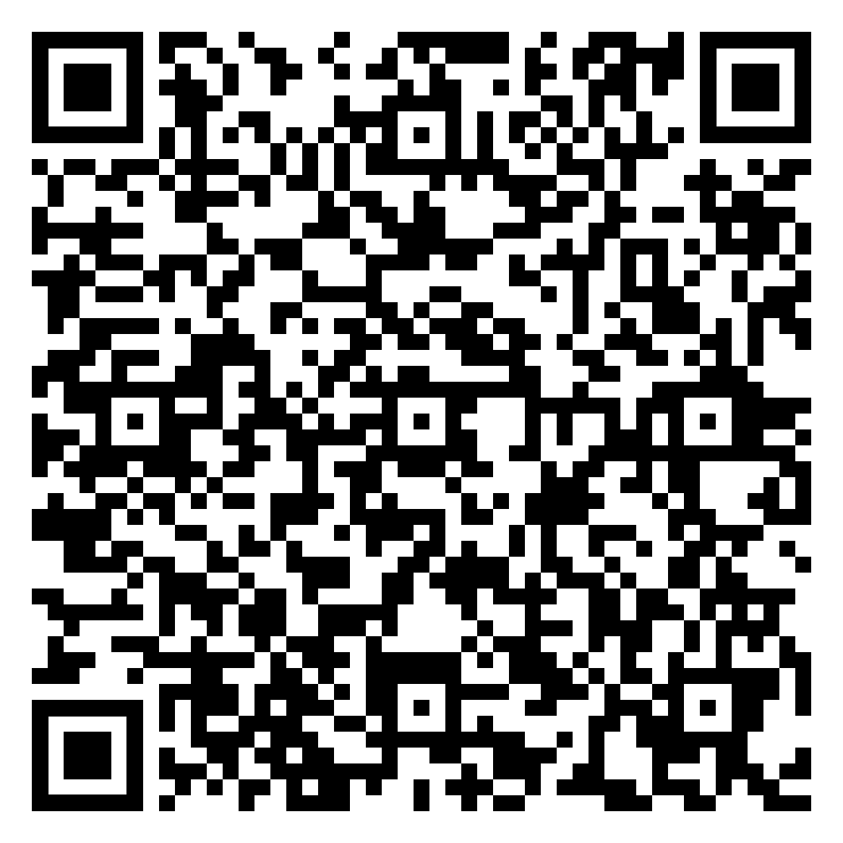
Speak to our experts
If you'd like to discuss how Citation can support your business come over to our stand or visit
Citation | Care Partner - Get a quote

Slide 32
Thank you!
© The contents of this presentation are copyright of Citation Professional Solutions and may not be reproduced or copied in any form without written consent.
Version 2 January 2024

