Slide 1
Digital Telecare: How ready are we for the digital switch?
David Budd Head of Strategic Partnerships | Appello
Notes:
Each member to discuss introduce yourselves, say your job role, how long you’ve been with Appello and describe your part in the service.

Slide 2
Introducing Appello Leading the way with digital telecare and Technology Enabled Care services
We have over 35 years experience in delivering telecare services to housing providers and local authorities.
Developed the first end-to-end digital telecare solution in 2016, which has gone onto become the widest deployed system in the UK.
Over 650 developments and over 40,000 residents benefitting from our digital telecare service, Smart Living Solutions (SLS).
Over 4 millions digital calls have been placed across our digital systems.
We also operate across multiple sites the UK’s largest telecare monitoring centre with over 400,000 connections.
Our monitoring centre utilise our award winning, cloud hosted monitoring platform CareNet EVO.
All Appello equipment is British Standard compliant
2
2

Slide 3
What is happening? The digital switchover
By 2025 the traditional telephone network – analogue or Public Switched Telephone Network (PSTN) will be switched off and upgraded to newer digital technology – Voice-Over Internet Protocol (VoIP).
Internet connectivity will be enabled on every telephone line and calls will be sent using digital signals.
The upgrade will simplify management of the telephone exchanges and make it easier for the telecoms companies to provide newer services in the future.
Work is already well underway and already completed in some areas of the UK, therefore the time is now to begin your digital telecare transition.
3
3
Notes:
OOH call handling is not a periphery activity for Appello, it has been a core business service we’ve offered for 21 years. In that time we have worked with some of the largest housing organisations in the country to secure their OOH emergency call handling needs.
Over this time we’ve been able to fine-tune our service so we meet the specific needs of our customers in an efficient and seamless way, transitioning from your teams to ours with no discernible difference to the caller.
As the slide details, resilience is a key benefit of working with us. Not only do we have a large number of call handlers for you to draw upon but we also operate from multiple sites and have around 100 remote staff who can hop online and be ready to work within minutes – thanks to our homegrown call handling platform – Carenet EVO. Carenet Evo is 100% cloudbased so can be accessed anywhere and because it is Appello developed and managed it means we can roll out new features to directly address our customer needs.
To manage 15k calls a month we use expert resourcing staff and resourcing technology. We pre-empt future resourcing needs and we constantly (i.e. every 15 minutes) monitor staff and call levels to ensure our service is functioning at optimum levels.

Slide 4
Don’t just trust us… Hear from the experts
“We recommend that service providers take urgent action to review the impact on their alarm services of the transition to digital telecommunications infrastructure across the UK. By December 2025, the majority of UK businesses and residential premises will be accessing high speed connectivity for voice and data services in place of phone line technology.”
- Technology Enabled Care Services Association (TSA)
“Copper wires and analogue signals have served our nation for over a century…it’s no longer as efficient as it could be. Replacement parts are hard to come by and, it fails more often than we’d like, meaning it doesn’t provide the world-class service that we need it to. This is why we'll be retiring the analogue phone network at the end of 2025.”
- Openreach
“Digital systems will create a basis for a next generation of telecare services that will provide a means for more personalised and early preventative interventions.”
- GOV Whitepaper
4
4
Notes:
OOH call handling is not a periphery activity for Appello, it has been a core business service we’ve offered for 21 years. In that time we have worked with some of the largest housing organisations in the country to secure their OOH emergency call handling needs.
Over this time we’ve been able to fine-tune our service so we meet the specific needs of our customers in an efficient and seamless way, transitioning from your teams to ours with no discernible difference to the caller.
As the slide details, resilience is a key benefit of working with us. Not only do we have a large number of call handlers for you to draw upon but we also operate from multiple sites and have around 100 remote staff who can hop online and be ready to work within minutes – thanks to our homegrown call handling platform – Carenet EVO. Carenet Evo is 100% cloudbased so can be accessed anywhere and because it is Appello developed and managed it means we can roll out new features to directly address our customer needs.
To manage 15k calls a month we use expert resourcing staff and resourcing technology. We pre-empt future resourcing needs and we constantly (i.e. every 15 minutes) monitor staff and call levels to ensure our service is functioning at optimum levels.

Slide 5
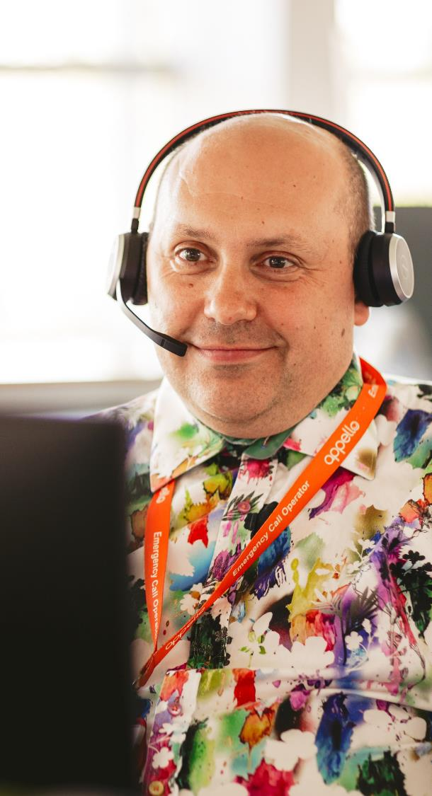
Are we on track for the transition to digital telecare? The digital switchover
2025 switch-off – a hard deadline.
First time call failure rates are a clear example of the necessity for action.
An estimated 125 housing developments are upgraded to digital every month.
At this rate, 6,250 developments will have been upgraded by 2025.
With approximately 25,000 developments in the UK, only 25% of the requirement to ensure all customers have a safe, reliable alarm system will be fulfilled.
There needs to be an approximate five-fold increase in the pace of upgrades to ensure a majority of customers have access to digital telecare.
5
5
Notes:
OOH call handling is not a periphery activity for Appello, it has been a core business service we’ve offered for 21 years. In that time we have worked with some of the largest housing organisations in the country to secure their OOH emergency call handling needs.
Over this time we’ve been able to fine-tune our service so we meet the specific needs of our customers in an efficient and seamless way, transitioning from your teams to ours with no discernible difference to the caller.
As the slide details, resilience is a key benefit of working with us. Not only do we have a large number of call handlers for you to draw upon but we also operate from multiple sites and have around 100 remote staff who can hop online and be ready to work within minutes – thanks to our homegrown call handling platform – Carenet EVO. Carenet Evo is 100% cloudbased so can be accessed anywhere and because it is Appello developed and managed it means we can roll out new features to directly address our customer needs.
To manage 15k calls a month we use expert resourcing staff and resourcing technology. We pre-empt future resourcing needs and we constantly (i.e. every 15 minutes) monitor staff and call levels to ensure our service is functioning at optimum levels.

Slide 6
Digital telecare, what are the challenges?
The success of this mass migration to digital telecare is dependent on housing providers initiating projects to upgrade their systems, and telecare suppliers being able to support with the right solutions.
Monitoring | Equipment | Supply v Demand | Capacity
The digital capabilities of current monitoring service. The digital capabilities of platform providers. At present approx. 20 platforms are upgraded annually, and these projects take approx. 6 months. | The digital capabilities of manufactures. Is an inability to have digital products monitored, slowing adoption? Once monitoring is no longer a barrier, can we assume their will be adoption on mass? | A delicate balance: supply will only increase if demand increases but a this increase in supply won’t happen overnight. There is a finite resource for installation works in the UK, which will take time to expand. | We know we can expect a swell in demand for digital telecare as we approach 2025 but are telecare suppliers – and the supply chain they depend on - able to meet this?
The immediate risk is that c18,000 developments will have life safety equipment that may not be fit for purpose by 2025. This leaves c750,000 people reliant on an emergency alarm system that potentially fails >10% of the time for first time calls.
6
Notes:
OOH call handling is not a periphery activity for Appello, it has been a core business service we’ve offered for 21 years. In that time we have worked with some of the largest housing organisations in the country to secure their OOH emergency call handling needs.
Over this time we’ve been able to fine-tune our service so we meet the specific needs of our customers in an efficient and seamless way, transitioning from your teams to ours with no discernible difference to the caller.
As the slide details, resilience is a key benefit of working with us. Not only do we have a large number of call handlers for you to draw upon but we also operate from multiple sites and have around 100 remote staff who can hop online and be ready to work within minutes – thanks to our homegrown call handling platform – Carenet EVO. Carenet Evo is 100% cloudbased so can be accessed anywhere and because it is Appello developed and managed it means we can roll out new features to directly address our customer needs.
To manage 15k calls a month we use expert resourcing staff and resourcing technology. We pre-empt future resourcing needs and we constantly (i.e. every 15 minutes) monitor staff and call levels to ensure our service is functioning at optimum levels.

Slide 7
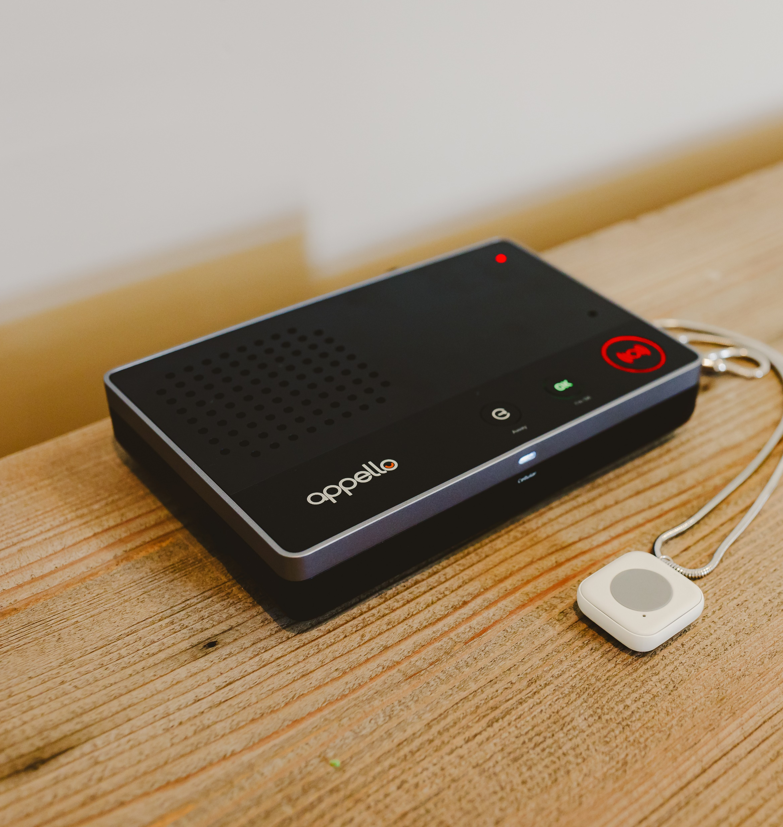
Appello Digital Alarm Solution The digital switchover
No phone line needed
Roaming SIM Connection
Ethernet & WiFi connection options
Still functional in a power cut
Simplest installation process - only one wire to plug in
Waterproof pendant with range of up to 300m
Can work in partnership to help Care Providers to ensure service users are upgraded
7
7

Slide 8
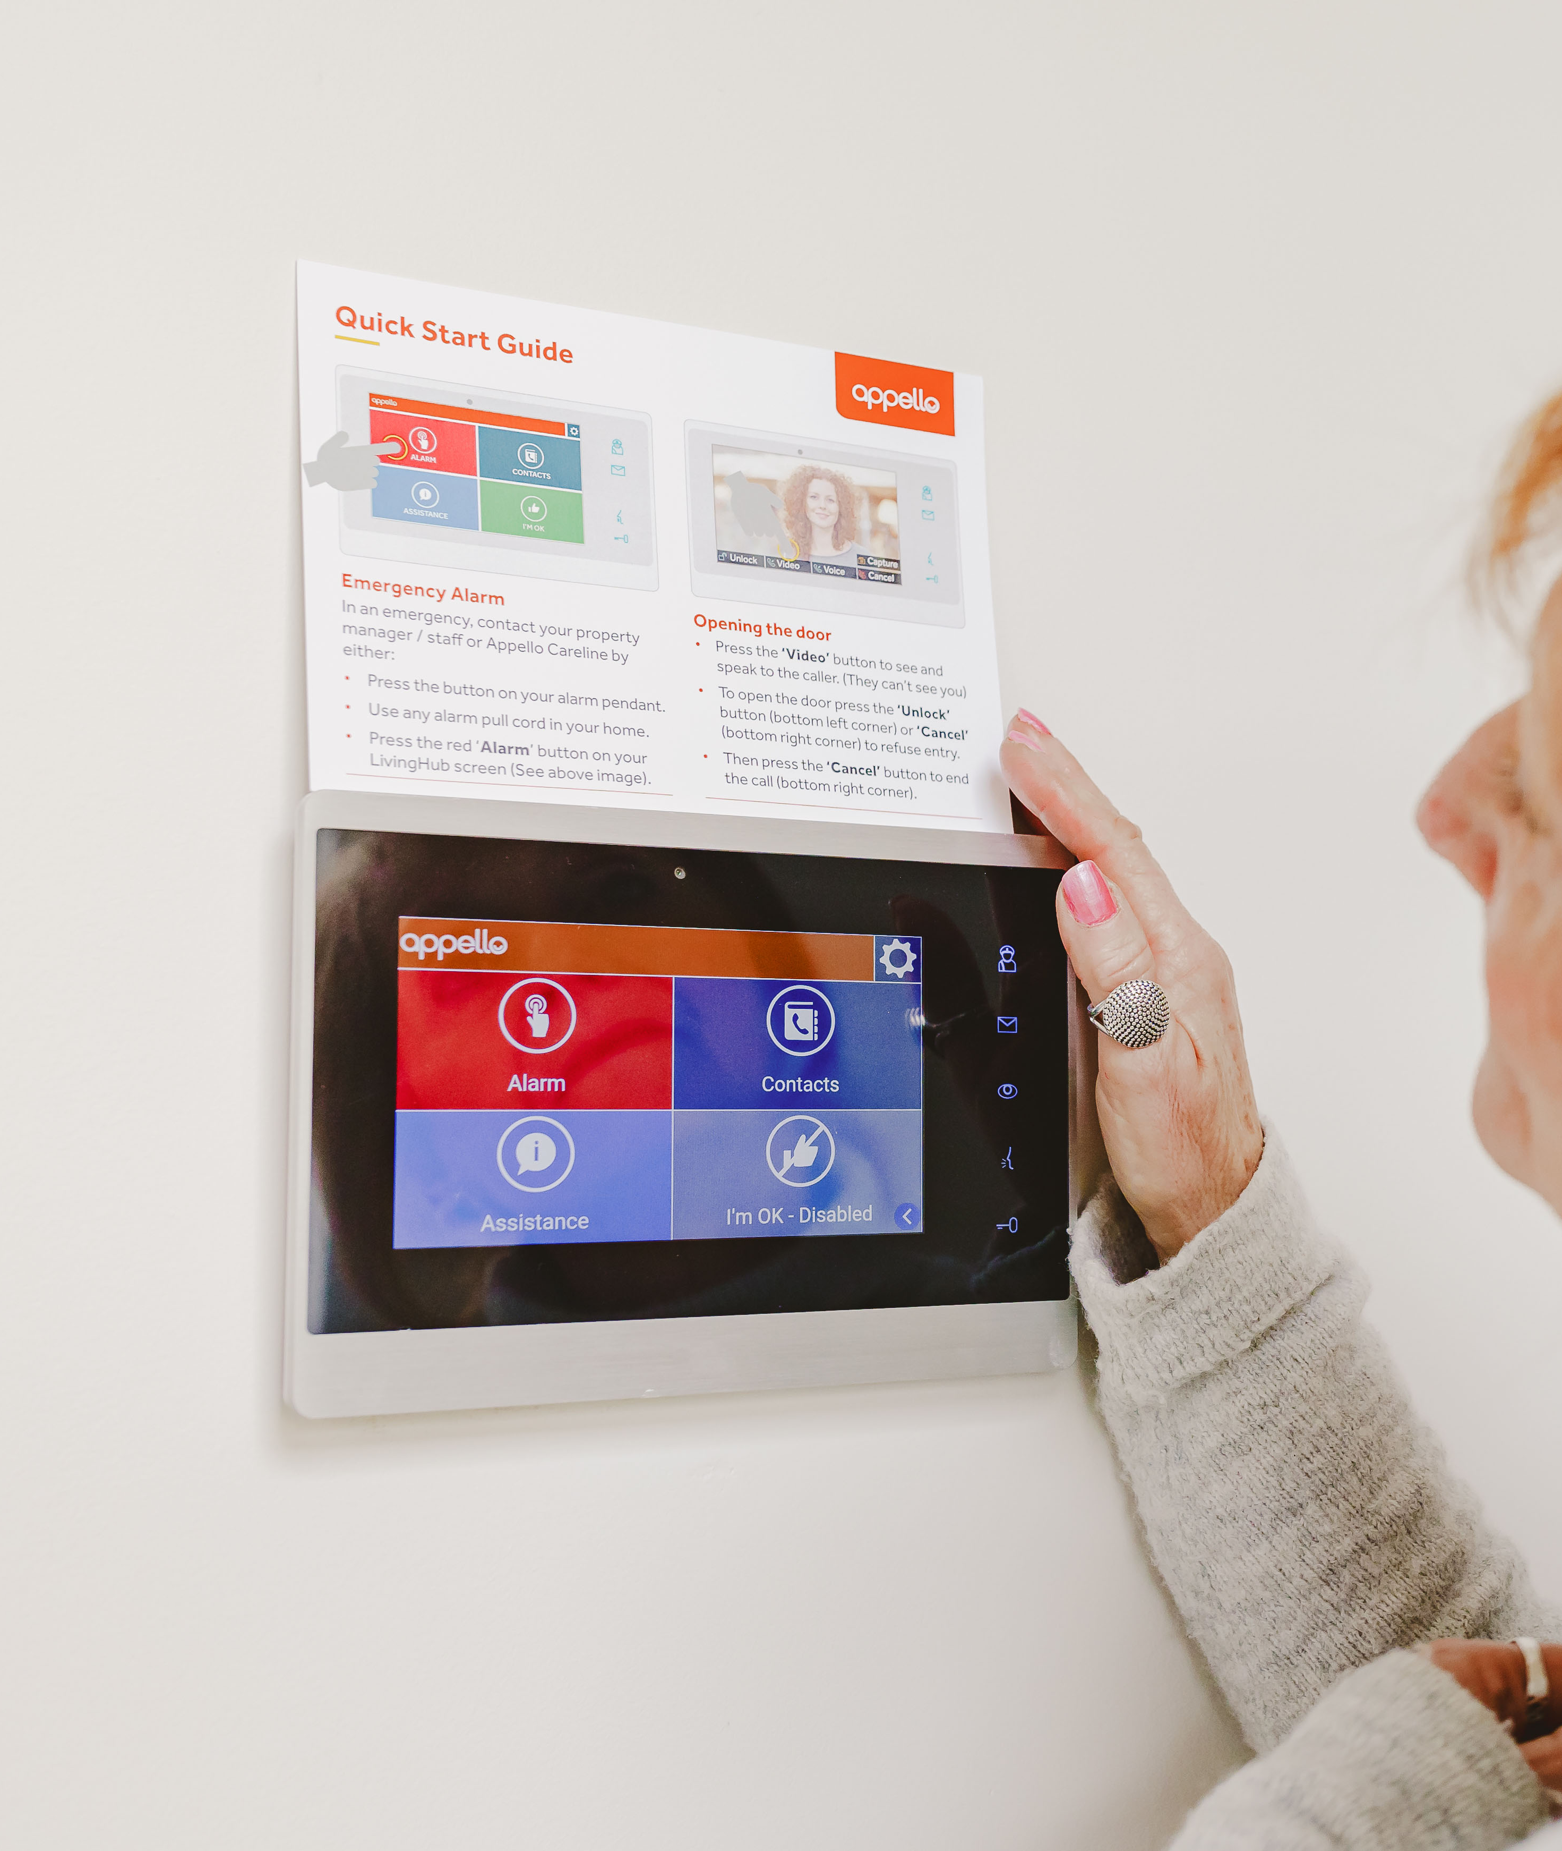
Smart Living Solutions & SmartConnect The digital switchover
Digital Network Ready
3s Connection Speed
Simultaneous Calling
I'm OK Notification
Cloud Management App
British Standards Compliant
8
8

Slide 9
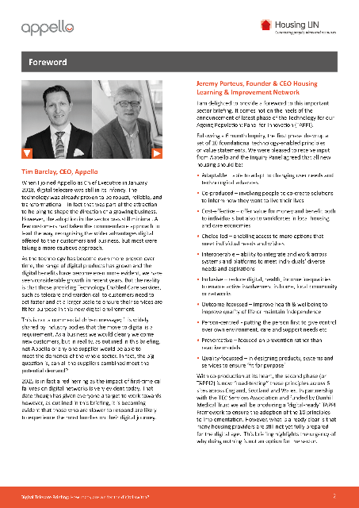
What to do next… The digital switchover
Get started – the time is now.
Talk to your service providers and other suppliers if necessary.
Confirm a timeline and set out your priorities.
Analogue failure of alarms needs to be added to risk registrar.
Get in touch
E-mail: david.budd@appello.co.uk
Call us: 0333 321 6470
Download Briefing Paper: https://bit.ly/3nePREn
https://appello.co.uk/
9

Slide 10
Why choose Appello?
We have been delivering Technology Enabled Care (TEC) services for over 30 years and have become one of the most innovative TEC companies in the UK.
We already have in place a fully digital TEC monitoring centre, with future-led, cloud hosted digital technology.
Our equipment is ready now to be installed whenever you are ready to make the transition to digital.
We are BSI compliant.
We can meet your current needs now and in the future.
10
10
Notes:
OOH call handling is not a periphery activity for Appello, it has been a core business service we’ve offered for 21 years. In that time we have worked with some of the largest housing organisations in the country to secure their OOH emergency call handling needs.
Over this time we’ve been able to fine-tune our service so we meet the specific needs of our customers in an efficient and seamless way, transitioning from your teams to ours with no discernible difference to the caller.
As the slide details, resilience is a key benefit of working with us. Not only do we have a large number of call handlers for you to draw upon but we also operate from multiple sites and have around 100 remote staff who can hop online and be ready to work within minutes – thanks to our homegrown call handling platform – Carenet EVO. Carenet Evo is 100% cloudbased so can be accessed anywhere and because it is Appello developed and managed it means we can roll out new features to directly address our customer needs.
To manage 15k calls a month we use expert resourcing staff and resourcing technology. We pre-empt future resourcing needs and we constantly (i.e. every 15 minutes) monitor staff and call levels to ensure our service is functioning at optimum levels.

Slide 11
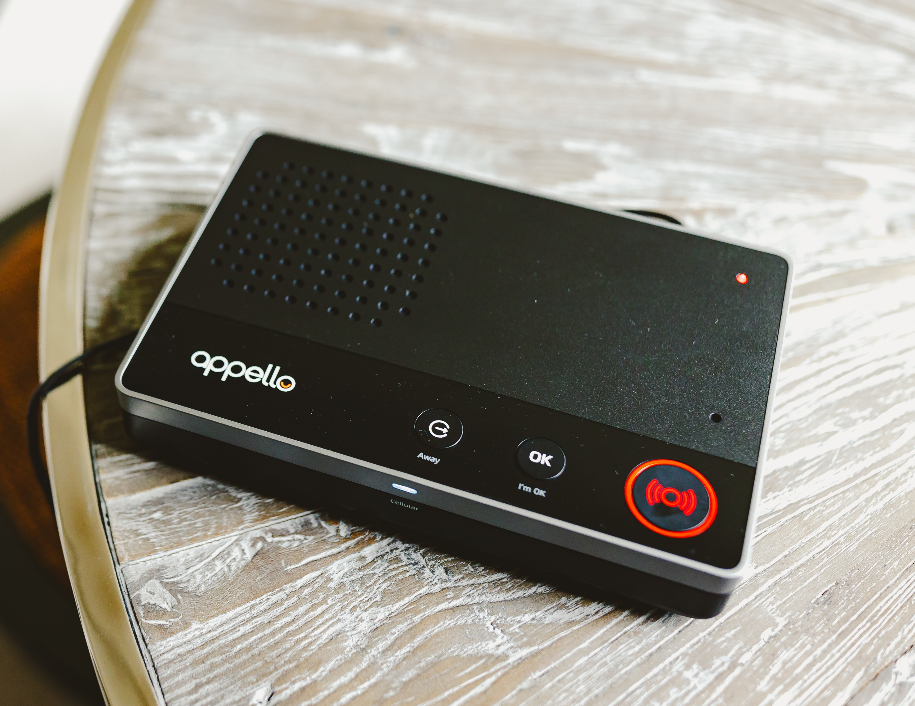
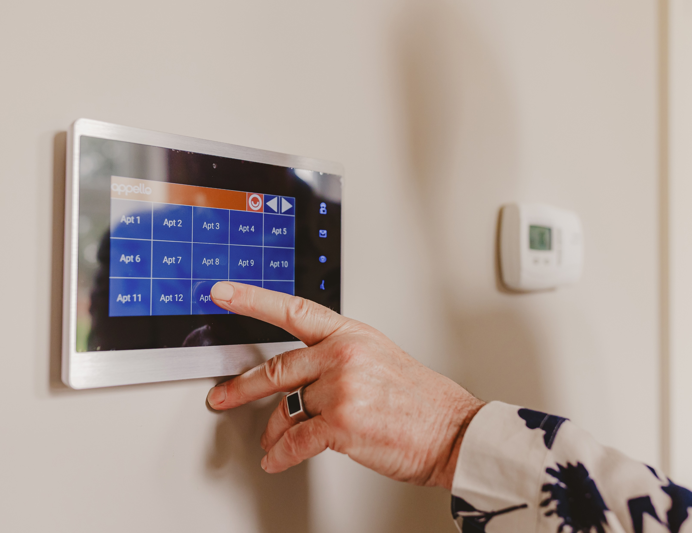
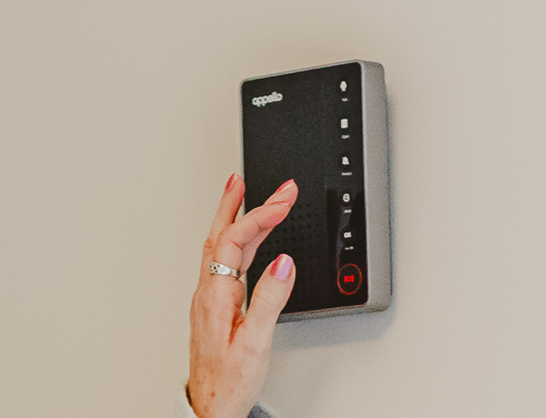
Approximate Pricing Our range of digital products
Dispersed
Hardwired
SmartLife
Smart Living Solutions
SmartConnect
Dispersed GSM Alarm with monitoring - £185 per unit
Hard-wired call system with monitoring - £1,350 per unit
Built-in High Spec multi-function system - £650 per unit
11
11

