Slide 1




The Digital Shift & Impact on Social Care
Care England
Richard Parkinson, Director at FarrPoint
April 2023
farrpoint.com

Slide 2
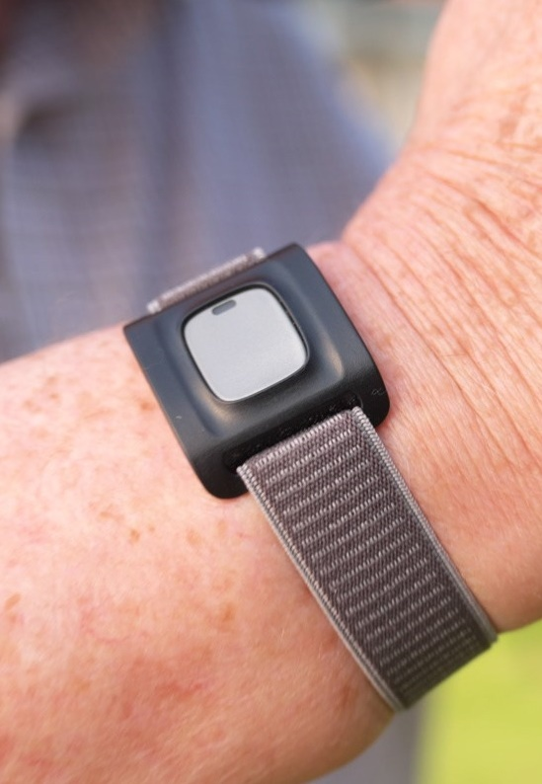
FarrPoint
Independent Technology Consultancy
  Closely involved in technology enabled care since 2015
  TEC Strategy
  Implementation Support
  Work on the impact of the digital shift across sectors
  Provided telecare and TEC advice to:
  Scottish Government
  Welsh national telecare programme
  UK Government
  Councils, housing and care providers.

Slide 3

What is the Digital Shift and why does it matter?

Slide 4
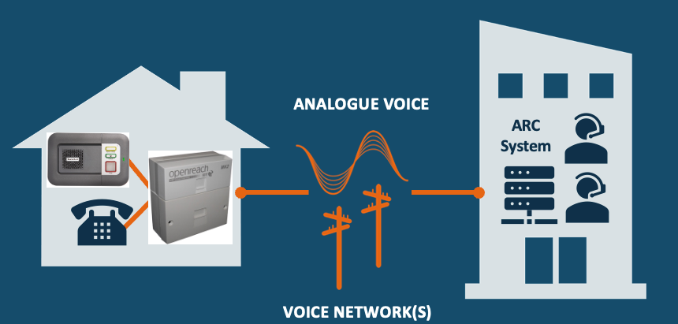
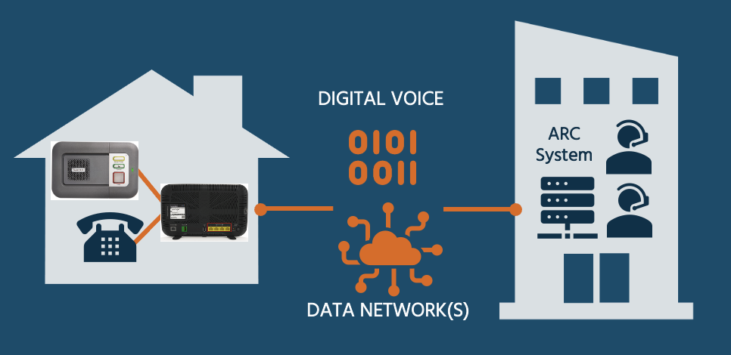
The Digital Shift
Any equipment / system connected to a telephone line is potentially impacted.
Systems may:
  Not work with digital telephone line
  Not be reliable when operating over a digital telephone line
Image sources: Tunstall, BT and Openreach. Icons from Noun Project

Slide 5
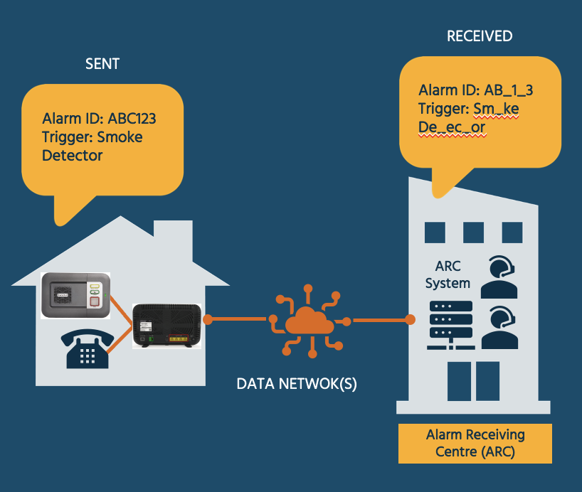
Why Does This Matter?
DATA NETWORK(S)
Digital phone networks not designed to carry legacy analogue signals
Signalling can get corrupted
5
Image sources: Tunstall, BT and Openreach. Icons from Noun Project

Slide 6
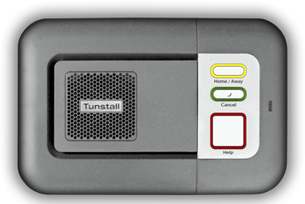


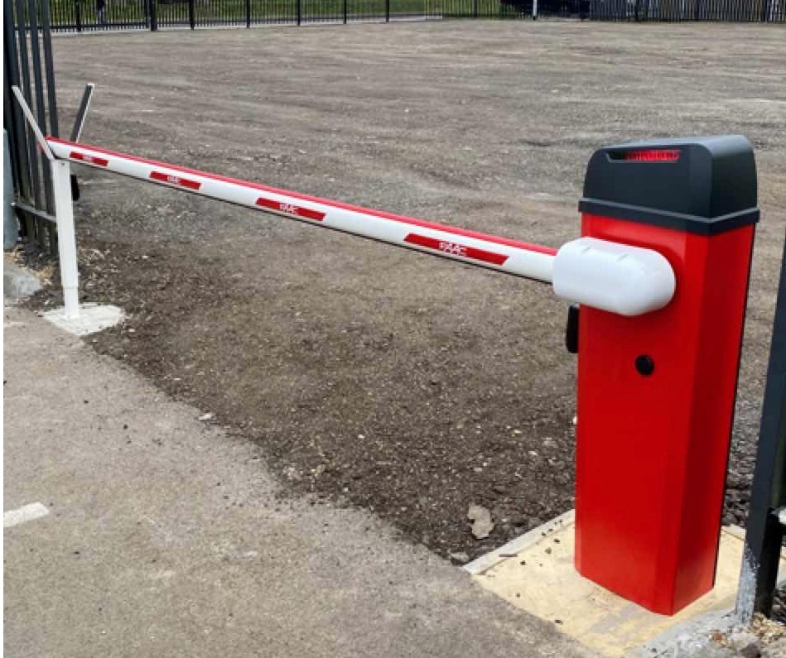

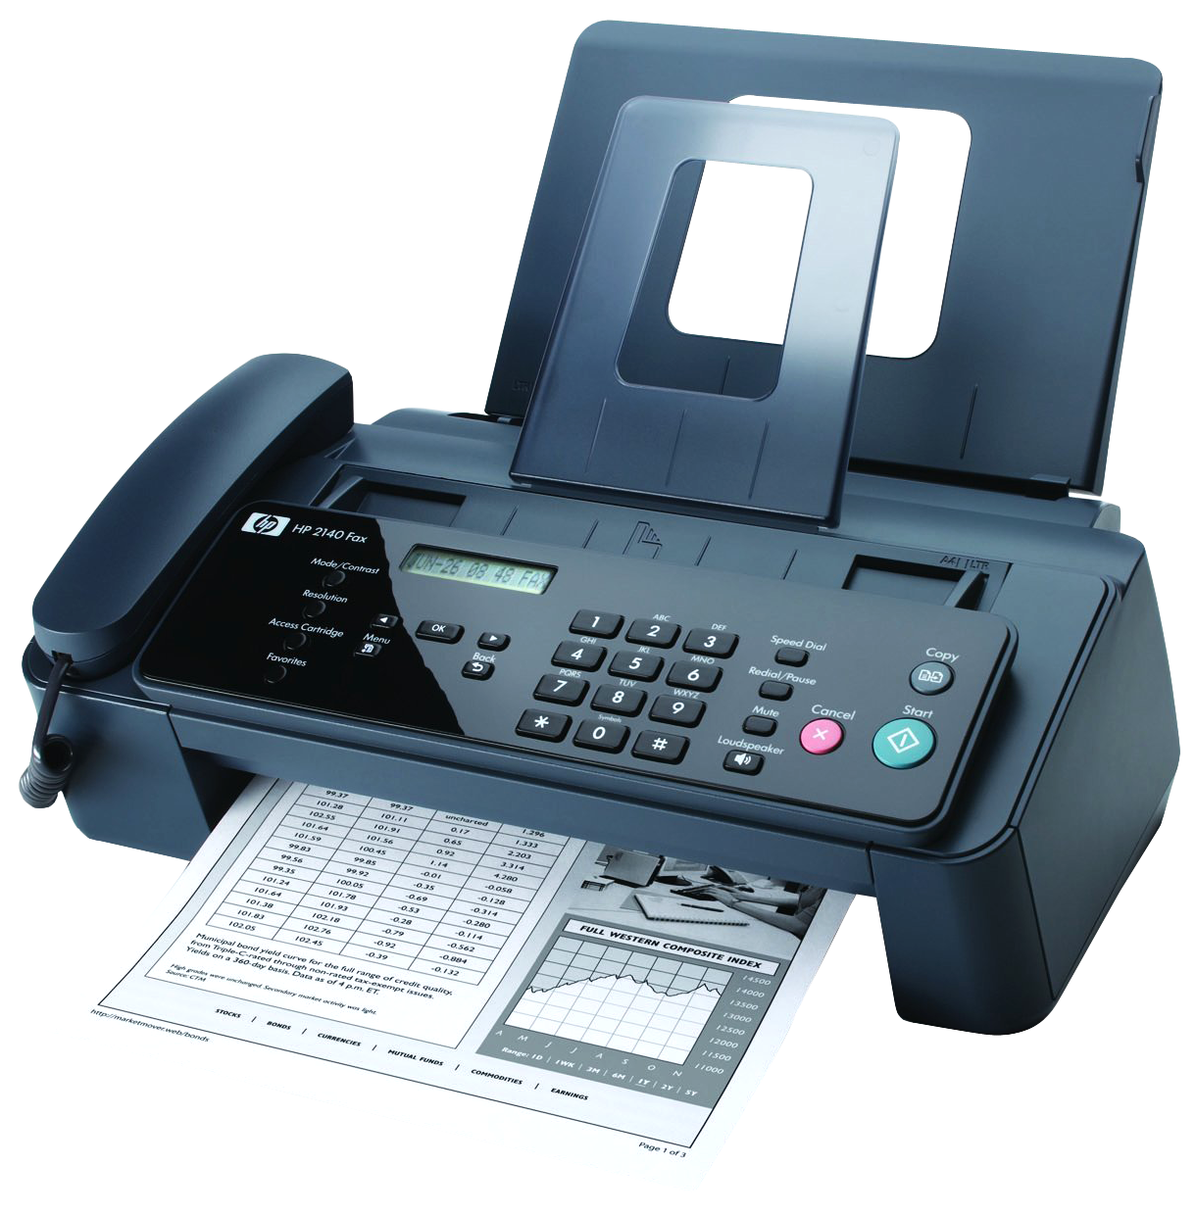
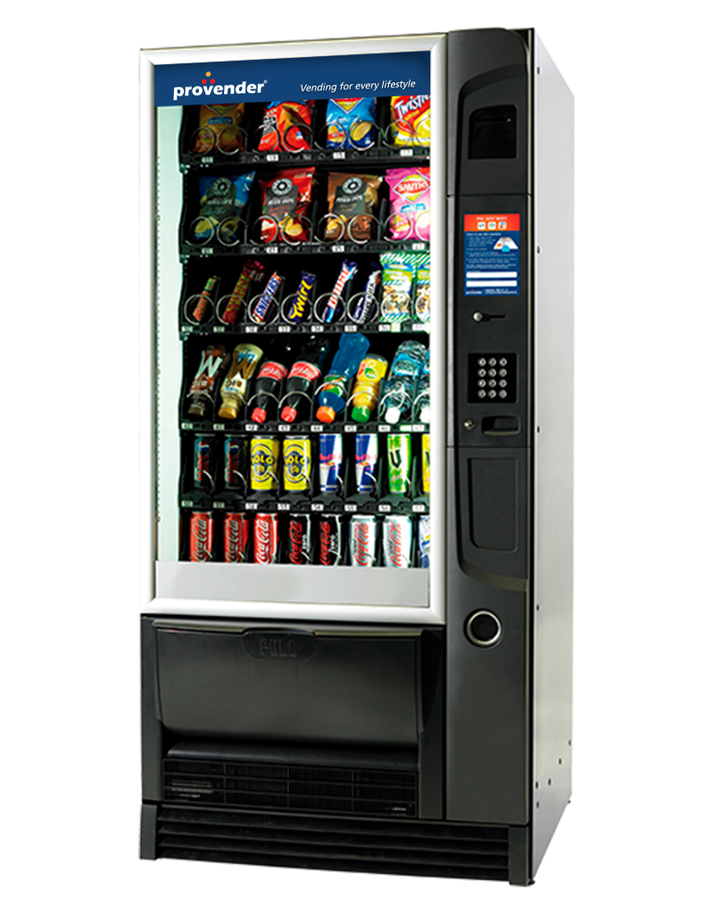



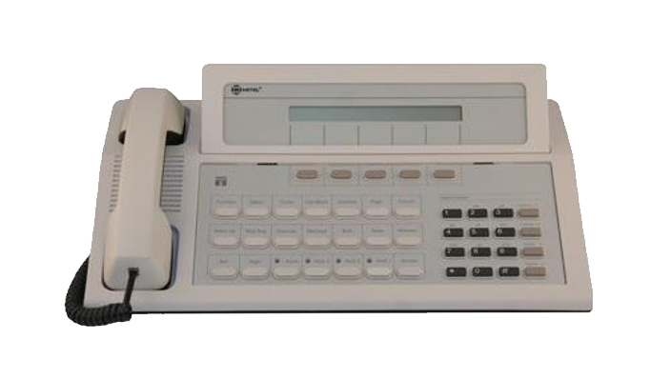

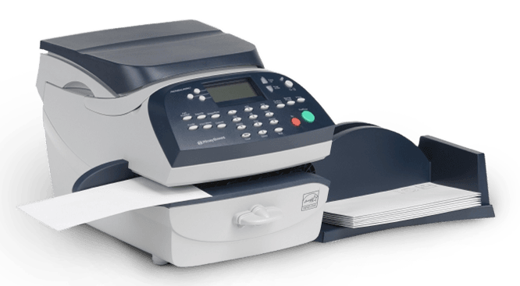
Why Does This Matter?
Any equipment that is connected to a telephone line is impacted.
Examples only. Note: all manufacturers’ systems impacted – not just those shown
TELECARE | WARDEN CALL | ACCESS SYSTEMS | LIFTS | FAX | VENDING MACHINES
ALARM PANELS | FRANKING MACHINES | HEATING / BUILDING MANAGEMENT | POINT OF SALE | PHONE SYSTEMS | WHAT ELSE?
6

Slide 7


Why Does This Matter?
Need to upgrade the phone line to a digital alternative
Or remove the need for a phone line
ANALOGUE TELEPHONE LINES
Exchange Lines
Redcare
ISDN
DIGITAL ALTERNATIVES
Digital Telephone Line (SIP)
Mobile telephony
Natively Digital Equipment
Internet of Things (IoT)

Slide 8

Digital Shift - Challenges & Opportunities

Slide 9
The Challenges
Including….
INFORMATION
When are phone lines changing?
Where are the phone lines and what are they used for?
What do I need to replace? With what?
COSTS
New Equipment / Upgrades
Associated costs – cabling / redecoration / IT
Suppliers
Resource
EVERYTHING ELSE
Digital / IT Skills Required
Resource Required
Timescales
Supplier Capability & Resource

Slide 10
The Opportunities
Including….
COSTS
Rationalise telephony
Move to better telephony deals
TRANSFORMATION
Opportunity to offer new / improved care services
Health and care integration
EVERYTHING ELSE
Upskilling staff skills
Future-proof digital platform to deliver new digital services and ways of working

Slide 11



Thank you!
Please contact me with any questions or comments:
Richard Parkinson
richard.parkinson@farrpoint.com
@RP_FarrPoint

Slide 12
Version Control
Owner: Richard Parkinson
Classification: Public
Revision | Description | Author | Checked | Reviewed | Authorised | Date
1.0 | Initial Issue | RP | AF | KV | RP | 19/04/2023
Copyright © 2023 FarrPoint Ltd has produced the information contained herein for NHS Transformation Directorate. The ownership, use and disclosure of this information are subject to the Terms and Conditions contained in the contract between FarrPoint Ltd and NHS Transformation Directorate, under which it was prepared.

Slide 13

Visit
farrpoint.com

