Slide 1
Delivering Workforce sustainability
Successfully onboarding new overseas team members.

Slide 2
BA Healthcare
20+ years serving UK health and social care.
Expert knowledge of immigration and recruitment.
9,000+ UK placements – across the country, across all types of providers.
NHS approved ethical recruiter.
Members of Care England, Care Forum Wales and Scottish Care.
The only provider of international healthcare staff approved by the National Care Forum and the Institute of Healthcare Management.
Bases in the UK, Dubai, Hong Kong & Malaysia.

Slide 3
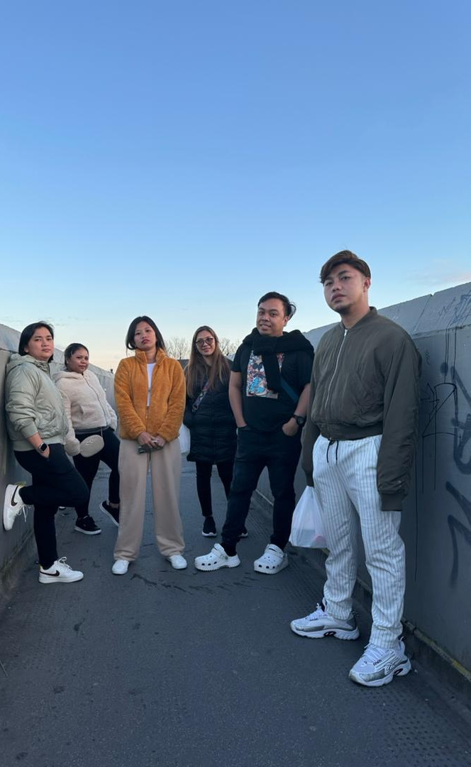
Today’s session
Why is on-boarding so important?
What does good on-boarding look like?
Key takeaways

Slide 4
Why is good On-boarding so important?
Usually left behind friends, family, community now isolated and a long way from home.
Moving half way round the world is hard!
Often highly skilled and experienced but may know very little about how health and social care works is delivered in the UK.
May have limited understanding of the system overall.
May have limited understanding of the cultural context of care.
Central part of ethical recruitment.
Poor un-boarding has a direct link to
Overseas recruitment is an investment - you need this to work, right?!
It’s the right thing to do.

Slide 5
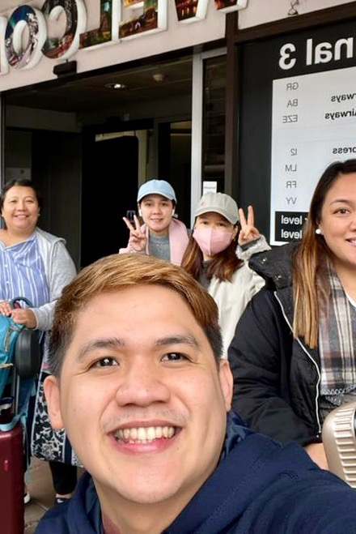
What does good on-boarding look like?
It starts early.
Its part of a process that runs from interview to being fully embedded.
It needs thinking about and planning when you decide to recruit from overseas.
Important to distinguish between bringing people into the UK and recruiting overseas workers who are already here.
Important to understand the system and environment your international team have come from.

Slide 6
Pre-arrival
Make it seem real, keep up the pace and make it seem exciting not daunting:
Candidates will be wary, will have heard horror stories, or it may just not seem real.
Pre-interview/pre-offer – make it real, make sure they know who you are, what’s your story?
Sell yourself as an employer. Don’t fall into the trap of thinking they’re lucky to work for you.
Process job offers quickly.
Keep in contact – use social media to build community and keep new team members positive.
Prioritise visa support – keep things moving, keep them motivated and responsive.
Don’t give good people opportunities to worry they’ve made a mistake in accepting a job offer. You want them to arrive excited!

Slide 7
Step into your new team members’ shoes
If you were moving to work in The Philippines what would you want to know?
Have a plan!
Make sure they feel a part of things - set up and maintain a Whatsapp or Facebook group and be active.
Tell them about the local area, share links and stories, share stories about what is happening in the place they are coming to work.
Don’t leave housing/accommodation until the last minute – this is critical.
Connect your new arrivals with local amenities or an ex-pat community.
When and where will they arrive?
Who will meet them?
How will they get to where they need to be?
Will they have everything they need? Cash, bank account, warm clothes, bedding, etc.
Don’t assume anything!

Slide 8
POST-arrival
The first few weeks are usually the most difficult time.
Its not just induction.
Show them round,
Make sure they have clear points of contact.
Do existing staff also need support or training?
Ensure there is some provision for pastoral and accommodation support.
Think about gestures to make people feel welcome.
Help them to manage money.
Is your induction appropriate – what needs to be added to provide foundational knowledge of the service you provide and the sector?

Slide 9
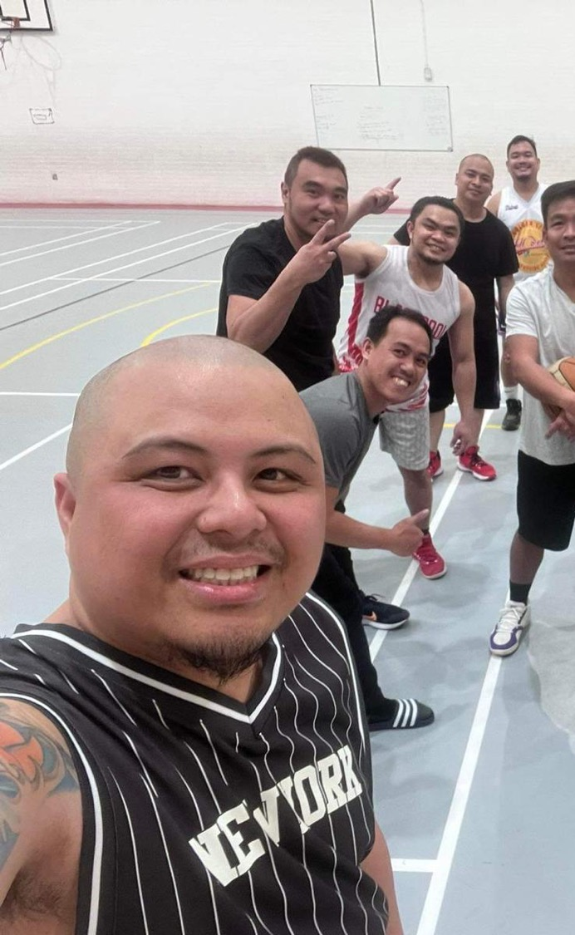
KEY TAKEAWAYs
A high quality on-boarding experience is the right thing to
do – for you and your team.
Have a plan that covers the full process – take some time,
think about it.
Try and see your service and your location from the perspective of someone who has no experience of the UK at all.
If you work with a good partner, they should do a lot of this for you.
Invest time and energy – it will pay dividends!

Slide 10
Affordable, ethical intelligent international recruitment.
Richard Canavan
UK Director
uk@ba-healthcare.org
0114 3830979
www.ba-healthcare.org

