Slide 1
UKCGC
Dr George Fernie george.fernie2@nhs.scot
9 October 2023

Slide 2








Centre for Contemporary
Coronial Law

Slide 3
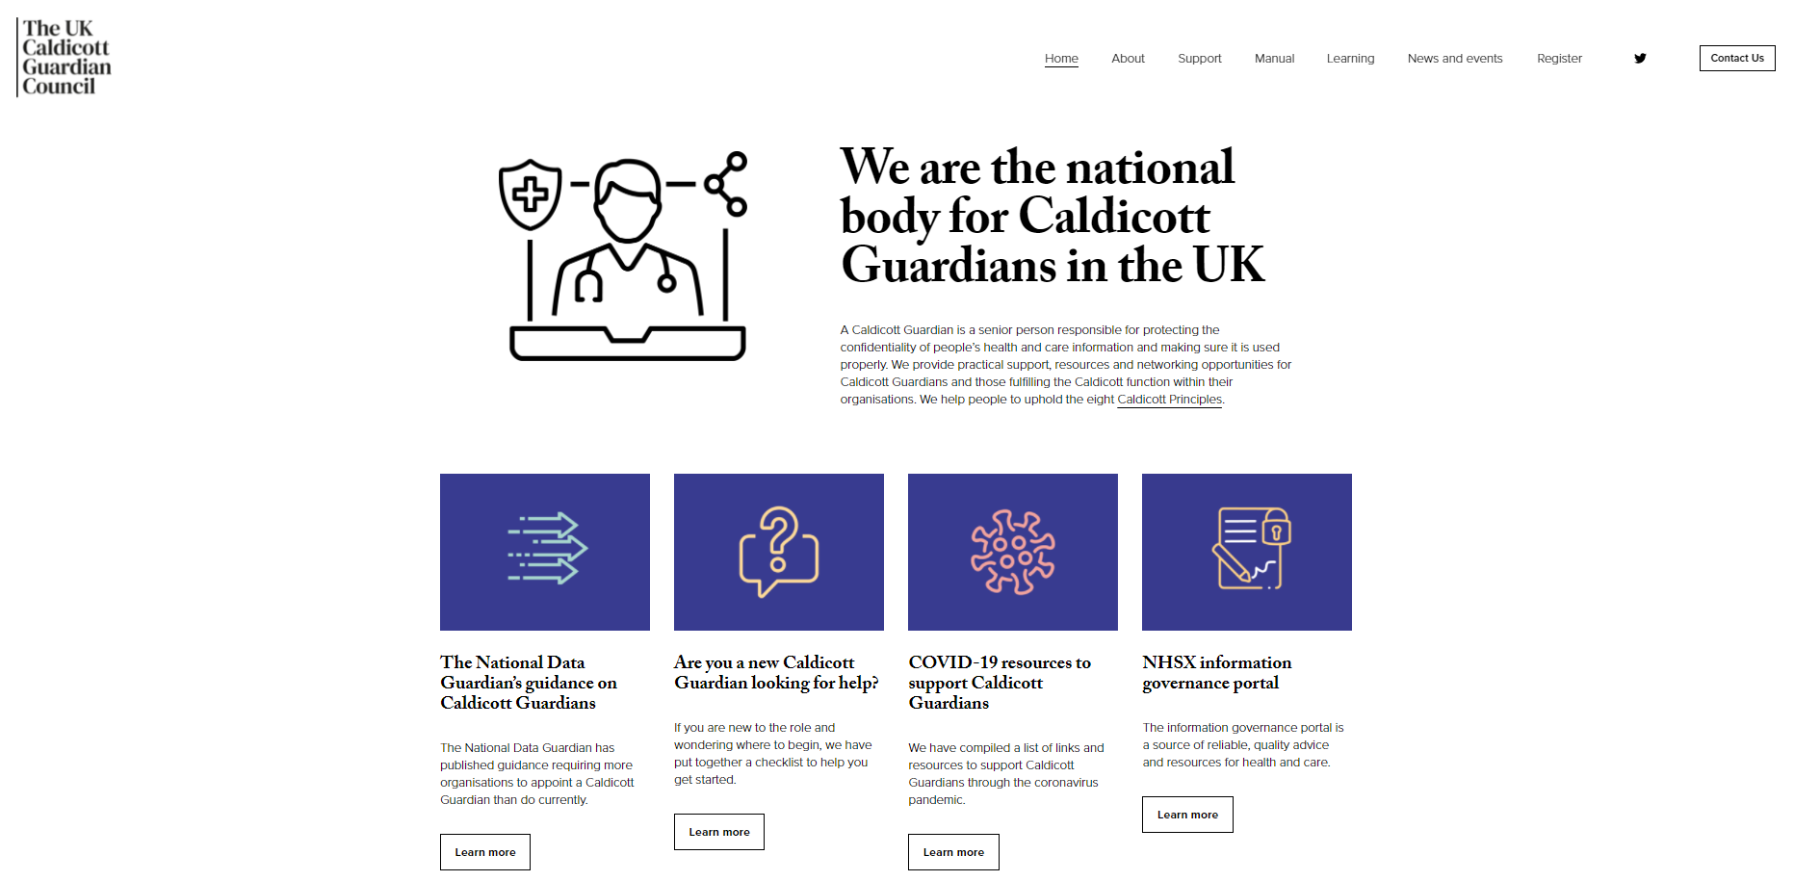

Slide 4
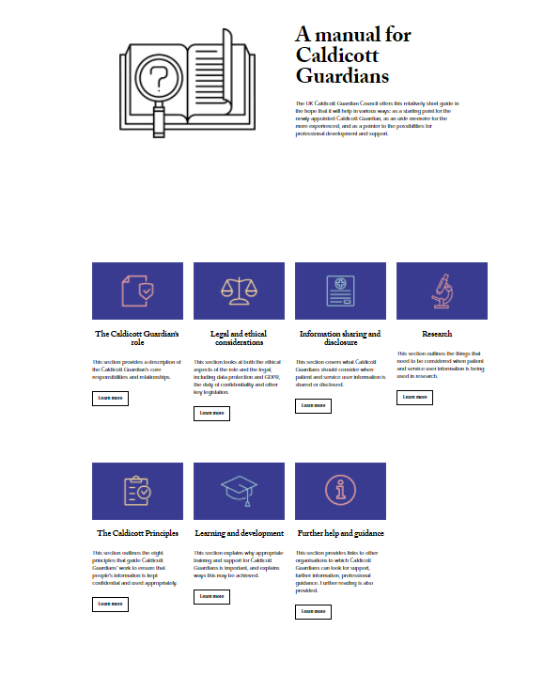

Slide 5

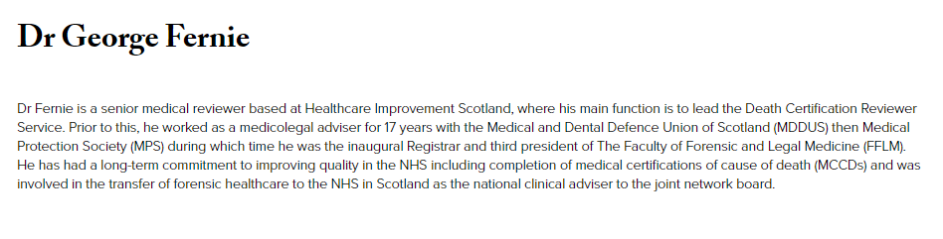

Slide 6
Authority of the role: history of work led by Dame Fiona Caldicott pre-2014
1997: the first Caldicott Review – commissioned by the Chief Medical Officer ​
Increasing concerns about the use of confidential patient information - moving from paper to electronic records and the potential for dissemination rapidly and extensively​​
The report made 16 recommendations plus six good practice principles for the use of confidential information within the NHS - became known as Caldicott Principles​
It also recommended a senior person, preferably a health professional, be nominated in each health organisation to act as a guardian for safeguarding the confidentiality of patient information – became known as Caldicott Guardians​
Themes: importance of trust between patient and clinician; the need for data to be available for wider purposes; the potential tension between this need and patient expectation - and the need for explicit and transparent principles to address this tension​

Slide 7
Authority of the role: history continued (2)
2013: The Information Governance Review – commissioned by the Secretary of State​
​Information governance had developed, but there remained a lack of confidence both amongst the public that information would be securely safeguarded, and within organisations about sharing it. The review aimed to:​
  ​‘…ensure that there is an appropriate balance between the protection of the patient or user’s information, and the use and sharing of such information to improve care’​
​The report identified a ‘culture of anxiety’, resulting from:​
  ​ ‘…instructions issued by managers in an attempt to protect their organisations from fines for breaching data protection laws. This leads to a ‘risk-averse’ approach to information sharing, which prevents professional staff at the front line from cooperating as they would like.

Slide 8
Authority of the role: history continued (3)
2013: The Information Governance Review continued
​The review created a 7th Caldicott Principle: the duty to share information for individual care is as important as the duty to protect confidentiality
​Duty later enshrined in law [Health and Social Care (Safety and Quality) Act 2015]
Review also defined boundaries of direct care and implied consent, and recommended ‘accredited safe havens’ to use data for commissioning purposes
Both strength and challenge: the body of work 1997 – 2014 (2018) and its associated language embodied in the personhood of one individual

Slide 9

The UK Caldicott Guardian Council
Key things to know:
Founded in 2003 as the definitive national body for Caldicott Guardians
Provide advice, guidance, standards, learning and information exchange
Council members meet formally every two months, all minutes online
A sub-group of the National Data Guardian Panel
Sponsored and supported by the National Data Guardian
Not a professional body or regulator

Slide 10
UKCGC objectives
Our main objectives:
Support Caldicott Guardians and those fulfilling the Caldicott function
Be a recognised point of contact for Caldicott Guardians and organisations seeking advice on the Caldicott principles
Facilitate the exchange of information, views and experience
Promote consistent standards and training
Support the formulation of best practice guidance and policies relating to the Caldicott principles
Maintain ‘A Manual for Caldicott Guardians’

Slide 11
Practical support and resources
Guidance materials on the UKCGC website (known as the Manual)
Advice request service
Virtual training workshops (case study based)
Monthly ‘drop-in’ breakfast clubs/master classes (virtual)
Newsletter
Online discussion forum
Online learning modules
Checklist for new Caldicott Guardians

Slide 12
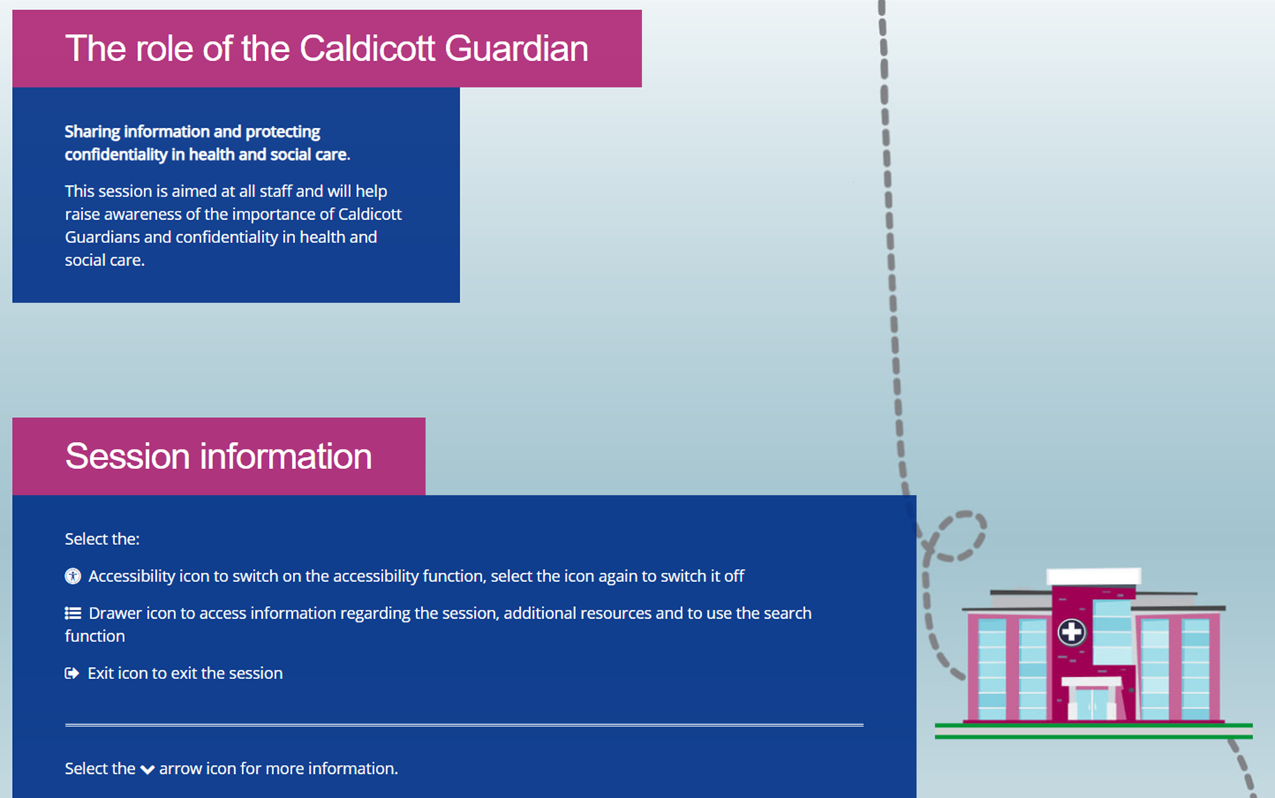
https://portal.e-lfh.org.uk/Dashboard

Slide 13
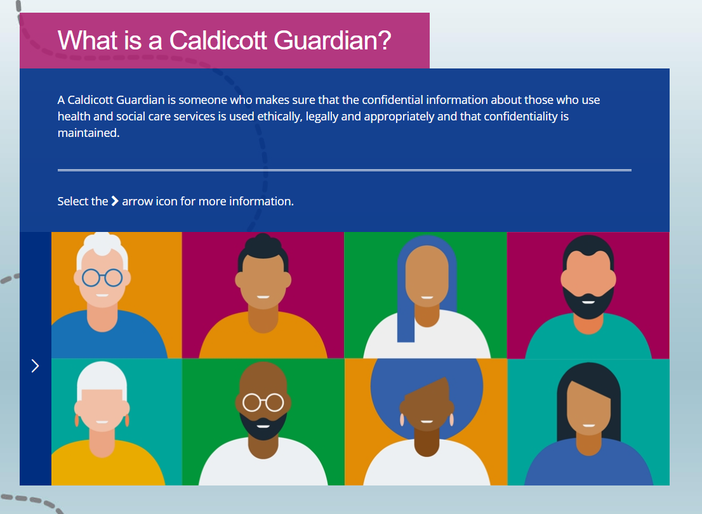

Slide 14
Caldicott role
“A Caldicott Guardian is a senior person within a health or social care organisation who makes sure that the personal information about those who use its services is used legally, ethically and appropriately, and that confidentiality is maintained”.
“Caldicott Guardians should apply the eight principles wisely, using common sense and an understanding of the law. They should also be compassionate, recognising that their decisions will affect real people — some of whom they may never meet”.

Slide 15
Caldicott Principles
Principle 1: Justify the purpose(s) for using confidential information
Principle 2: Use confidential information only when it is necessary
Principle 3: Use the minimum necessary confidential information
Principle 4: Access to confidential information should be on a strict need-to-know basis
Principle 5: Everyone with access to confidential information should be aware of their responsibilities
Principle 6: Comply with the law
Principle 7: The duty to share information for individual care is as important as the duty to protect patient confidentiality
Principle 8: Inform patients and service users about how their confidential information is used
Published December 2020

Slide 16
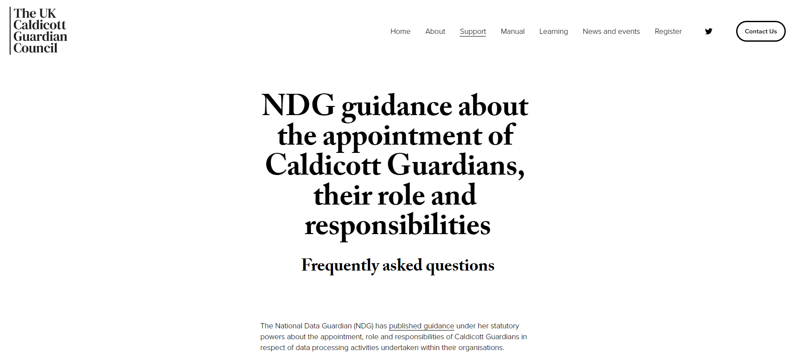
NDG Guidance FAQs — UKCGC

Slide 17

Questions?

Slide 18
Contact us
Website: www.ukcgc.uk/
Email https://www.ukcgc.uk/contact-us
Twitter @UKCaldicottGC

