Slide 1
The marketing trends driving enquiries and move-ins
Michael Morrell, CEO & co-founder
November 2023

Slide 2
Today’s presentation
01
Introduction to Mediahawk
02
Call tracking and analytics
03
Emerging trends
04
Q & A

Slide 3
Introducing Mediahawk

Slide 4
Trusted by leading care home brands

Slide 5
Call tracking and analytics

Slide 6
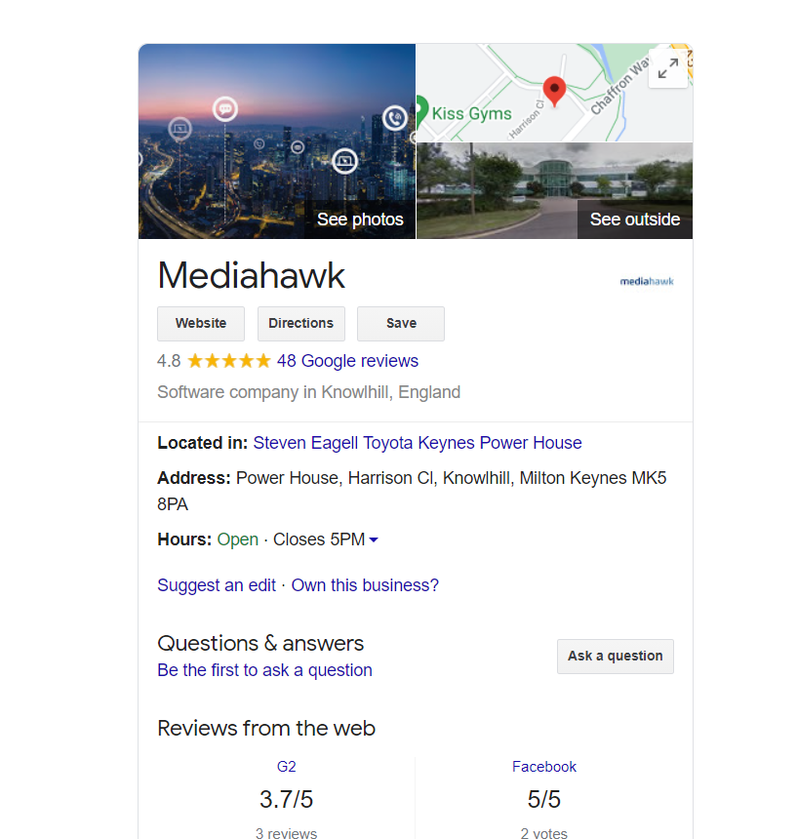
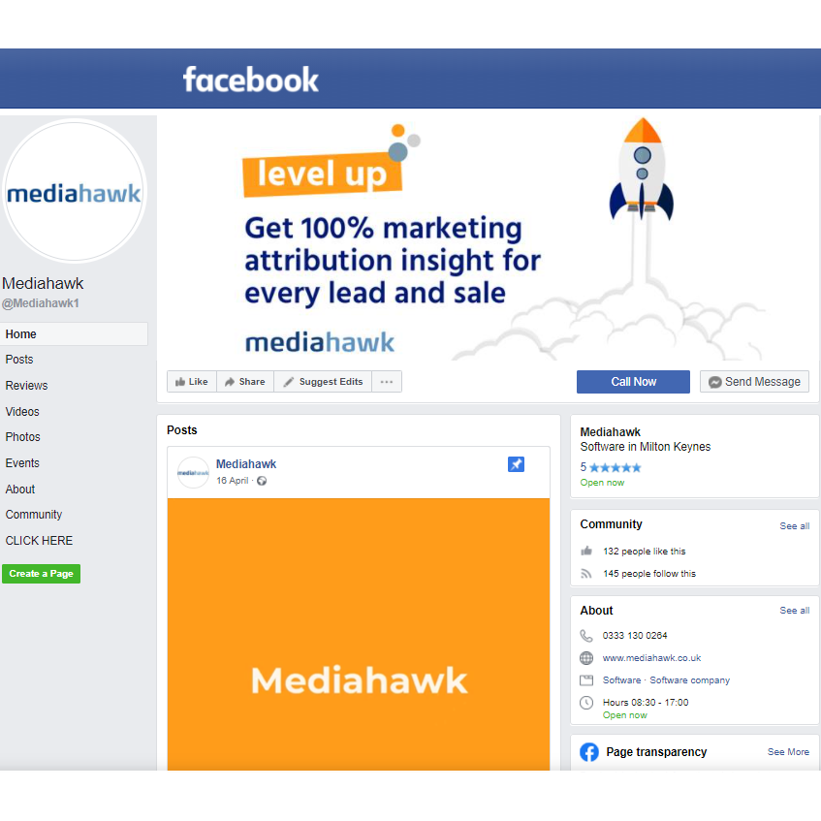
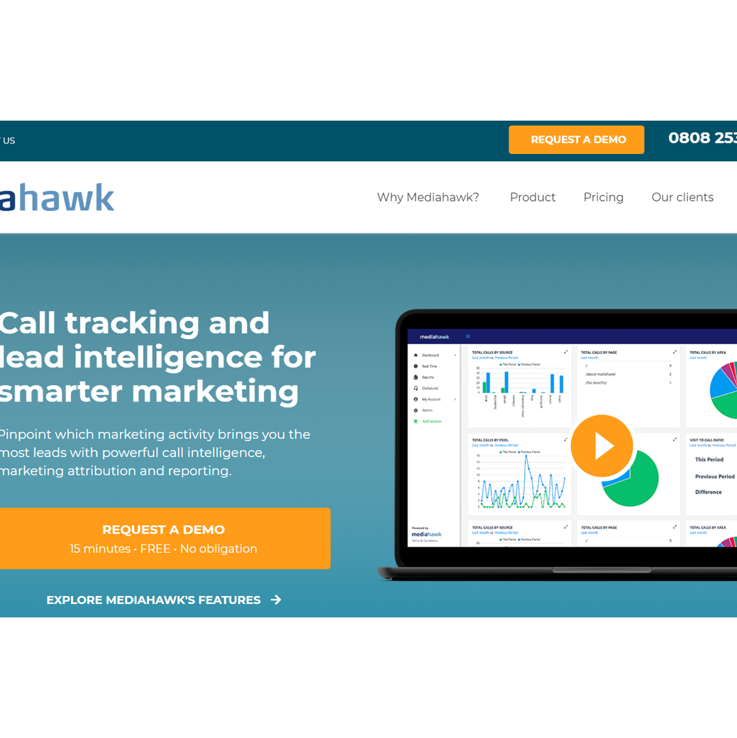
The call-tracking journey
OFFLINE
Door drops
Billboards
Sponsorship
Local press

Slide 7
Emerging trends

Slide 8
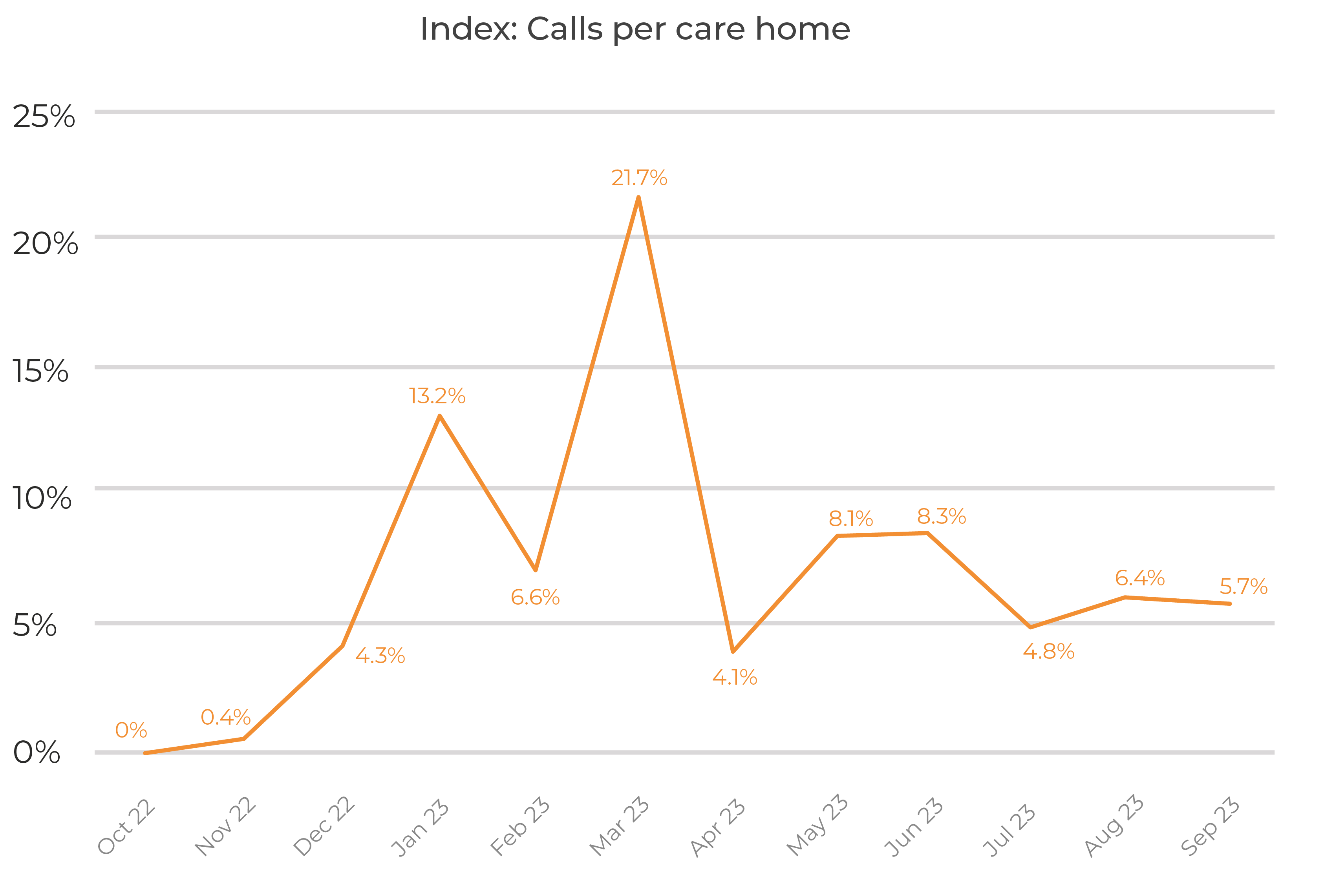
Steady year-on-year growth
Strong growth through winter and into March 2023
A fast drop and a long plateau from April but remains 5.7% higher than October 2022
Outlook:
The current trend to continue. A likely small increase in December, with an uptick in the new year

Slide 9
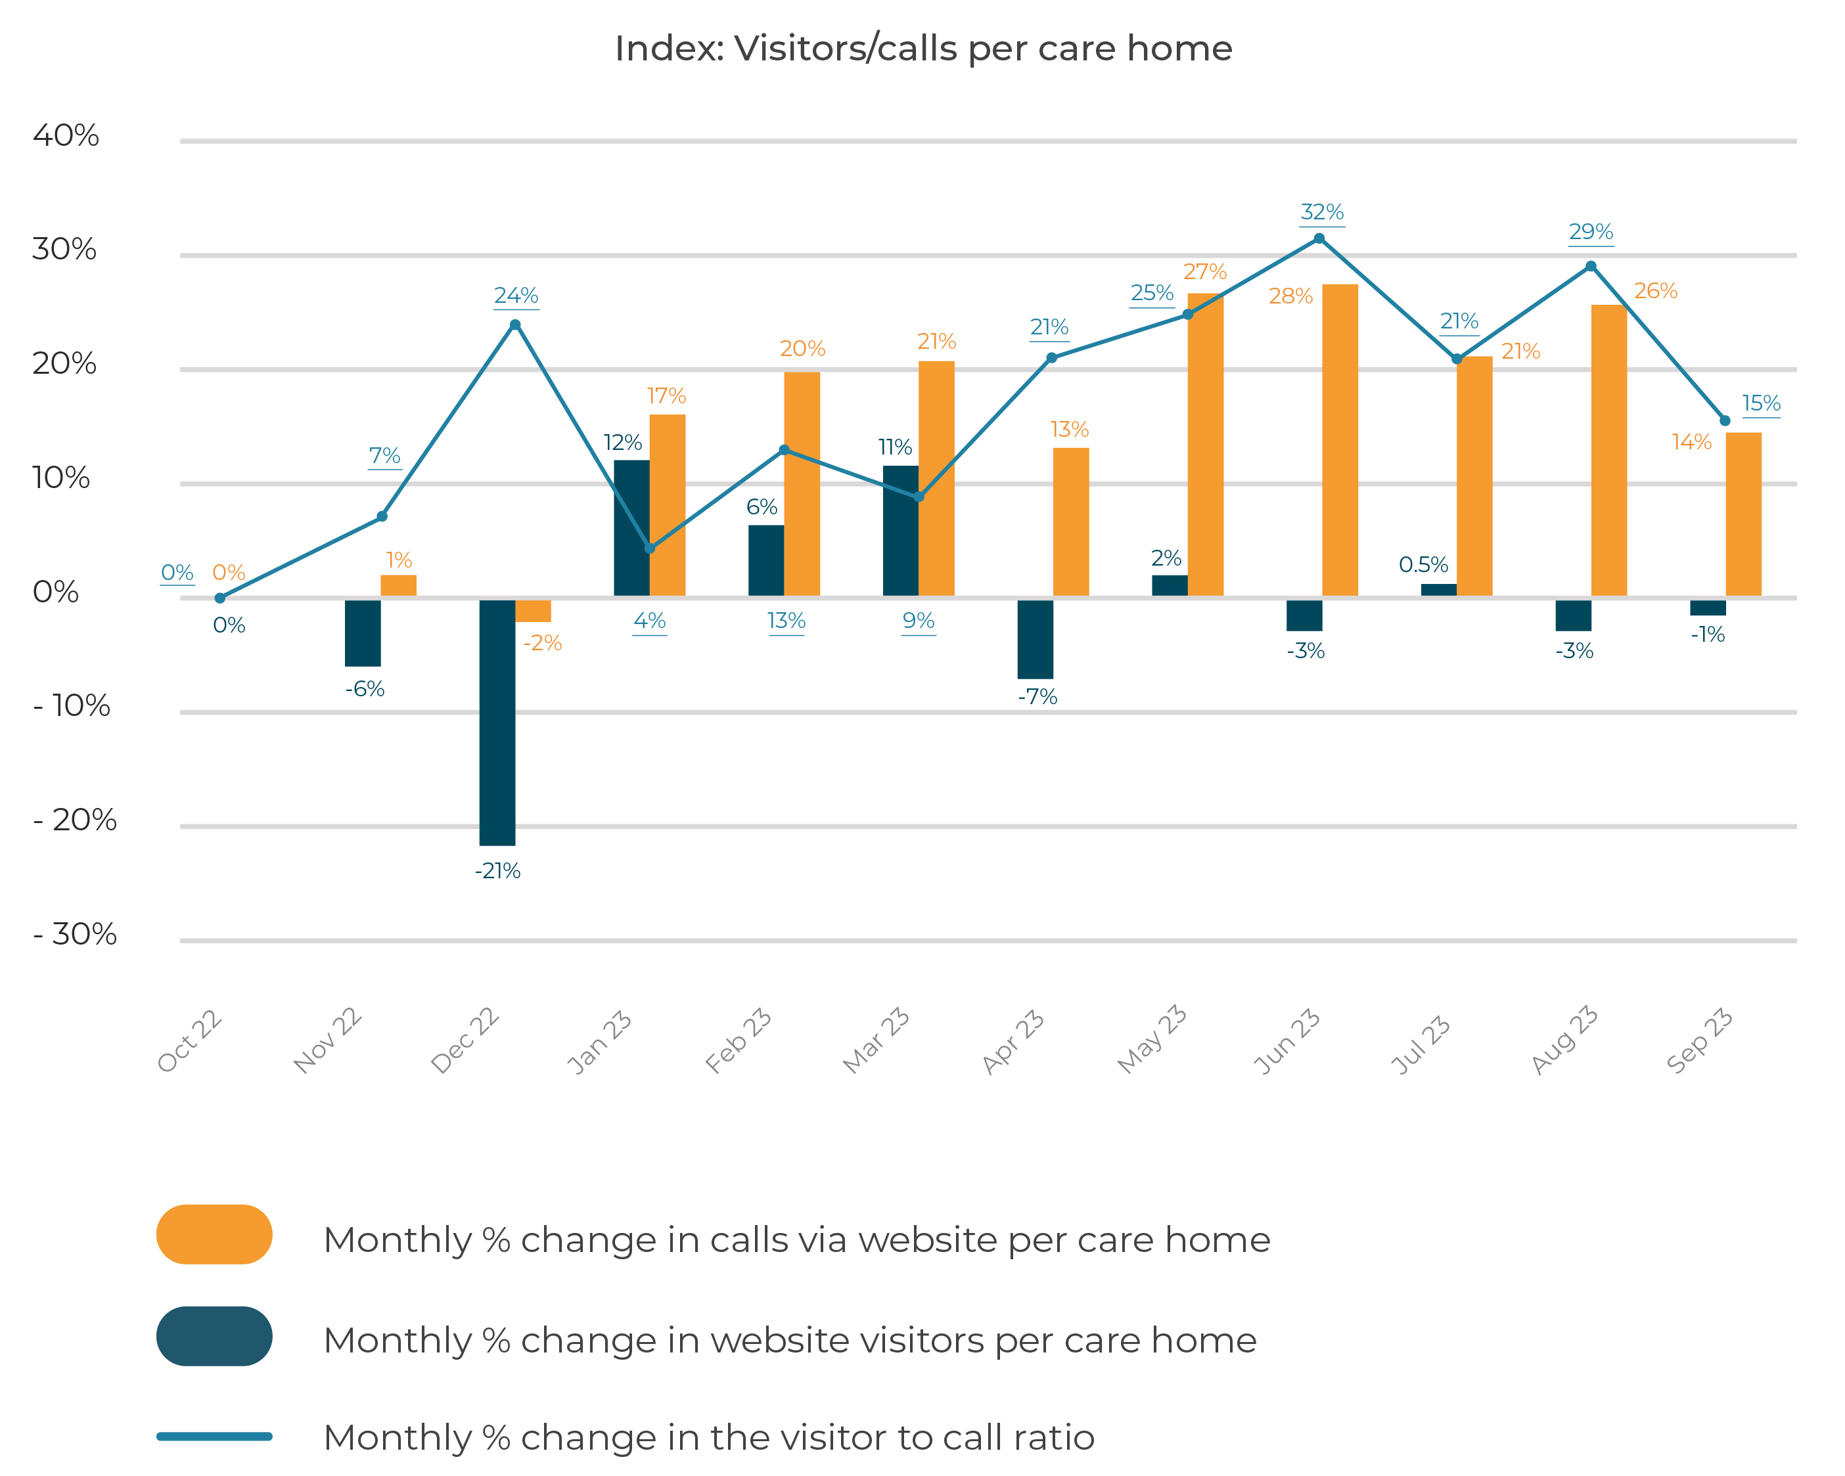
Website call and traffic in focus
Paid search drives calls counter the general trend through increased spend
Time to move-in
has increased year-on-year. Consistently 50% longer, sometimes double the time
Call downturn in April follows the general market trend
Flat visitors but increased calls – tough fight for enquiries

Slide 10
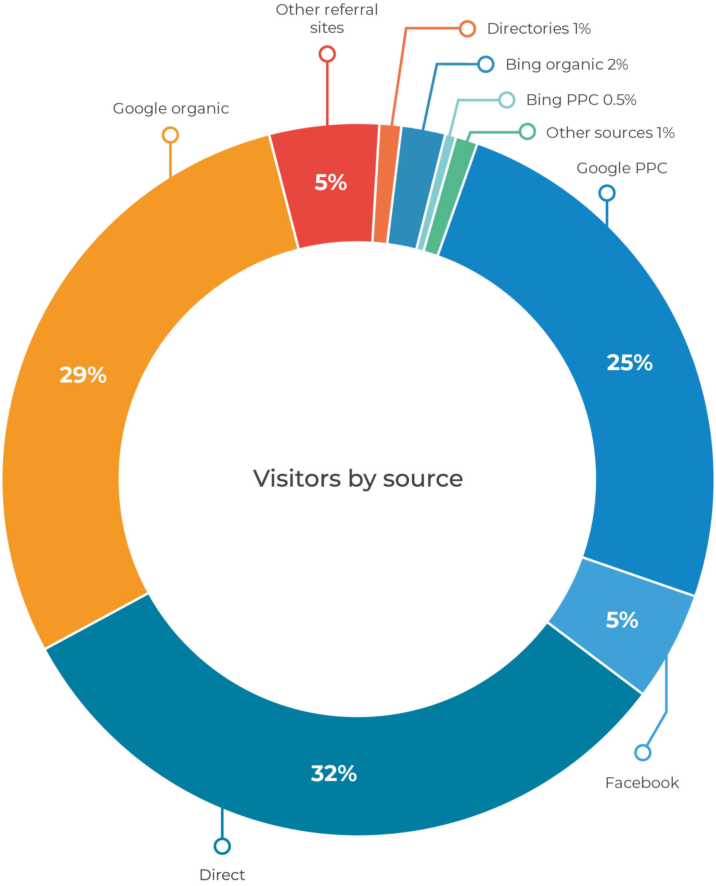
Online traffic source profile
Key trends
+ Paid
- Organic
- Facebook
TIP - Do not forget offline: Well-targeted and timed door drops influence 10% of move-ins

Slide 11
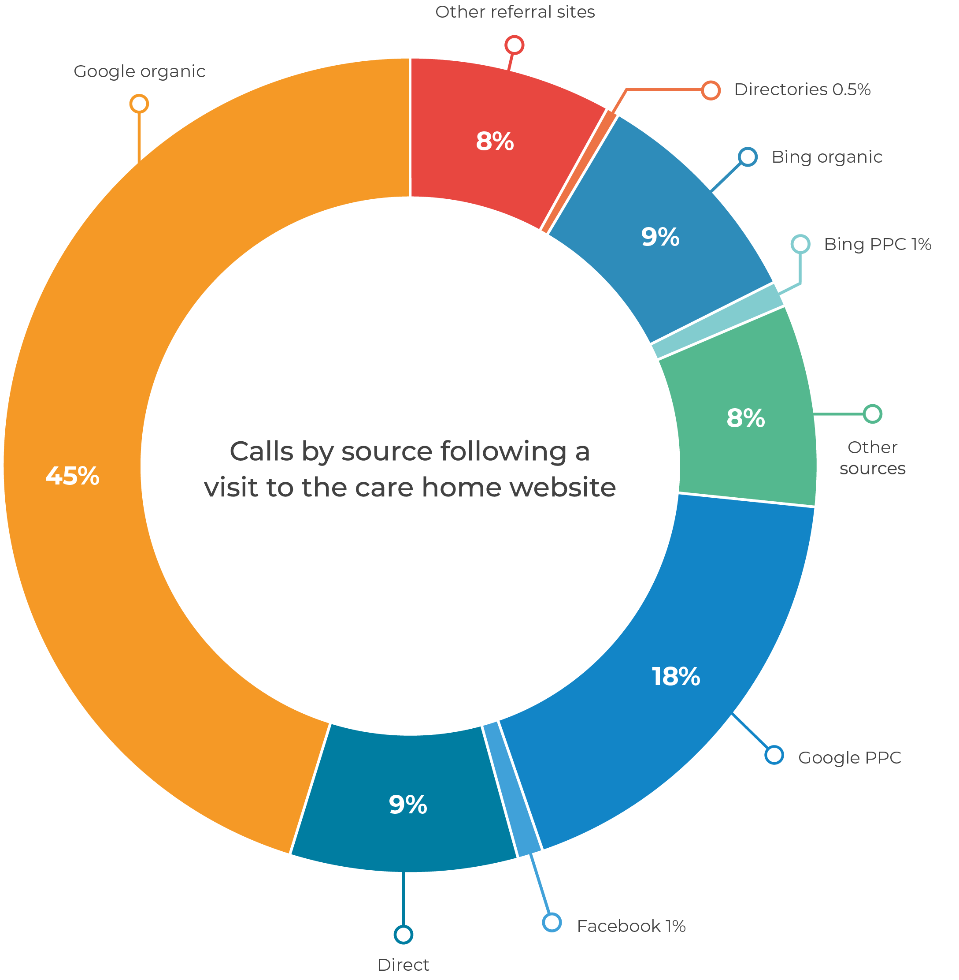
Online call source profile
Bing’s share is small but it is highly efficient at driving calls
Organic call share drops consistent with traffic reduction
Occupancy
Marketing drive has improved occupancy rates close to pre-covid levels. Marginal improvements will push spend further
Paid search increase in spend is driving calls and increasing efficiency

Slide 12
Summary – key trends
1
Phone calls have been relatively flat since April 2023, however showing a 6% year-on-year growth between September 2022 and September 2023
A marketing response focused on paid advertising, is driving enquiries with a 24% year-on-year growth in paid calls. Facebook and organic are losing share
2
Operators are close to or at pre-covid occupancy rates and marginal improvements are the focus, this will push marketing spend (esp. digital) higher
3
4
Enquiry to move-in time has increased significantly year-on-year. It will take longer for the enquiry metric to reflect in revenue.

Slide 13
Download our report
mediahawk.co.uk/care-trends-autumn23/

Slide 14
Thank you Any questions?
0333 222 1433
mmorrell@mediahawk.co.uk
mediahawk.co.uk

